Slide 1
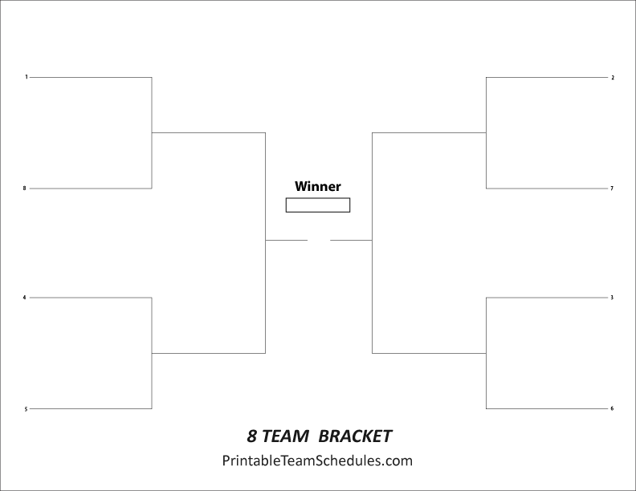
Huns
Romans
Best Aspects 1. 2.
Best Aspects 1. 2.
Why did they win?
Why did they win?
Why did they win?
Persians
Chinese
Best Aspects 1. 2.
Best Aspects 1. 2.
Why did they win?
Why did they win?
Greeks
Goths
Best Aspects 1. 2.
Best Aspects 1. 2.
Why did they win?
Why did they win?
Celts
Indians
Best Aspects 1. 2.
Best Aspects 1. 2.

