Slide 1
The Great Schism
By:Eric Martinez

Slide 2
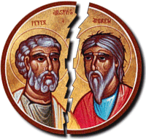
French bishop was elected as Pope Leo IX. He and the clerics who accompanied him to Rome were intent on reforming the papacy and the entire church. Five years earlier in Constantinople, the rigid and ambitious Michael Cerularius was named patriarch. Michael Cerularius was later then placed to be excommunicated. Meaning he was excluded from church services.

Slide 3
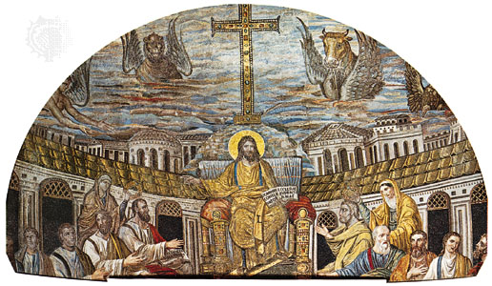
[
Under the Byzantine rule, Problems arose in Southern Italy in the 1040s, when Norman warriors conquered the region and replaced Greek bishops (Members able to grant holy orders) with Latin ones. People were questioning and were confused by the way things were set, and they argued about the proper form of the worshiping and other matters. Differences over marriage and divorcement, the bread used for the Eucharist, days of fasting, and other usages that arent as important.

Slide 4
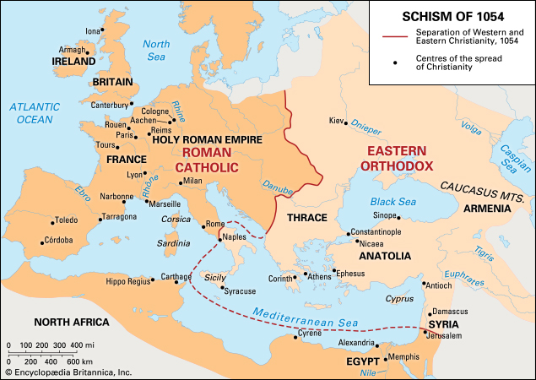
Thesatisfied for what there churches were offering so there was a split between western europe which was roman catholic, while the eastern side was an eastern orthodox
se people were not.

Slide 5
Then this guy named humbert comes over to cerularius and his supporters to launch a vicious criticism. But the patriarch ignored him, so he then went to hagia sophia where he placed on altar the bull of excommunication. The returning to rome convinced that he had gained victory.

