Slide 1
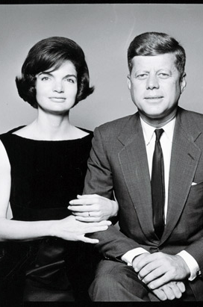
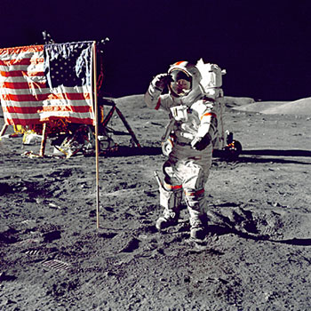
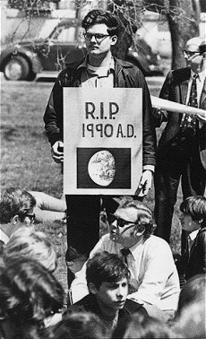
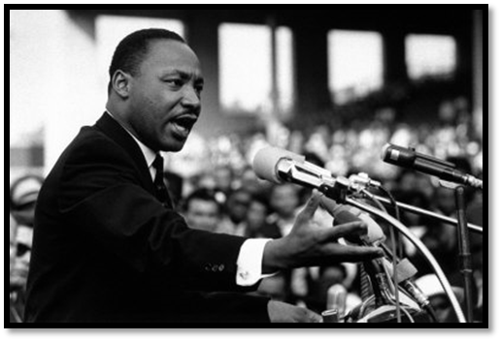
The 1960s

Slide 2
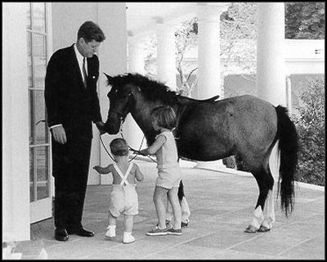
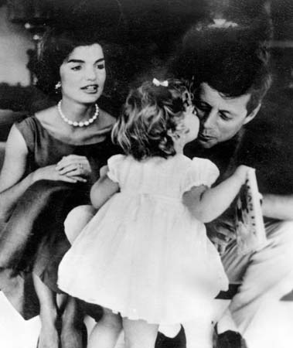
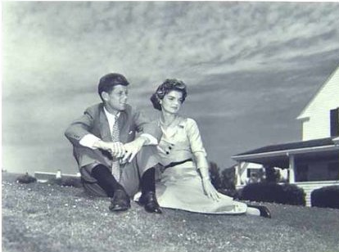
Kennedy: Domestic
Robert Kennedy = Attorney General
The TV tells all the good things
Camelot
Not = back problems, pain pills, affairs
Stimulated the economy through defense spending
Also wanted aid elderly, education and urban renewal
Clean Air Act (1963)
Idea for Medicare

Slide 3
Kennedy: Indochina
Laos:
(‘61) – civil war between US and Communists
(‘63) – Kennedy agrees to a neutral government, but Communists were still majority
Vietnam:
Ups troop #s
Buddhist monks protest Diem
We help the Vietcong (NLF) take out Diem

Slide 4
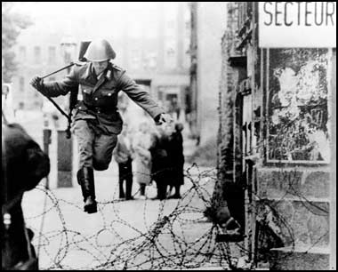
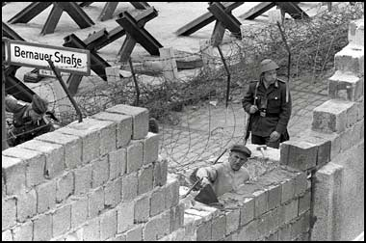
Kennedy: Germany
Kennedy & Khrushchev go to Vienna to talk about Berlin
August 1961: Berlin Wall constructed
“Ich Bien Berliner” speech, doubles the draft, sends defense money to Berlin

Slide 5
Kennedy: Cuba
“La Brigada” invades the Bay of Pigs
Eisenhower’s plan
We don’t give them air power
1962: USSR has 3 types of ICBMs (missiles) in Cuba that can reach ...
South Carolina, D.C., Canada
Kennedy wants to blockade Cuba and dismantle the weapons if Khrushchev will not.
October 25: Khrushchev will back down if Kennedy will never invade Cuba, and take American missiles out of Turkey
We agree, but only privately to the latter.
RESULTS: Kremlin/White House hotline & “Détente”

Slide 6
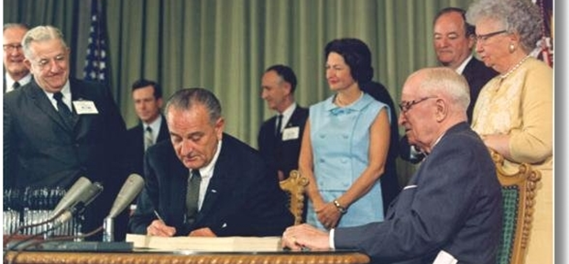
Lyndon B. Johnson takes over
Sworn in on Air Force One
Vows to continue JFK’s policies
“War on Poverty”
Lower Taxes, Job training, Headstart
Great Society
Voting Rights, Medicare/Medicaid, Open Immigration, Safer Highways, Preserve the Wilderness
BUT
Congress underfunded the programs they passed
African-Americans riots
Vietnam took top priority

Slide 7
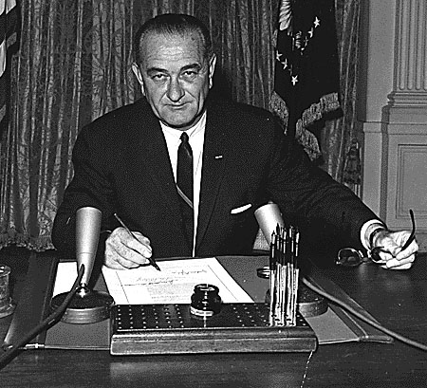
Johnson: Gulf of Tonkin Resolution
August 1964
N.V. patrol troops versus U.S. destroyers
…Right?
“Unprovoked Attack”
Asks congress to go after N. Vietnam with all means necessary
USA is officially in the Vietnam War

Slide 8
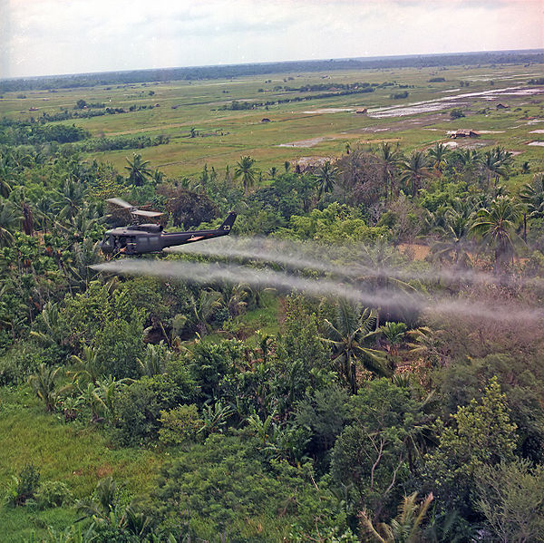
Johnson: The Vietnam War
1965: Operation Rolling Thunder
Goals:
Make Hanoi negotiate
Boost Saigon’s government
Stop the supplies through the Ho Chi Minh Trail
1965-8: Increased bombing
No end in sight

Slide 9
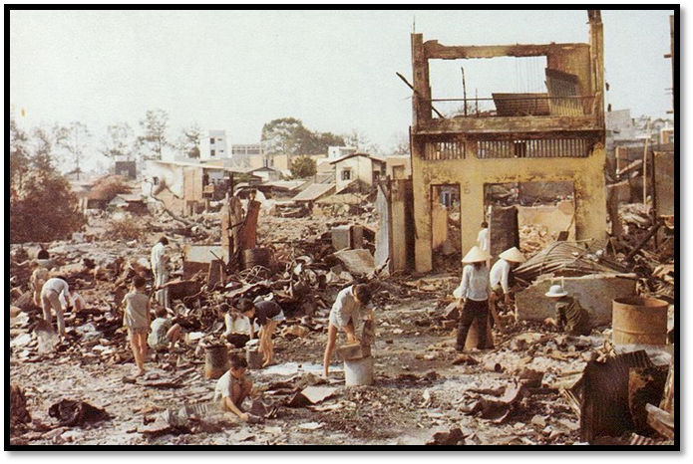
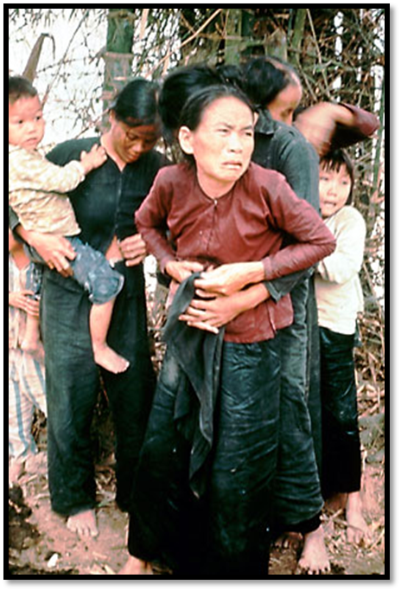
Johnson: Turning Points
Jan. 31, 1968: Tet Offensive
We stop North Vietnam after a month
The media emphasizes the heavy losses
March 31, 1968: Johnson announces he’s looking for peace
March 1968: My Lai Massacre
Lieutenant William Calley

Slide 10
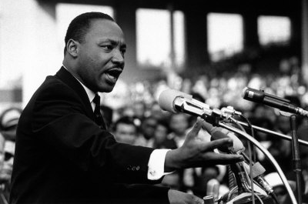
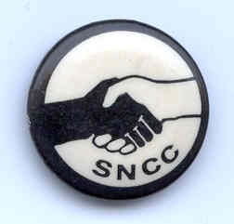
Civil Rights: African-Americans Under Kennedy
1961: CORE freedom rides in the South
SNCC: Student Nonviolent Coordinating Committee
Birmingham, Alabama, 1963
MLK, jr. organizes marches, sit-ins, pray-ins.
“Letters from a Birmingham Jail”
Kennedy calls civil rights a “moral issue”
March on Washington, 1963
A. Phillip Randolph
“I Have a Dream” speech
White backlash

Slide 11
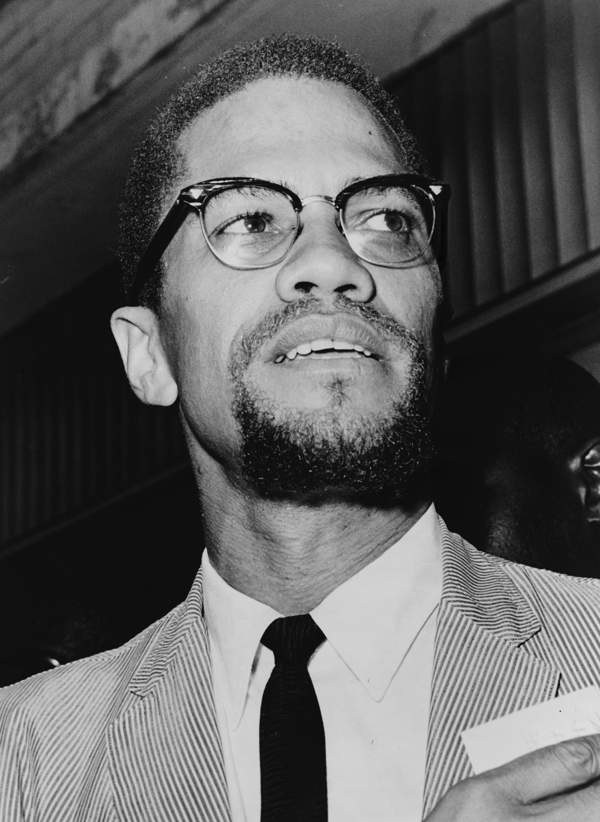
Civil Rights: New Directions
Summers of 1965-1968: Race Riots
Malcolm X
Nation of Islam (NOI)
“Wake up, Clean up, & Stand up”
Cassius Clay → Muhammad Ali
1966: CORE & SNCC
Excludes white members
Want black power through violence, if necessary
1966: Black Panthers created

Slide 12
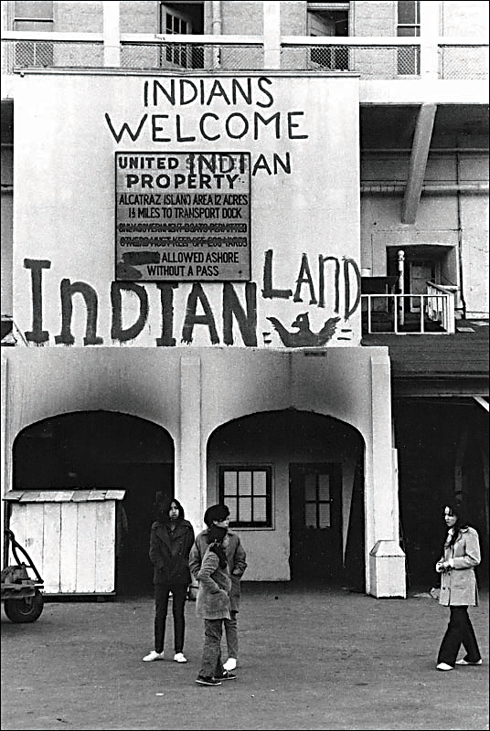
Civil Rights: Native-Americans
1961: “Declaration of Purpose”
1964: Native-Americans want to be included in War on Poverty
1967: National Council for Indian Opportunity
1968: young “Native-American” movement
1969: American Indian Movement (AIM) occupy Alcatraz

Slide 13
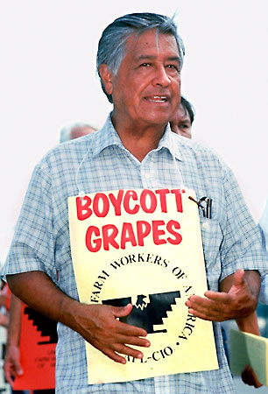
Civil Rights: Hispanic- & Asian- Americans
César Chávez & United Farm Workers
1965, strikes in San Joaquin
Boycotted grapes
Chicano/a Movement
“Oriental” → Asian-Americans
Protested the war in Vietnam

Slide 14
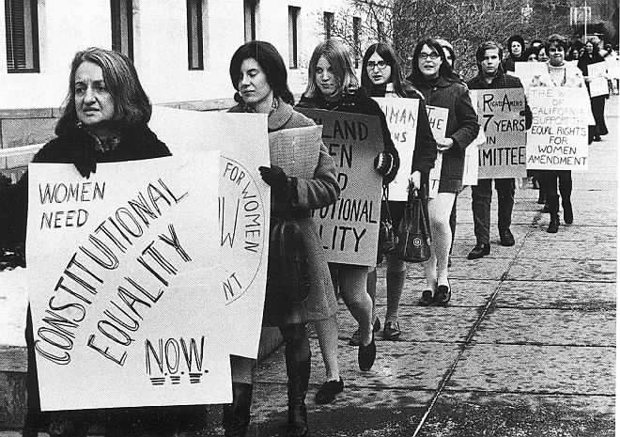
Civil Rights: Gender/Sexuality Activism
1960: The Pill marketed
EEOC doesn’t enforce Civil Rights Act
National Organization for Women (NOW) created (Betty Friedan)
“Consciousness Raising”
Militant Feminists
Women’s shelters, day cares, rape crisis centers, women studies’ programs
1970: Women’s Strike For
Equality
Gay Activism
June 1969: Raid on Stonewall Inn
1973: APA, mental health,
and homosexuality

Slide 15
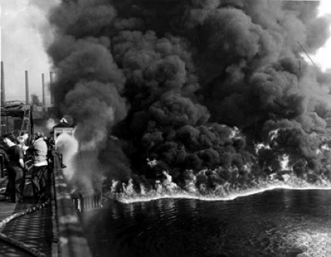
Environmentalism
1969 – Cuyahoga River
Science & Survival ; The Population Bomb
Occupational Safety & Health Administration (OSHA)
Environmental Protection Agency (EPA)
May 4, 1970: Earth Day
Effect on us today
“The river that oozes rather than flows”
-- Time Magazine

Slide 16
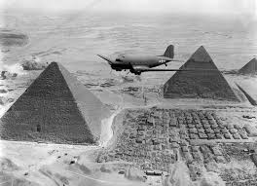
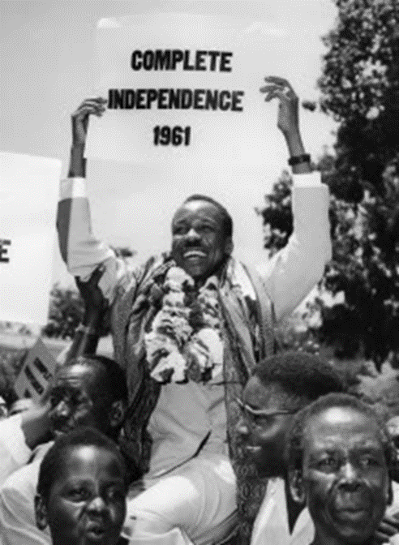
Meanwhile in Africa
Pan-Africanism
WWII: African soldiers fought and died to help free Europe from Nazi conquest.
The Effects
economic mess
Some really good new leaders
Many looked to the US and USSR for stability (#Coldwarproblems)
Many have constant dictators

Slide 17
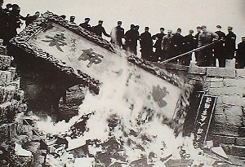
Meanwhile in China
Mao abandons the 5 year plan & replaces it with the “Great Leap Forward” (industry + agriculture)
10 years of civil war.
Intellectuals & resistance are purged.

Slide 18
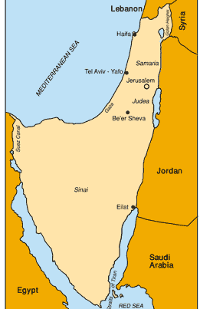
Meanwhile in the Middle East
1960: Palestinian Liberation Organization forms.
1960s: Egypt’s Nasser is given secret information that Israel planned on invading Syria. So he blockades Israel.
1967: Israel’s victory in 6 Day War

Slide 19
The Rise of Terrorism
The IRA (Irish Republican Army) forms to take back Northern Ireland from Britain.
Terrorist groups in Latin America target police, public buildings & military posts in fights against repressive governments and U.S. economic domination.

