Slide 1
The 1950s

Slide 2
Asia: the second front
NORTH KOREA SOUTH KOREA
Japan & USA
US made them weak after WWII, but made them strong to stop Communists
We also help France get Indochina (Vietnam, Laos, Cambodia)
People’s Republic of China & USSR
Mao Zedong takes over China. The ‘real’ government runs away to Taiwan

Slide 3
The Korean War
June 24, 1950: North Korean troops go past the 38th parallel.
Truman equates it to Hitler in the 1930s
Truman gets the UN to approve action in Korea
USSR was boycotting the UN over China
Doesn’t ask Congress
USSR takes over S. K.
We drive them back
MacArthur asks to take all of Korea
China makes us stop: STALE-MATE
Truman wants to leave; MacArthur wants to keep going
MacArthur is fired
July 1953: Korean War stopped; Korea still divided

Slide 4
The Korean War

Slide 5
The Red Scare
HOW DID WE NOT “WIN” IN KOREA????
Executive Order 9835
No Communists (or sympathizers) in US government jobs
Pro-Union or Pro-Civil Rights were suspect
Life & the Red Scare
J Edgar Hoover says colleges are hotbeds
Communists vs. Hollywood
Communists vs. Unions (who return to asking for benefits)
Senator Joseph McCarthy
Supported by: Republicans, blue collar workers, pro-America ethnic groups, businessmen.

Slide 6
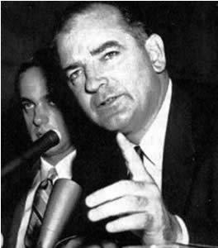
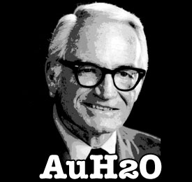
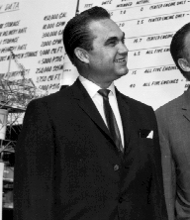
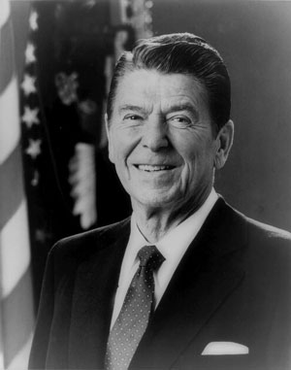
The End of McCarthy (but not the --ism)
McCarthy angered because one of his aides is drafted
The army suspects McCarthy pulls too many strings
April 1954 = Televised McCarthy shutdown
December 1954 = McCarthy censured
John Birch Society
Takes over McCarthy ideas
Rise of “new conservatives”
Berry Goldwater, George Wallace, Ronald Reagan

Slide 7
Brinksmanship
Going to the “Brink” without fighting
1945: USA creates an Atomic Bomb
1949: USSR creates an Atomic Bomb
1952: USA creates a Hydrogen Bomb
1953: USSR creates a Hydrogen Bomb
1958 = No more testing nuclear bombs
1960 = US spy plane crashes into Soviet territory

Slide 8
CIA Missions
Led by Allen Dulles
Operation Ajax
Paid for an Iranian coup
Operation PBSuccess
Overthrow the elected Communist government in Guatemala
Vietnam
Put Ngo Dinh Diem in power to make sure Ho Chi Minh won’t be elected
Gives rise to the National Front for the Liberation of Vietnam (NLF)

Slide 9
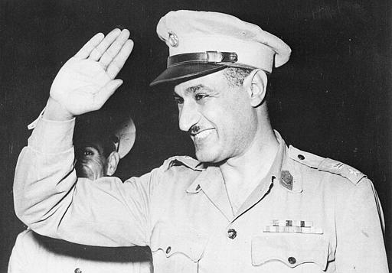
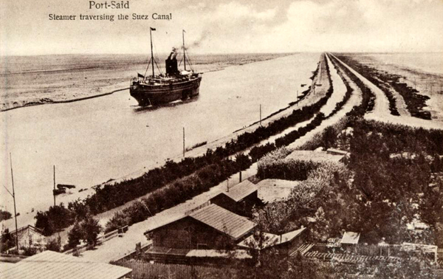
“Trouble in the Suez”
1954 = Gamal Abdel Nassar comes to power in Egypt
US offers to help industrialize
Nassar buys weapons from Czechoslovakia & recognizes China
We cancel our help
Nassar steals the British Suez Canal
1956 = Britain & France & Israel try to get back the Suez Canal back
Eisenhower Doctrine

Slide 10
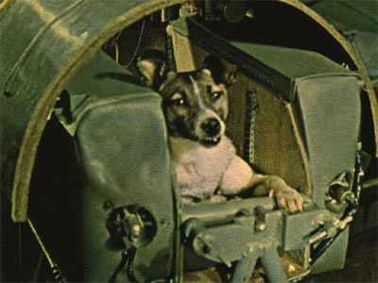
Satellites
October 4, 1957 = USSR launches Sputnik
November 3, 1957 = USSR launches Sputnik II
December 6, 1957 = USA launches Vanguard
Eisenhower creates Science Advisory Committee, which creates NASA

Slide 11
People of Plenty
1950s: Highest US standard of living
Science
Chemical fertilizers
DDT banned after Rachel Carson’s “Silent Spring”
Nuclear power plants
Plastic
Food storage, stretchy clothes, Teflon pans BUT landfills
Fuel
Oil trumps coal
Computers
Mark I → ENIAC → ‘48 Transistor Tubes
Stanford Industrial Park → Silicone Valley

Slide 12
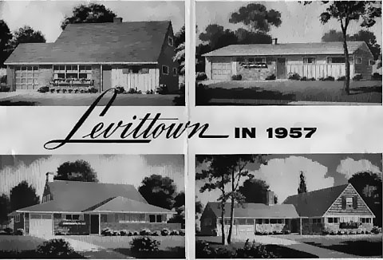
Life in the ‘Burbs
85% of homes built in the 1950s are suburbs
Architects: Alfred & William Levitt
Encouraged by…
Increasing cars and housing loans
Federal Housing Administration
Veterans’ Administration
Highways from WWII
Focus on …
What we want, not what we need
advertising

Slide 13
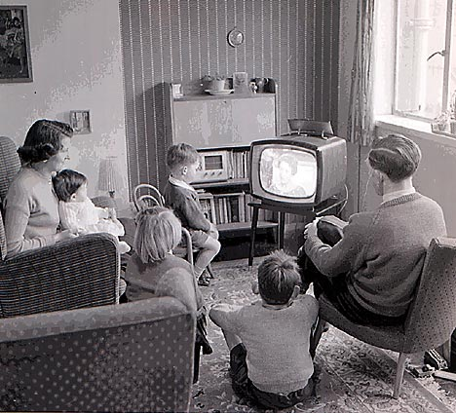
Family Life
Nuclear Family
Reinforces gender stereotypes
Child mortality down & baby boom
School changes:
Originally– reinforced stereotypes, promoted well-rounded kids
Later – National Defense Education Act promotes math and science

Slide 14
Beatniks
Anti-materialism
Uninhibited Sex
Searched for “Authentic Experience”
Allen Ginsberg “Howl” & Jack Kerouac “On the Road”
Demonstrated…
Against Anti-Communist Raids
Against the Arms Race
For Integration

Slide 15
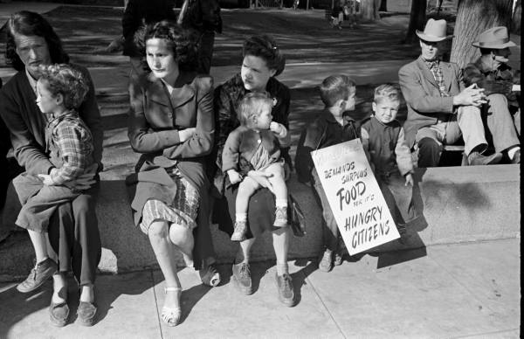
Poverty
Nearly ¼ of Americans live in poverty in the 1950s
1/3 are migrant workers; the rest live in urban slums
Landlords and realtors won’t allow African-Americans to move into the suburbs
Michael Harrington, The Other America (1962)

Slide 16
Brown V Board of Education
Earl Warren leads the Supreme Court (‘53)
Jenks v United States : accused can see prosecution evidence
Yates v United States : stopped prosecuting Communists
Brown v. Board of Education of Topeka (1954)
Overturned Plessey v Ferguson
Prosecution : Thurgood Marshall
The South REFUSES to comply

Slide 17
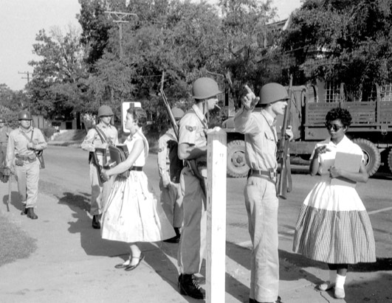
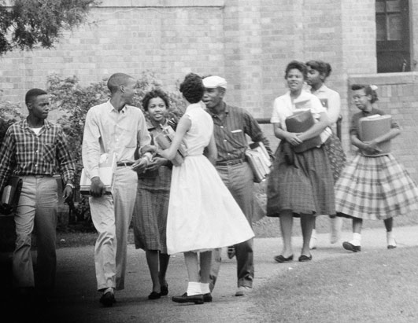
Brown V Board of Education
September 1957
Federal Court orders desegregation
Arkansas governor Orval E. Faugus says no
Eisenhower dispatches federal troops to ensure integration
The 9 students get personal soldiers to get through the year
Little Rock closes schools for 2 years Impact
Strengthened resolve of African-Americans
Televised → National issue
Civil Rights Act of 1957 & 1960

Slide 18
Post “Brown” Civil Rights
Nonviolent / Civil disobedience protest
December 1, 1955: Rosa Parks
Defended by Martin Luther King, Jr
Year long bus boycott
November 1956: Supreme Court bans segregated busses
Showed this type of protest works
Shows black people DON’T like segregation
1957: Southern Christian Leadership Conference (SCLC)

Slide 19
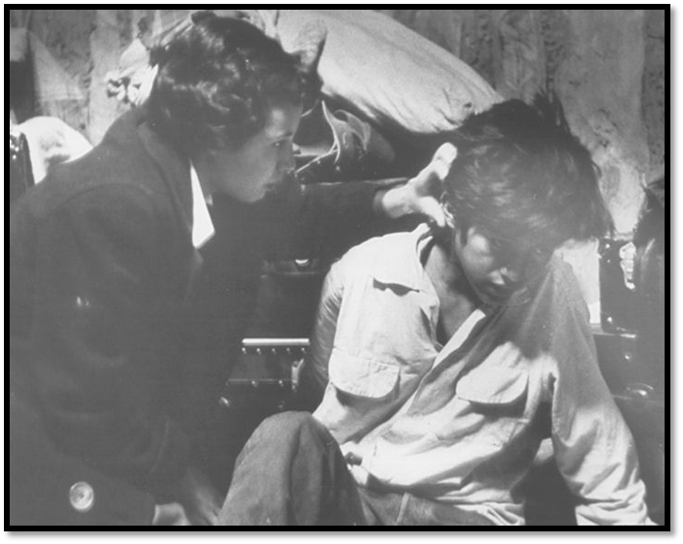
Latin-Americans & Native Americans
Poorest minority in the 1950s
Unemployment on reservations up to 86%
Assimilation
1954-62: 12 termination bills
No support- 61 reservations
Takes away reservation land
Voluntary Relocation Program
High number of Puerto Rican immigration
“El Barrio” in New York
Mexican-Americans
1951: Bracero program 1953-5: “Operation Wetback”
League of United Latin American Citizen (LULAC)
Can’t stop exploitation
Campaigns for integration

