Slide 1
Roles of the Media

Slide 2
Media as “gatekeeper”
Media decides which stories are important enough to receive public attention- and which ones aren’t.

Slide 3
Media as “Watchdog”
Media keeps watch on the government and those in power.
Example: Watergate Scandal

Slide 4
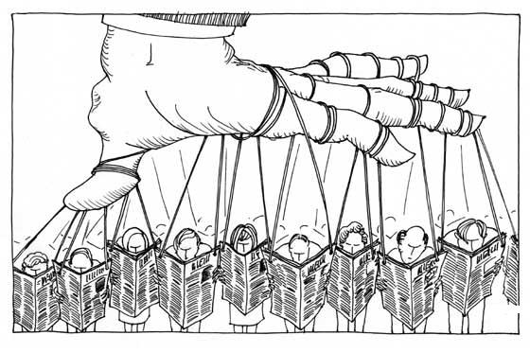
Media as “Agenda-Setter”
Media decides what issues society discusses in the public sphere and thus influences the political agenda.

Slide 5
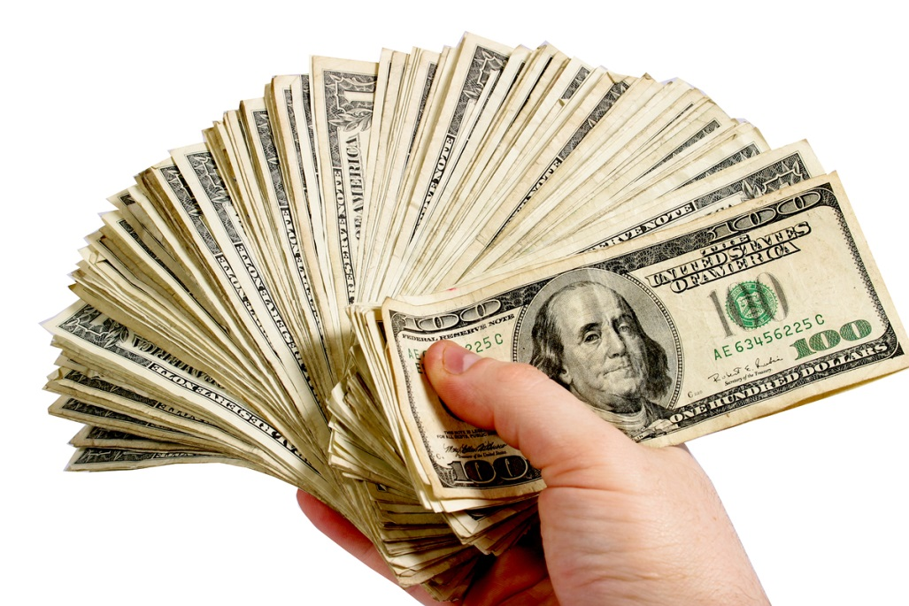
Media as “Business”
Most media makes money by selling time and spaces to advertisers.
In order to survive today’s culture, news must keep things short, fast-paced and exciting.

Slide 6
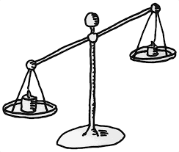
Media as “biased”
Some sources are liberal and some lean conservative

Slide 7
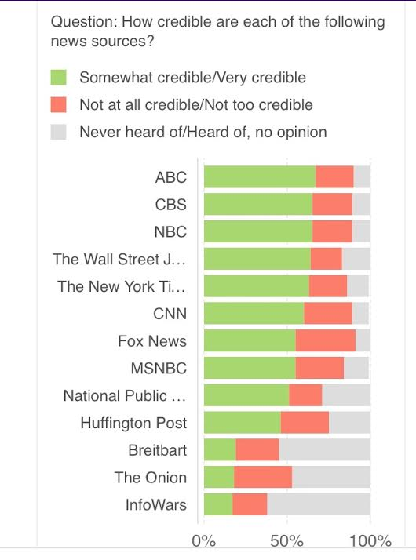
Perception of Media credibility
Which of these news station tilts liberal?
Which of these news stations tilt conservative?

Slide 8
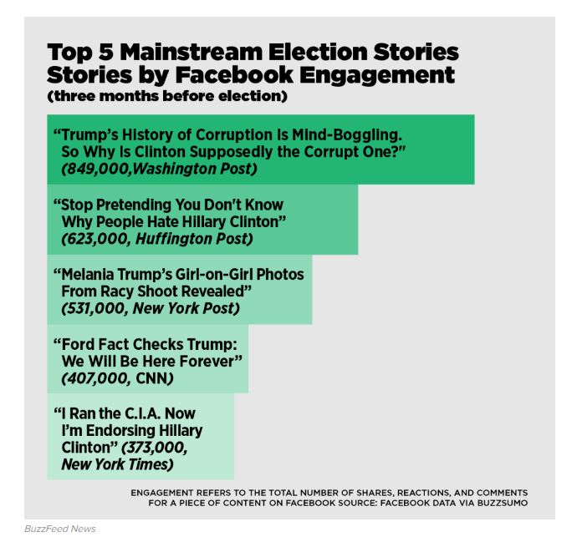
Fake News
Top Fake News Stories of 2016
Trump saves marines.
Pope Francis/Trump
#PizzaGate
Ireland loves refugees
Clinton sold weapons to Isis

Slide 9
Media as Propaganda
Use of arguments to convince someone of something
An attempt to change your behavior, your choice
An appeal to emotion and not intellect= TV ADS!

Slide 10
Propaganda Techniques

Slide 11
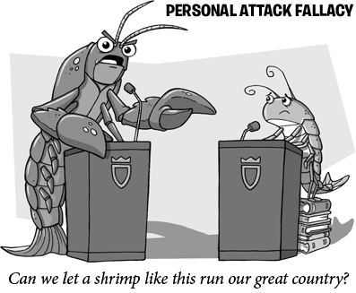
Name Calling or stereotyping

Slide 12
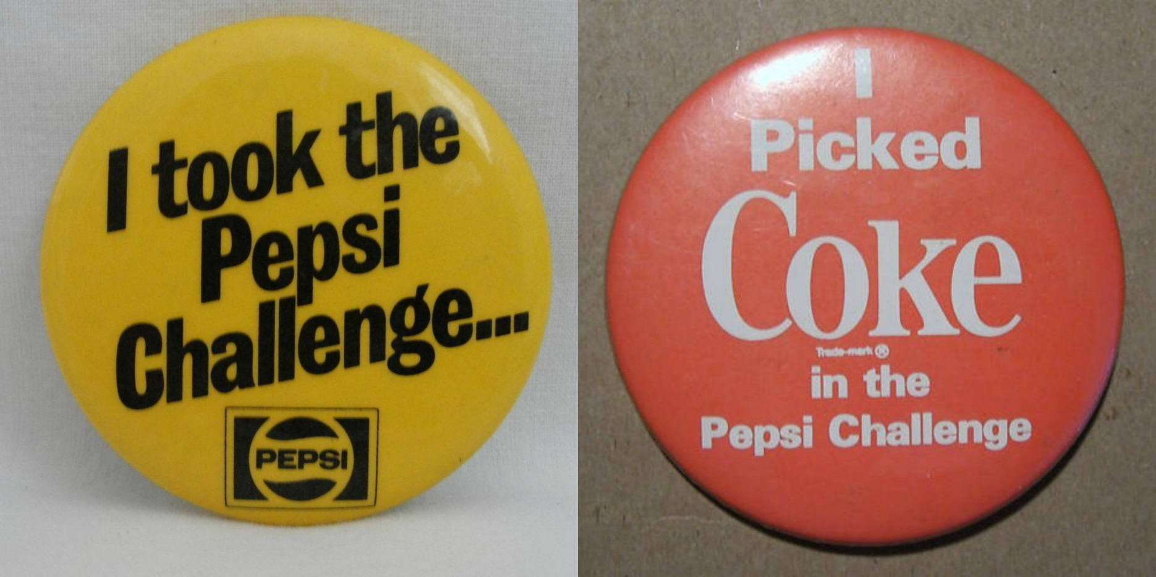
Black or White
Presents a dynamic of “either/or”

Slide 13
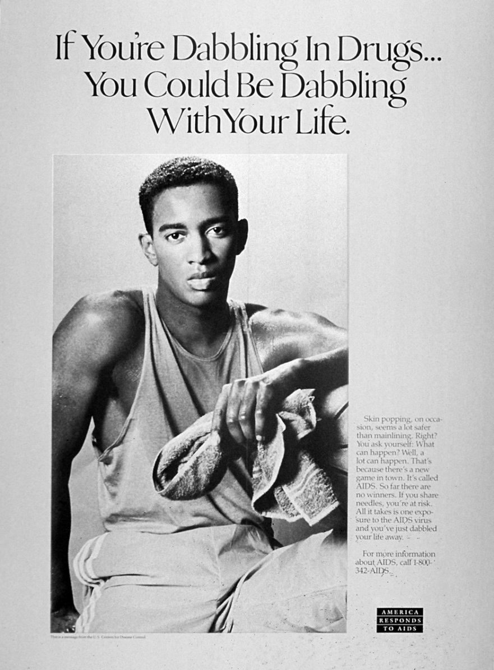
Fear
Warns that disaster will result if a particular course of action is not followed.

Slide 14
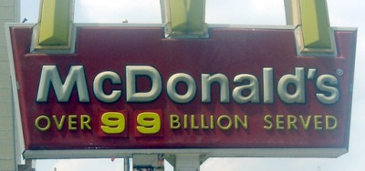
Bandwagon Technique
Everyone is doing it!
You should too!!!

Slide 15
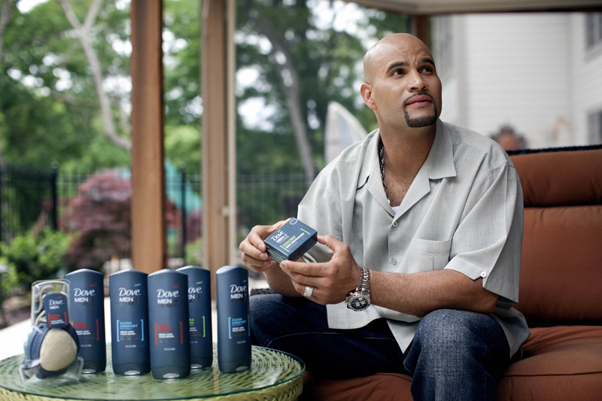
Testimonial
Quotations or endorsements which connect a famous or respectable person with a product or item.

Slide 16
Plain Folks
Makes the leaders look like
Plain folks (mom and pop style). A convincing method to show they are just common people.

Slide 17
Campaign Financing
FEC regulates campaign financing?
Why?
Dealing with large sums of money has potential to breed corruption, scandal
This is why public financing was put into place.
Listen to NPR radio broadcast.

Slide 18
Loopholes
Buckley v. Valeo court case= restrictions on amount of money someone can use during a campaign reduces their ability to freely express their ideas.
Impact: Candidates have no cap on spending as long as the money is raised from private donors.

Slide 19
Loopholes
PACS: corporate or union based organizations that donate money for the purpose of influencing an election.
Regulated by FEC
Example: NRA, Kraft Food, McDonald Corporation
527s: similar to PACS but they don’t donate directly or work with the candidates campaign.
Not regulated by FEC and tax-exempt
Example: Swiftboat Veterans for Truth
Bundling: One individual gathers contributions from a large number of people and donates the money all at once.
Bundler gains a lot of political influence

Slide 20
Loophole
SUPER PAC
a political committee whose primary purpose is to influence elections,
It can take unlimited amounts of money, outside of federal contribution limits, from rich people, unions and corporations, pool it all together, and spend it to advocate for a candidate
They must be independent and not coordinated with the candidate.

Slide 21
Loophole
Hard money: regulated campaign contributions that are limited and given directly to the candidate.
Soft Money: Unlimited and unregulated campaign contributions to national parties, supposedly for generic “party building activities” (get out the vote, yard signs etc…)

Slide 22
Questions
What are the differences between interest groups and political parties?
Why are interest groups more effective in influencing the government than individual citizens?
What are three reasons why citizens join interest groups
Do interest groups help make representative government truly “government by the people”. Explain.

Slide 23
Warm Up
True/False
Super PACs can give unlimited amounts of money to a candidate.
PACS cannot accept more than $5000 in individual contributions
Public financing is funded through taxpayers.

Slide 24
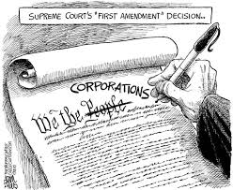

Slide 25
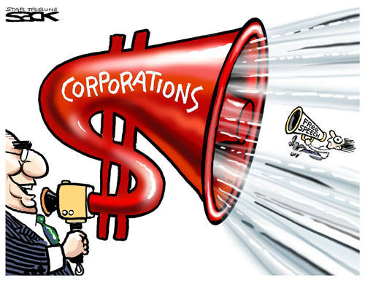

Slide 27
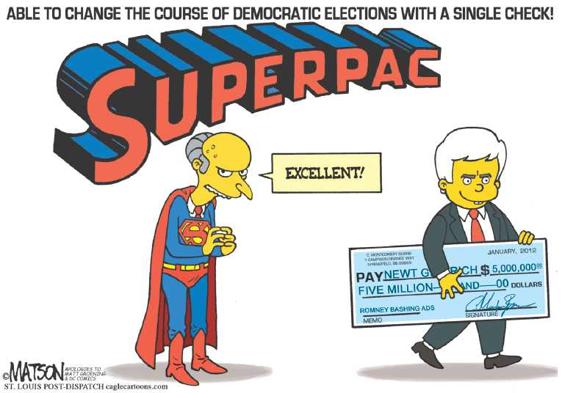

Slide 28
Types of Interest groups
Public Interest: focus on topics that affect the general population like education, the environment and politics.
Economic interests: promotes the economic interests of their members of in business, labor, trade organizations.
Professional groups: advocates for people in a particular profession, such as doctors, lawyers and teachers.
Ideological groups: promotes policies based on a set of core political or religious beliefs.
Single-Issue groups: focuses on one narrow topic, such as immigration or drunk driving.

Slide 29
Lobbyists
What is a lobbyist?
Does it surprise you that a governmental interest group (U.S. Chamber of Commerce) would have the largest lobbying budget? Why or why not?
What are some of the qualities that make up a good lobbyist?
What are the differences between direct, indirect and grassroots lobbying?
Why are lobbyists traditionally held in high suspicion?

Slide 30
Warm Up: Discuss with a partner
What do you know about the A.P. government exam?

