Slide 1
Ghana
By:
Britany, Chase, Mayoree, and Mario

Slide 2
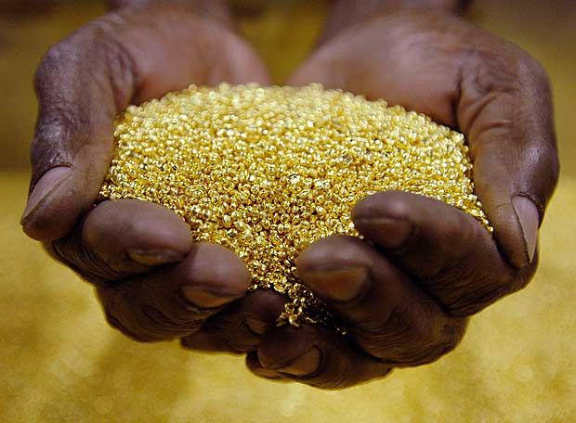
Trading Items
Two most important trade items were gold and salt
Gold came from a forest region South of the Savanna between the Niger and Senegal rivers
The Saharan contained deposits of salt
In the Saharan village of Taghaza, workers built their houses from salt blocks because it was the only material available

Slide 3
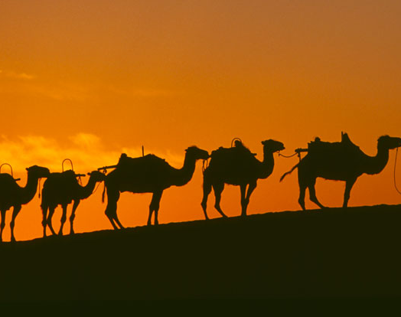
Gold-Salt Trade
Merchants met in trading cities, where they exchanged goods under the watchful eye of the king’s tax collector
In addition to taxing trade, royal officials made sure that all traders weighed goods fairly and did business according to law
Royal guards also provided protection from bandits

Slide 4
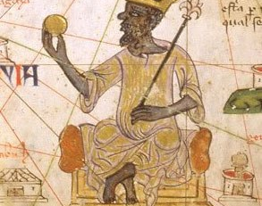
Coast Of Gold
By the year 800, Ghana had become an empire
Since Ghana’s king controlled trade and commanded a large army, he could demand taxes and gifts from the chiefs of surrounding lands
In the royal palace, the kings would store gold nuggets and slabs of salt collected as taxes

Slide 5
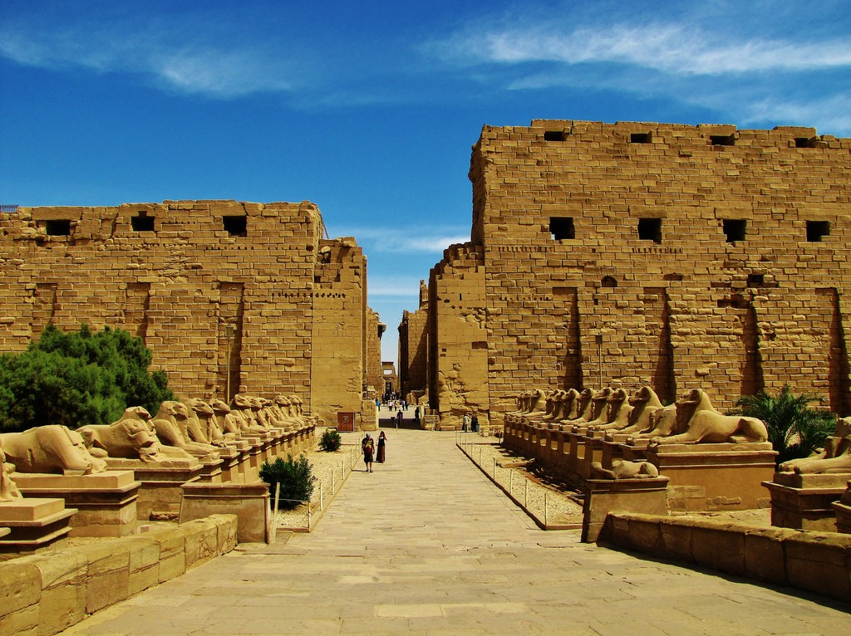
The King and his Gold
Only the king had the right to own gold nuggets, although gold dust freely circulated in the marketplace
The king then limited the supply of gold and kept its price from falling
Ghana’s African ruler acted as a religious leader, chief judge, and military commander

Slide 6
Islamic Spreading
While Islam spread through North Africa by conquest, south of the Sahara, Islam spread through trade
Muslim merchants and teachers settled in the states south of the Sahara and introduced their faith there
Ghana’s rulers converted to Islam

Slide 7
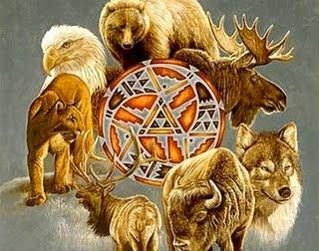
Islamic Influences
People in the empire clung to their animistic beliefs and practices
Animism is the belief that spirits living in animals, plants, and natural forces play an important role in daily life
In 1076 the Muslim Almoravids of North African completed their conquest of Ghana resulting in disruption of the gold-salt trade

Slide 8
Connection
Sundiata ,Mali’s first great leader, took over the kingdom of Ghana

Slide 9
The End

