Slide 1
Opener: 3/5 - #1
Using the textbook, page 543, COPY and answer the following:
What physical feature separates South Asia from the rest of the continent? How do you think it affects the region?

Slide 2
Physical Geography of South Asia
The Land Where Continents Collided

Slide 3
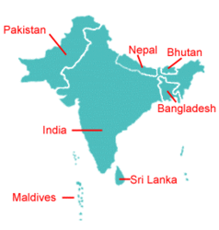
Together the countries of South Asia form the Indian subcontinent.
Subcontinent: large landmass that is smaller than a continent.
The Indian subcontinent also includes two island territories located in the Indian Ocean: Maldives & Sri Lanka.

Slide 4
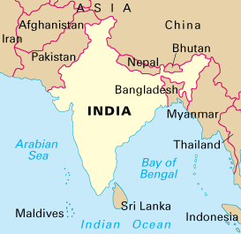
Indian Subcontinent
One big peninsula!
Surrounded by 3 bodies of water: Arabian Sea, Indian Ocean, and the Bay of Bengal
India makes up 75% of the landmass

Slide 5
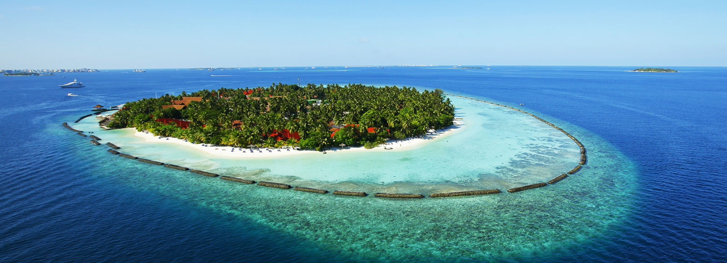
Islands
Sri Lanka – teardrop shaped island off the coast of India
Maldives {archipelago} – low-lying tops of submerged volcanoes, surrounded by coral reefs and shallow lagoons

Slide 6
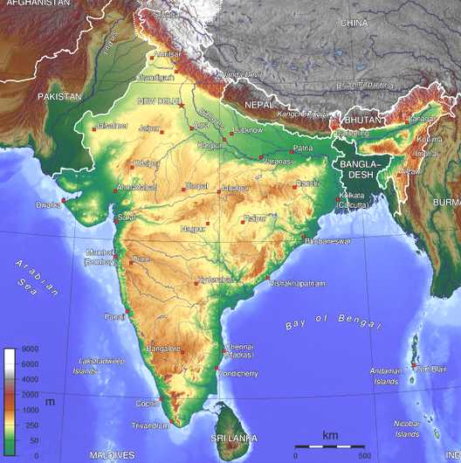
Mountains

Slide 7
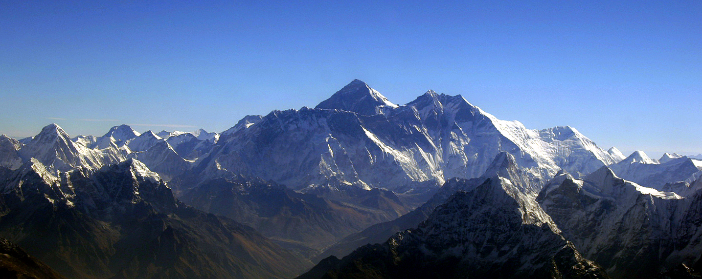
Himalayas
The most important mountain range in Asia
The Himalayas separate India from China.
The Himalayas block clouds that are formed by monsoons from entering Western China.

Slide 8
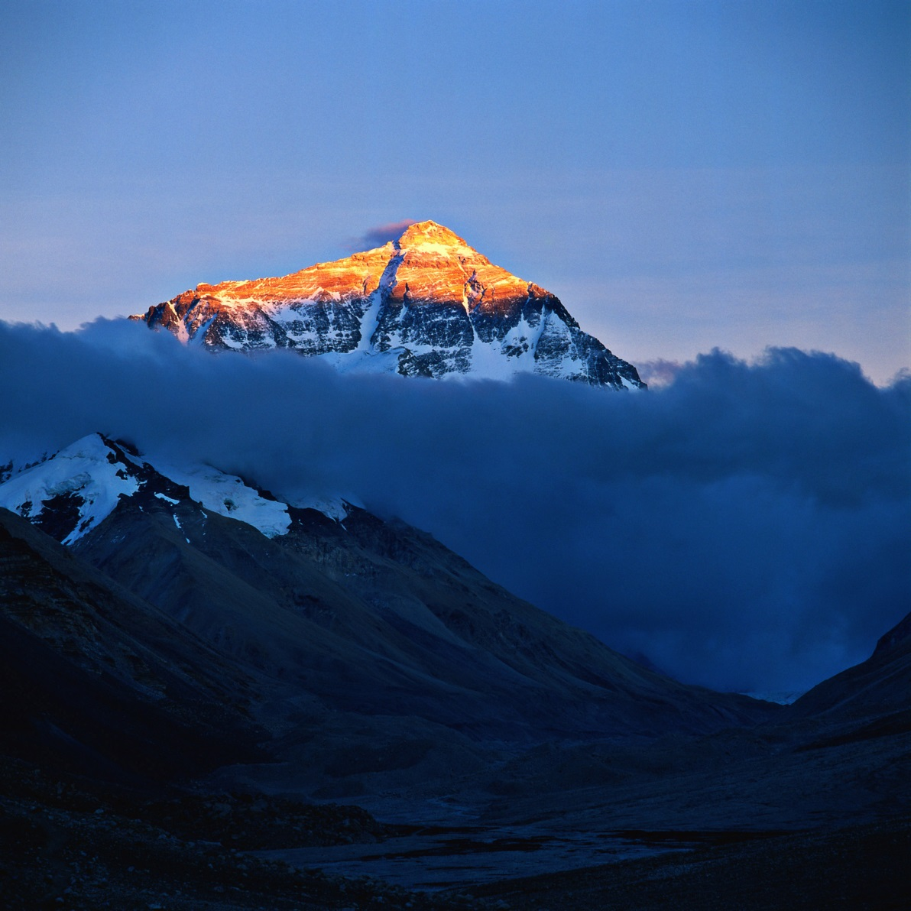
Mt. Everest
World’s highest peak – 29,028 feet high
Kennesaw Mt - 1,808 feet high

Slide 9
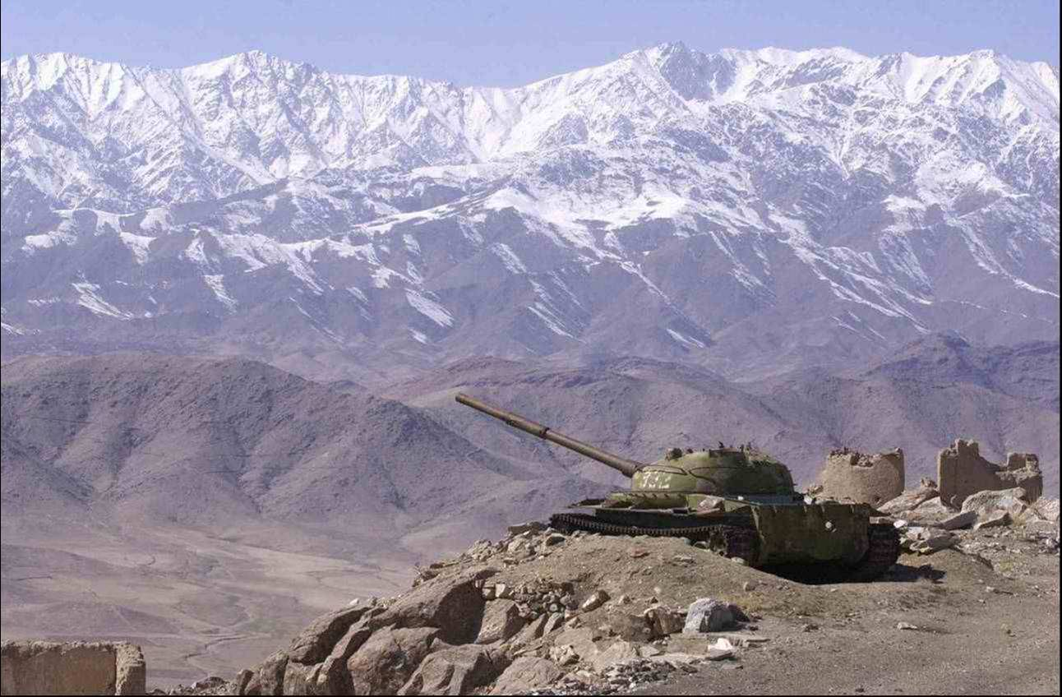
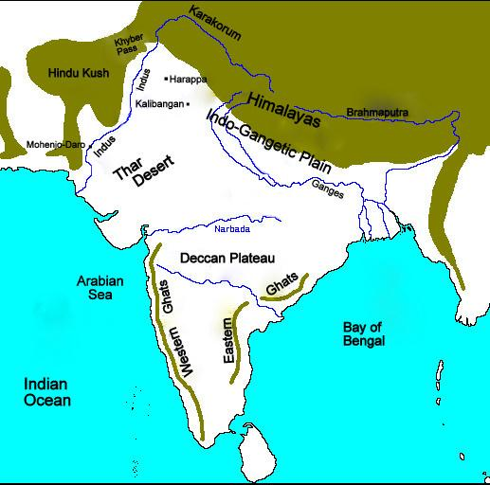
Hindu Kush
Mountain range between Afghanistan and northern Pakistan
Kept central Asian tribes from invading India

Slide 10
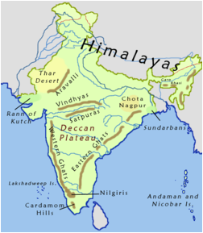
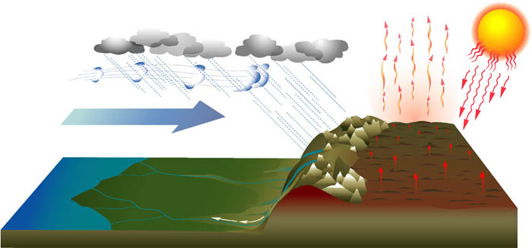
Eastern & Western Ghats
The Eastern & Western Ghats are coastal mountain ranges along the Indian subcontinent.
They collect the rainfall during the monsoon season, keeping the interior rather dry and arid.

Slide 11
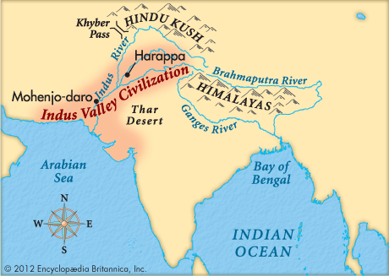
Rivers
South Asia’s three great river systems originate in the Himalayas.
The most important rivers in South Asia are:
Ganges
Indus
Brahmaputra

Slide 12
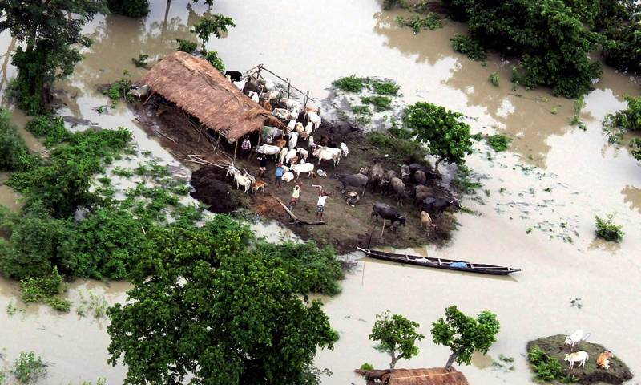
Rivers
The Ganges and Brahmaputra start in the Himalayas and flow into the Bay of Bengal.
Indus-flows mostly through Pakistan and empties into the Arabia Sea
The Ganges and Brahmaputra flow through Bangladesh and as a result, this country often floods during the monsoon season.

Slide 13
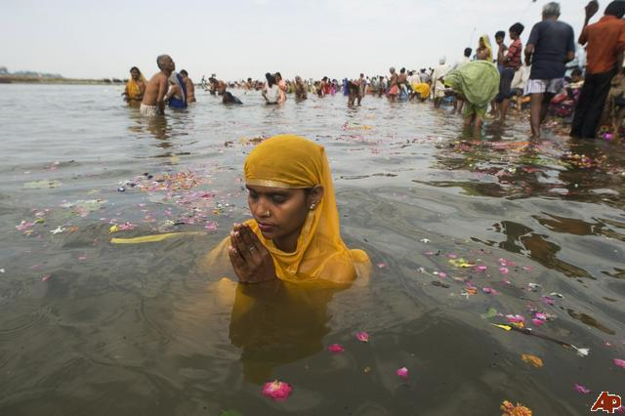
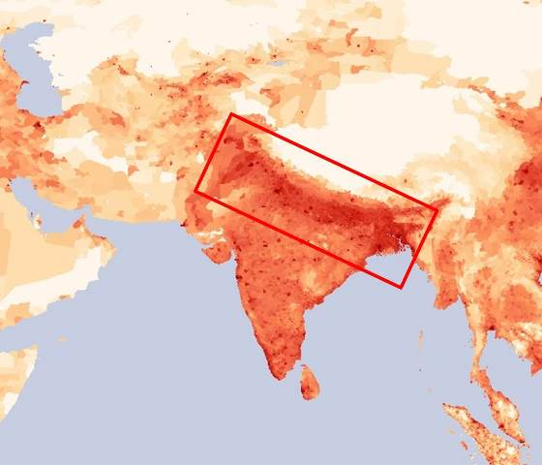
Rivers
Rivers support life in the region
Ganges River is sacred for Hindus
The Indo-Gangetic Plain is the most heavily populated part of South Asia
- 3/5 of India’s population

Slide 14
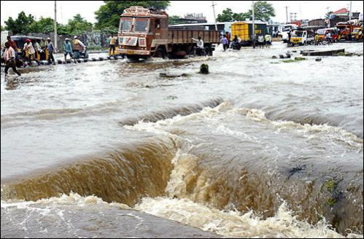
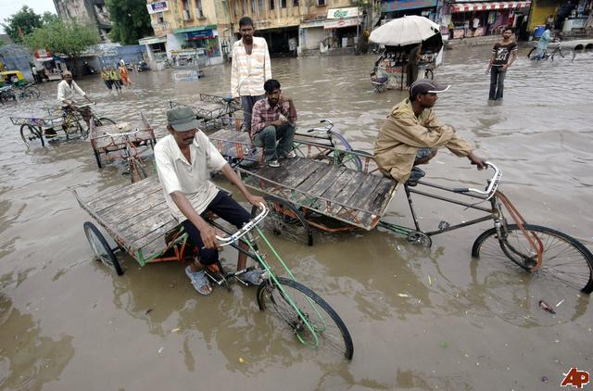
Monsoons:
Severe storm marked by heavy rains and strong winds that reverse direction

Slide 15
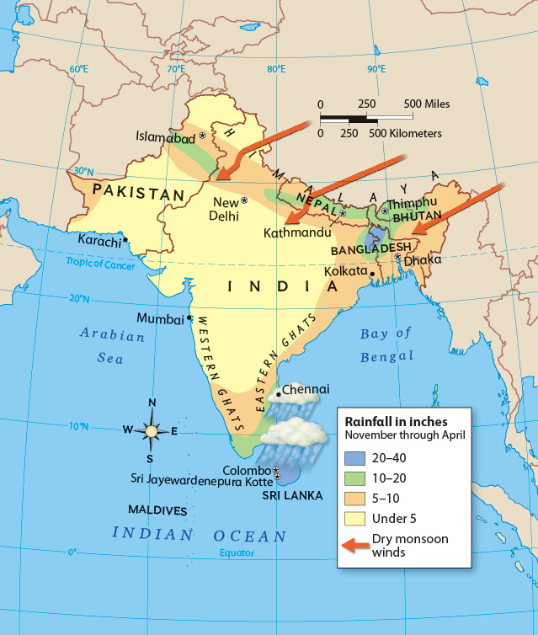
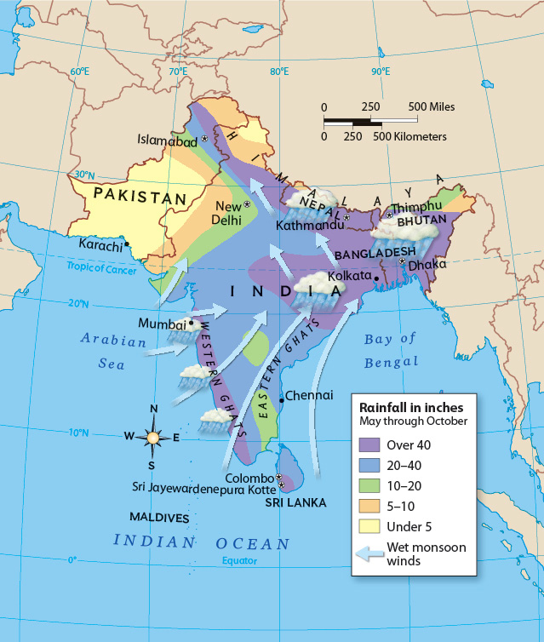
Monsoon Seasons
Winter: October-February, dry winds blow across South Asia from the northeast
Summer: June-September, the winds blow in from the southwest bringing moist ocean air and heavy rainfall

Slide 16
Monsoons
https://www.youtube.com/watch?v=yvvuarY6LbQ

