Slide 1
Major influences on American government

Slide 2
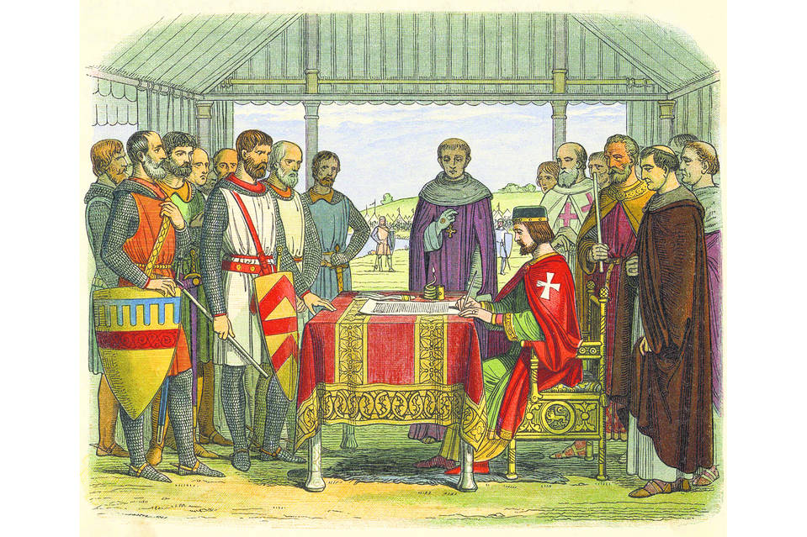
MAGNA CARTA (1215)
Said that certain taxes could not be levied without the agreement of the people

Slide 4
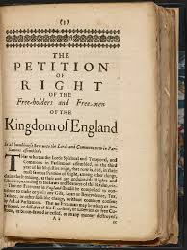
Petition of Right (1625)
The English monarch was not allowed to collect taxes without Parliament’s consent

Slide 5
English Bill of Rights (1688)
Defined the rights of all English subjects.

Slide 6
Homework
Read p. 38-40
List weaknesses of Articles of Confederation

