Slide 1
Opener: 9/29 - #5
COPY & answer the following:
How would you define “reincarnation”? If you could be reincarnated, what would you come back as and why?
Answer in 3-5 COMPLETE SENTENCES

Slide 2
Religions of South Asia #6
Hinduism & Buddhism

Slide 3
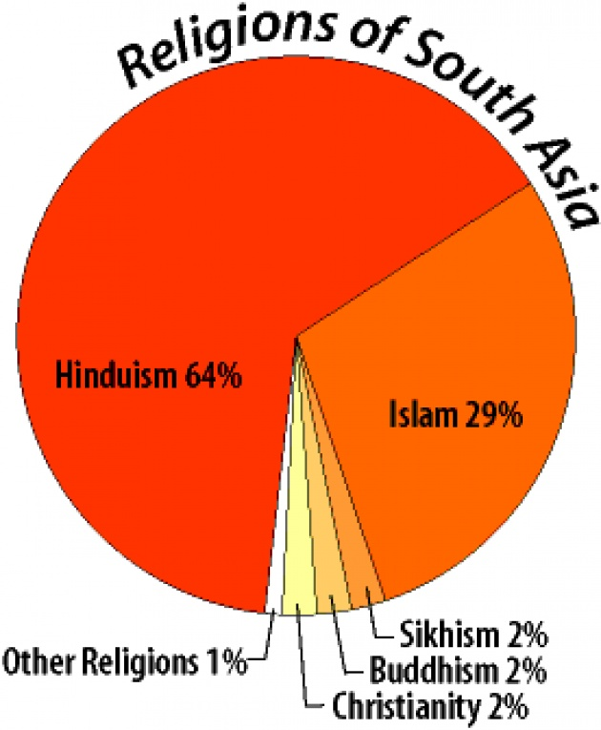
Religions of South Asia

Slide 4
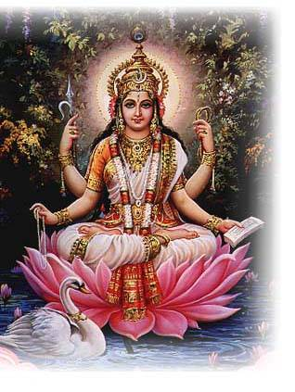
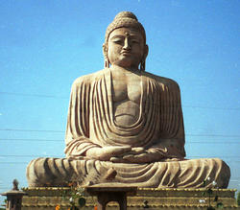
Religions
Two of the world’s great religions began in India—Hinduism & Buddhism

Slide 5
Hinduism
There is NO founder for Hinduism.
Hinduism is hard to “define” because its beliefs are so complex and no one attempted to define them until Christian missionaries came in the 19th century.
However, we can say for MOST Hindus:
Rooted in India
sacred scripture known as the Veda
draw on a common system of values known as dharma.

Slide 6
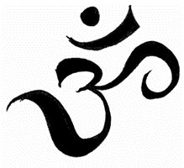
A-U-M (“Om”)
Religious Symbol
sound through which the universe was created
3 syllables that symbolize (1) waking, (2) dreaming, and (3) deep sleep.
Together, they help the speaker get to the 4th state: spiritual awakening

Slide 7
Hinduism: Religious Beliefs ~All about BALANCE~
Dharma – responsibility or “calling”; The Vedas (holy books) explain that people must follow their spiritual callings to keep the universe in balance
Caste System – a set of rules for a person’s Dharma
Karma – action; all actions will cause a reaction. Good acts will bring good fortune; Bad will bring bad. It may happen in this life or the next
Reincarnation – the process of rebirth after death into a new body based on the Karma during life.
Moksha – freedom from Reincarnation

Slide 8
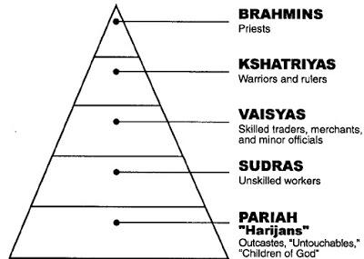
Hinduism: Caste System
Caste System – born into, can only move through reincarnation
Actions in previous life determine caste in next one
The caste system led to discrimination in India and it has been outlawed, but some people still believe in it and practice it.

Slide 9
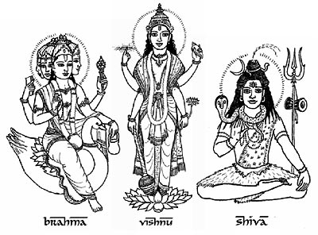
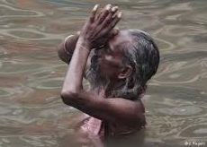
Hinduism: 1 God; Many Versions
Monotheistic – Hindus believe in one Supreme
Polytheistic – Hindus believe in thousands of versions of the Supreme
The First Three: Brahma (the creator), Vishnu (the preserver), & Shiva (the destroyer).
Ganga is another goddess who shows herself on earth as the Ganges River.

Slide 10
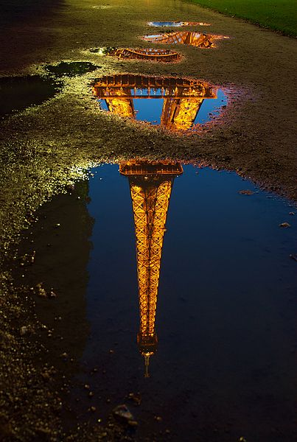
An Analogy

Slide 11
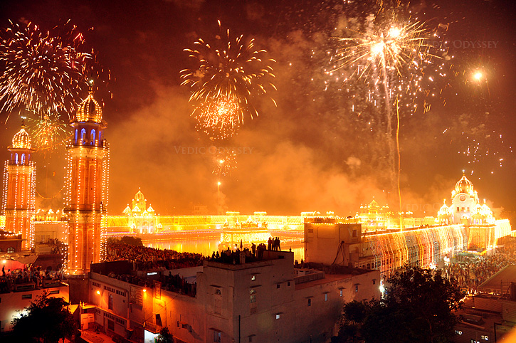
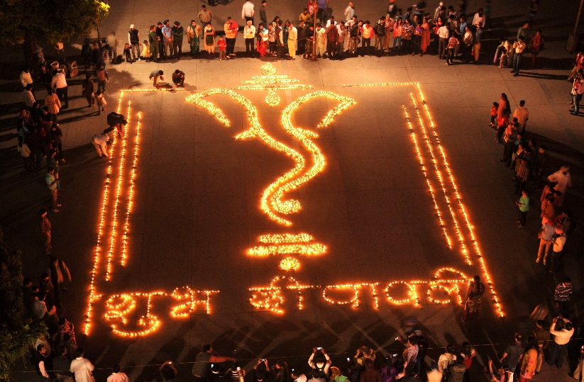
Hinduism: Diwali
New Year (Festival of lights) 5 day celebration with lamps, gifts, & fireworks. It remembers when Prince Rama rescued his wife from an evil demon. People light lamps to symbolically light the way for Rama & Sita’s return.

Slide 12
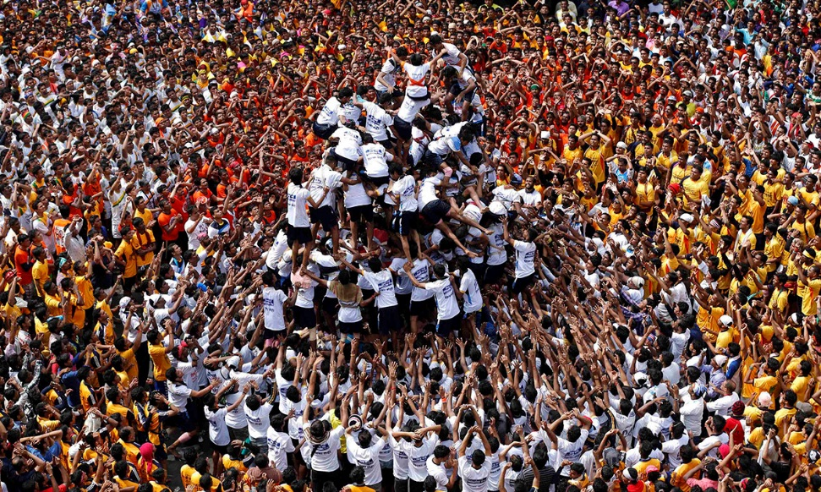
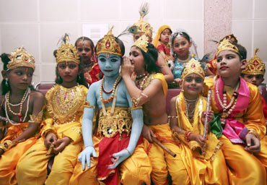
Hinduism: Krishna Janmashtami
Krishna’s birthday. They meet at night at a temple. They move lamps in circles around temple statues. Then they have a big feast with songs & dancing.

Slide 13
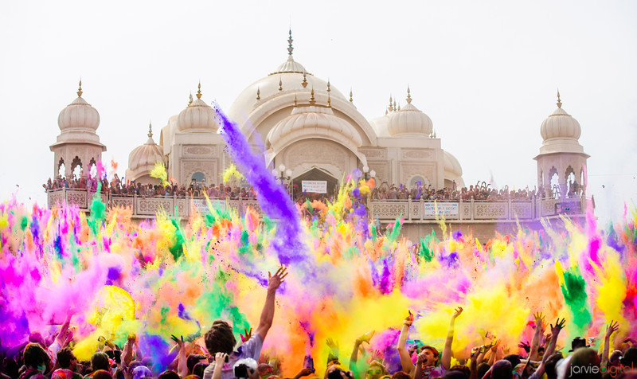
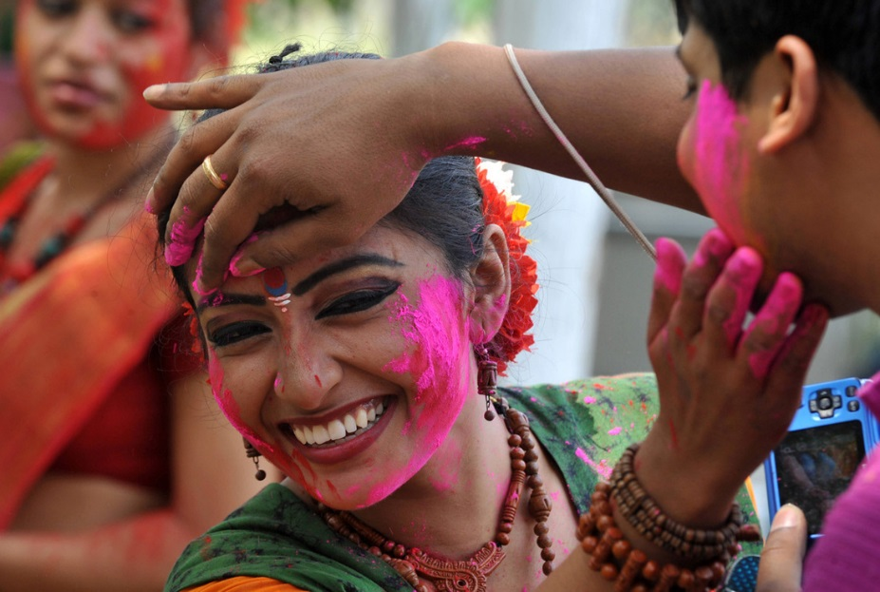
Hinduism: Holi
Spring festival to remember that Krishna was a jokester. They throw colored powder & dye at each other (like a water balloon fight)

Slide 14
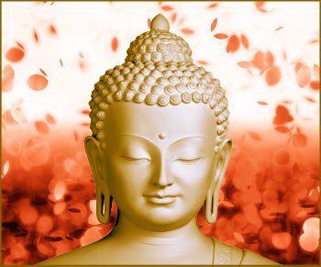
Buddhism
Buddhism is related to Hinduism and shares many of the same basic beliefs.
Considered a “Philosophy” more than a “Religion”

Slide 15
Buddhism
Founder: Siddhartha Gautama (Buddha) A prince who realized 2 important things when he was 30 (in 530 B.C.):
1. Riches do NOT equal happiness
2. Nirvana (Spiritual happiness) would be reached by letting go of Earthly things
In doing so, he became known as Buddha, or the “Enlightened One”. He is NOT considered a god.
His teachings are put into many books that are called the Sutras.

Slide 16
Buddhism
Buddha spent his life trying to teach people that people suffer because they are attached to material things.
Four Noble Truths
Life is filled with suffering
Cause of suffering is desire for temporary pleasure
Way to end suffering is to stop worrying about the past and the future. Live in the present.
Way to overcome suffering is the Eightfold Path

Slide 17
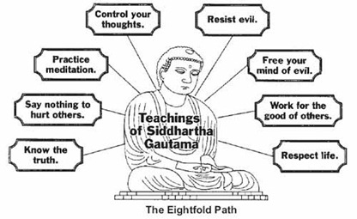

Slide 18
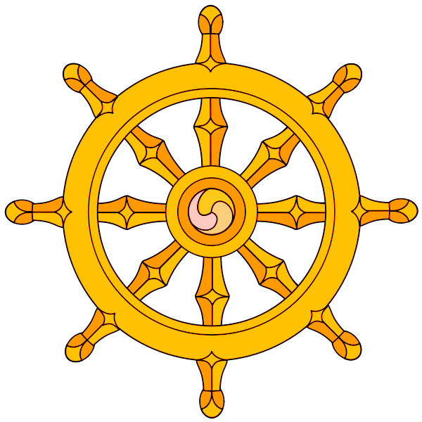
The Dharma Wheel
Religious Symbol
The center represents concentration
The outside wheel represents the Buddha’s Dharma (here it means behavior or teachings)
The 8 spokes represent the 8-fold path

Slide 19
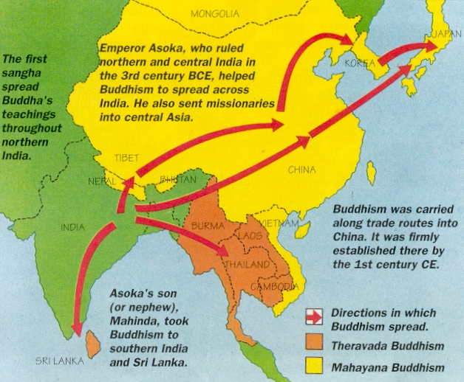
Buddhism: Spread
Started in India
Spread to China, Korea, Japan, & other areas through trade.
Today mainly in Japan, China, Cambodia, and Thailand.

Slide 20
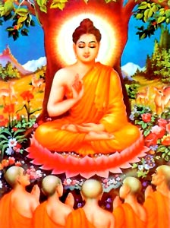
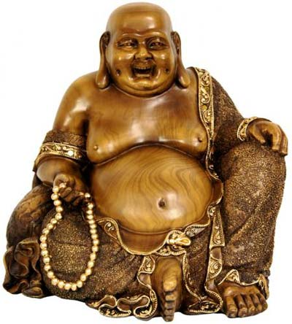
Buddhism: Spread
Indian Buddha
Chinese Buddha

Slide 21
5 question check

