Slide 1
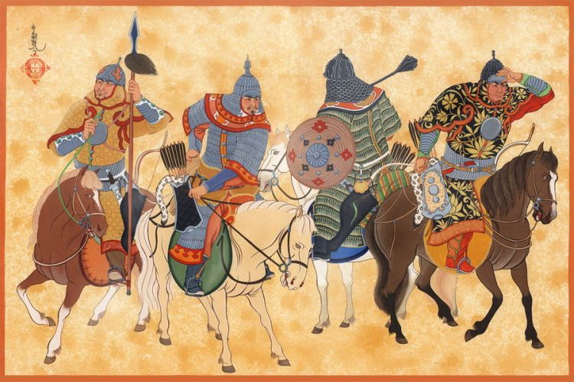
The Mongols
By: Lonniel G., Gloria R. , & Jennifer L.
4th block
Unit 3

Slide 2
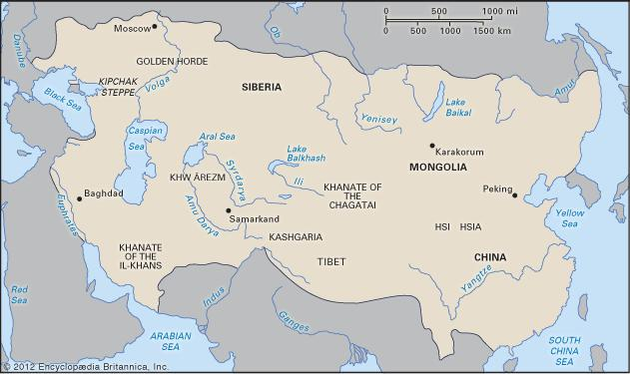
What was the Mongolian Empire
The Mongols were nomadic people who lived in the Asian steppe.
They had domesticated animals and were good at horseback.
They moved through seasonal patterns and would return to existing campsites.
Traveled in groups called clans.
Instead of trading with others they would raid other people.
A man named Genghis Khan would unify the Mongolian people in 1200
It would become the largest unified empire in the world.
Most areas never recovered after Mongol attacks.
They stopped expanding in 1260.
The empire was made up of 4 main regions, Khanate of the Great Khan(China and Mongolia), Khanate of Chagatai(Central Asia), The Ilkhanate(Persia), and Khanate of the Great Horde(Russia).

Slide 3
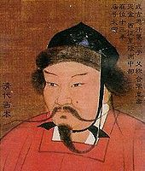
Who was Genghis Khan
He was born in 1162 and died due to illness in 1227.
He would unite the Mongolian empire in1200.
Was a great military leader and planner in how to move his troops.
He would attack and destroy all if not most of central asia by 1225.
He attacked the Islamic people because they killed Mongol ambassadors and traders.
He increased trade.
After his death only descendants of him ruled the empire.
He also never forced Mongol beliefs on the regions they captured.
United mongol confederations with civil war

Slide 4
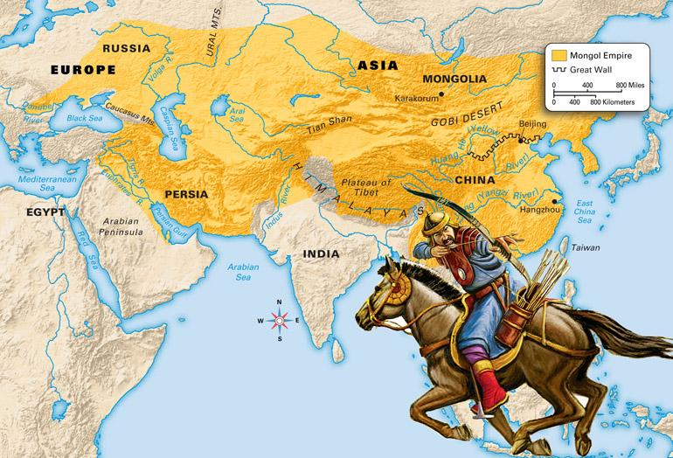
China
China was the first goal that Khan wanted conquered.
Invaded China in 1276 AD.
Less the 50 years after Genghis died, they conquered territory from China to Poland , which created the biggest empire.
Mongols and the Chinese live along each other, but lived apart from one another economically.
The Mongols brought violence and destruction to all aspects of China’s civilization.
Mongols were insensitive to Chinese cultural values, distrucstful of chinese influences, and incepted heads of chinese government.

Slide 5
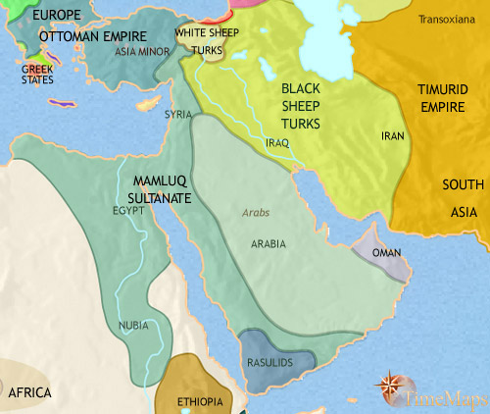
Middle East
Muslims killed mongolian traders and ambassadors, angering Genghis Khan, which led to the conquest on the middle east
After mongolian conquest on to the middle east they took interest on the religion
Converted to islam and took part in buddhism and hinduism as a result of their conquest
The mongol invasions on the middle east were disastrous and destructive leaving it in a critical condition (politically & economically)
Either killed or deported scholars or scientists
Destruction of Baghdad, Bukhara, and Samrkand

Slide 6
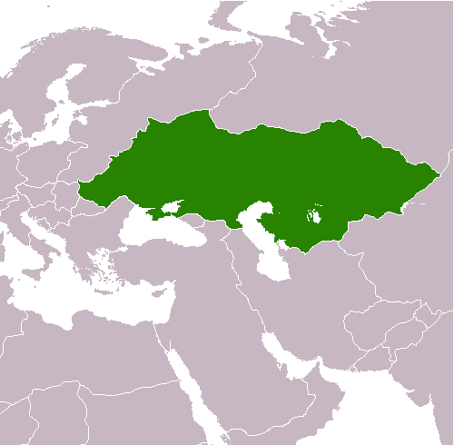
Russia
Invaded Russia in the mid 1200s led by Genghis Khan.
Ruled all of southern Russia for 200 years.
Named Russia Khanate of the Golden Horde.
In 1240 Kiev was destroyed by the Mongols led by Batu Khan.
Wanted 2 things from the Russians: Obedience and Money.
Russians could follow their own customs as long as they didn’t rebell.
Church was a mediator between the Mongols and Russian because the Mongols were big in religion.
Mongols blocked Russia from its neighbors blocking access to new inventions and ideas.

Slide 7
Multiple Choice Questions
What were the name of the four regions of the Mongolian Empire?
the Great Khan,Chagatai,Ilkhanate,the Great Horde
the Great Horde,the Great Khan,Qin,Persia
Persia,Ilkhanate,Atlanta,China
the Great Khan,Chagatai,Ilkhanate,Kive
How long did the Mongols rule southern Russia?
200 years
50 years
147 years
900 years
What was unique about how the Mongolian people lived?
They were nomadic people
They had domesticated animals
They spoke english
The creation of the number zero

