Slide 1
The 21st Century

Slide 2
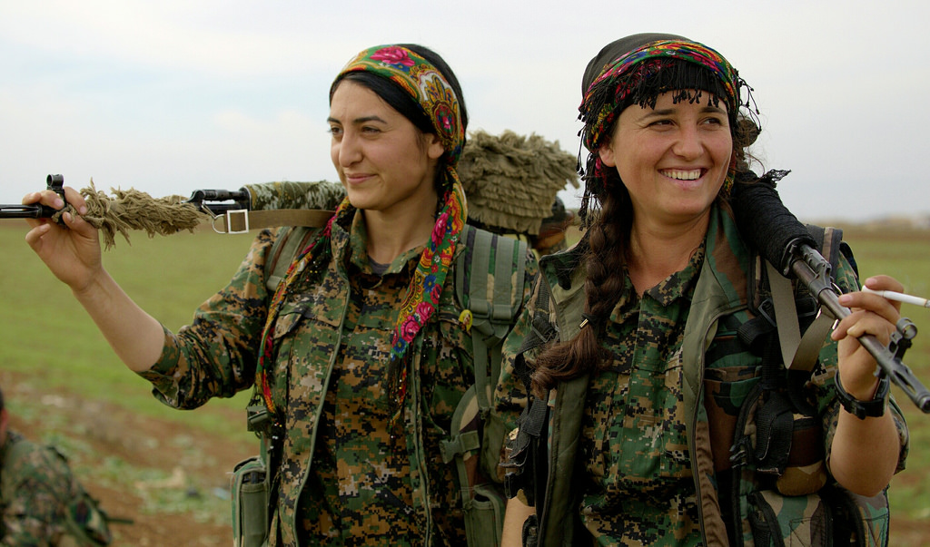
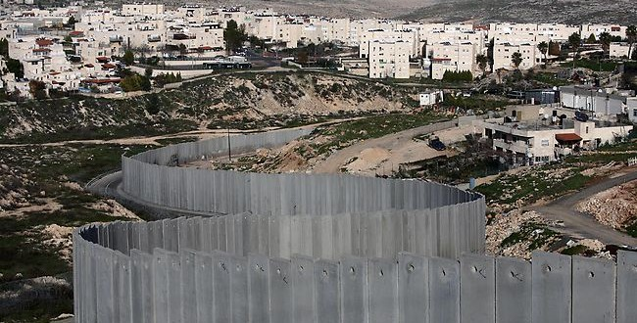
The Middle East
War on Terror
September 11, 2001: Taliban Terrorists attack WTC & Pentagon
War On Terror begins: Afghanistan & Iraq
2006: Saddam Hussein & 2011: Osama Bin Laden executed
ISIS
2011: Arab Spring & Syrian Civil War
ISIS invited in
Major drought → people too poor to fight
US, Syrians, & Kurds: Winning back major cities!
Israel & Palestine
Assassinations of Israel, PLO, and Hamas leaders
Israel invades the West Bank & Builds a Wall around it
2005: Cease Fire! Israel takes Jews out of Gaza!
Hamas still a problem
Trump recognizes Jerusalem as the capital of Israel

Slide 3
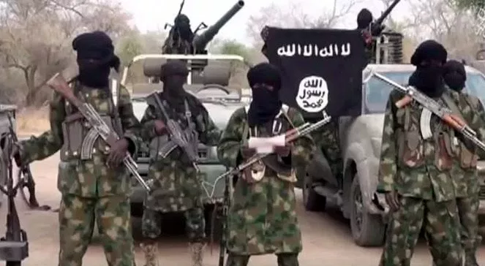
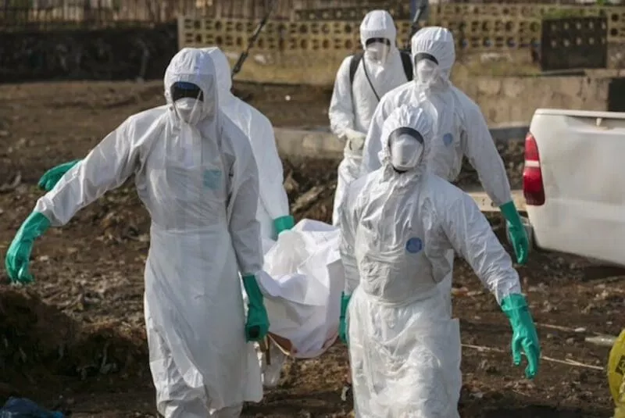
Africa
War in Darfur: Sudan
Genocide against non-Arabs in Sudan
South Sudan becomes independent in 2011
Boko Haram: Nigeria
Anti-Western, Branch of ISIS
Bombings, shootings, kidnappings, fires
Benghazi Attack: Libya
2012: Terrorists attack US diplomatic building
2016 Election: Did Clinton drop the ball?
Ebola
Liberia, Guinea, Sierra Leon, Nigeria, USA, Mali

Slide 4
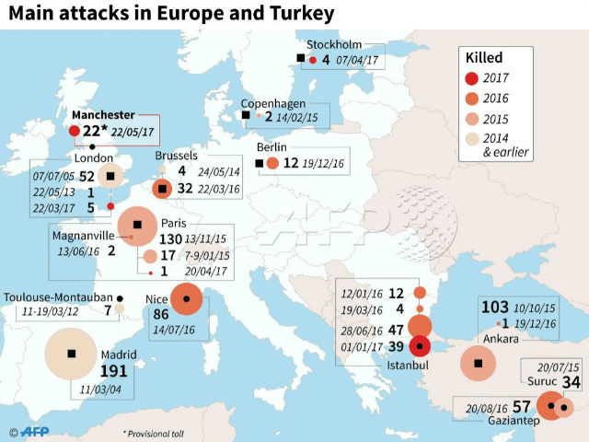
Europe
Financial Crisis
Greece’s money is worthless & drags down the rest of the EUROPEAN UNION.
Britain votes to leave the European Union
Refugee Crisis
Middle Eastern & African refugees escape to Europe: Jobs, Peace, Prosperity
Mixed reactions in Europe: Hungary vs Germany (Angela Merkel)
Terrorism
London Underground Bombing, Charlie Hedbo Attack, Paris attacks
Paris Climate Agreement

Slide 5
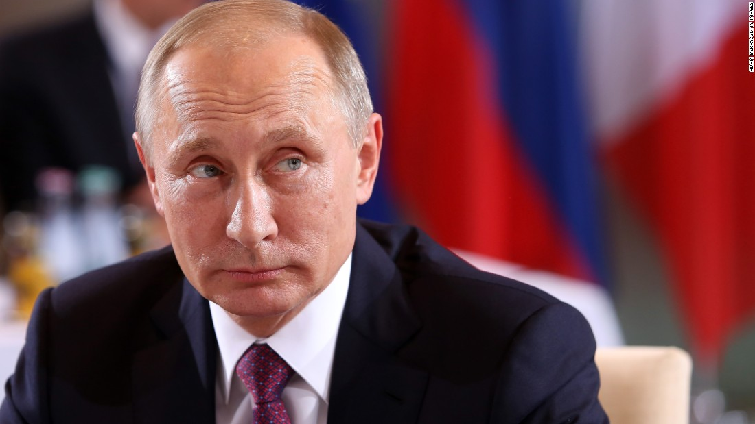
Russia
Vladimir Putin (Since 2000)
2013: Ukraine protests new leader of their country, Russia invades
Backs Assad in Syrian Civil War
2016 Election
Russia hacks 20+ states’ elections to undermine democracy. Several members of Trump administration had talks with Russia (results unclear)
Computer/Social Media Bots still

Slide 6
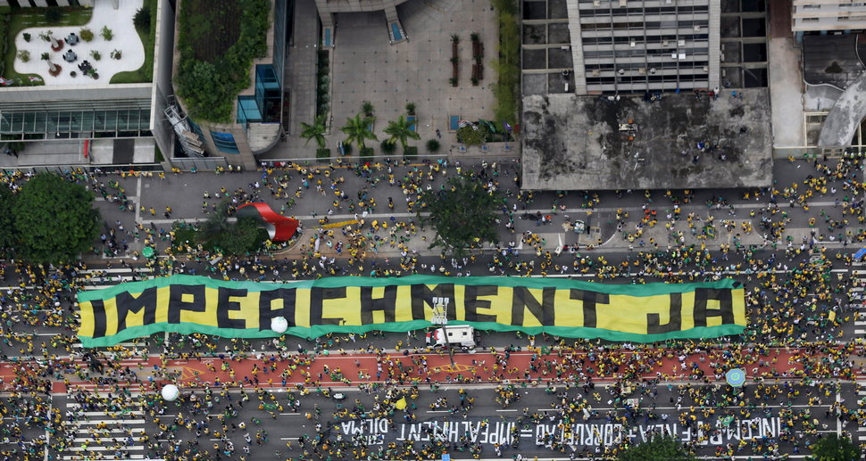
Latin America
Cuba
2014: End of 57-year Cuba embargo
2016: Fidel Castro died
Trump rolls back travel & trade
Brazil
Huge divide between rich & poor
2014 World Cup
2016 Olympics (& Zika Virus)
President Impeached
Mexico
Illegal v Under documented Immigration
Drawbacks: hurt American jobs, fear of crime, cost taxpayers money to keep out
Positives: pay shopping taxes, do jobs that US citizens don’t want to do

Slide 7
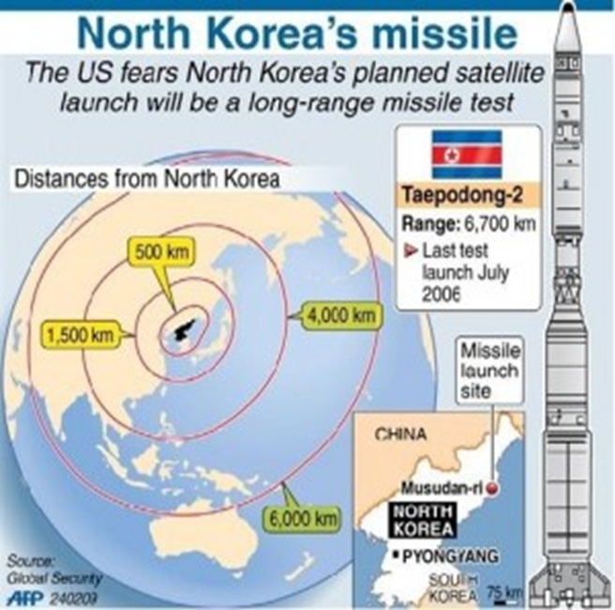
North Korea
1994: Kim Jung-Il leader of N. Korea PRO NUCLEAR WEAPONS
2005—North Korea declared that it had Nuclear Weapons.
2006—North Korea tested one of these bombs.
On December 17, 2011, Kim Jong-Il died of a heart attack.
Kim Jong-Un becomes leader at age 28.
Very Anti-American
Trump threatens to attack North Korea
North Korea threatens to attack the USA

Slide 8
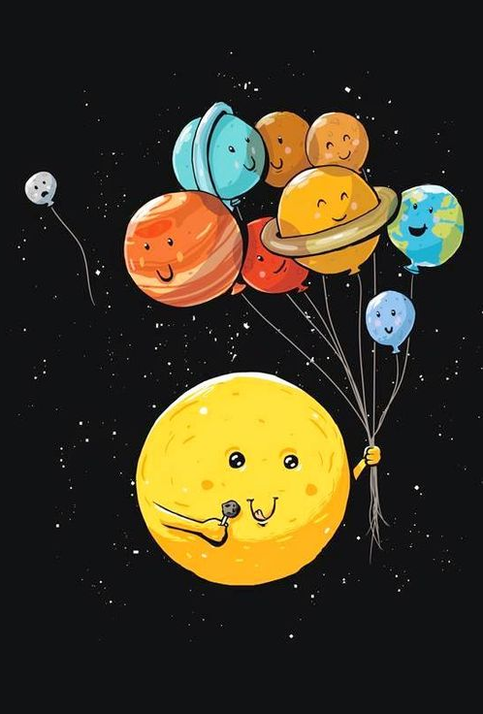
To Infinity…And Beyond!
2006: Pluto is no longer a planet
2013: a human breaks the sound barrier
2014: European Space Agency lands on a comet
2015: Water on Mars!
2016: NASA finds 9 planets that could support life

