Slide 1
The 1980s

Slide 2
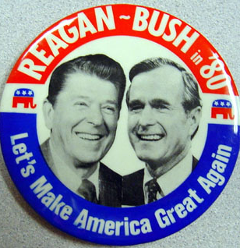
“Let’s Make America Great Again”
Carter was ineffectual
Rise of Conservative Christian fundamentalism
Family values
Supported by Vietnam-era
Democrats
Promised:
Low taxes
Small government
Strong military

Slide 3
Domestic Policy
Low Taxes: “Trickle-Down Economics”/”Reaganomics”
Tax cuts (Welfare cuts for poor; tax cuts for rich)
encouraged investment of wealthy
Cut many of the Great Society programs, increased military spending
Small Government: Deregulation
Telephones, transport, automobile factories
Effect on environment?
End of decade: Top 1% own 40% of Wealth
1980s banking habits + Credit Cards → October 19, 1987 Crash (“Black Monday”)
And yet…
Recession ends in 1982
100,000 new millionaires daily

Slide 4
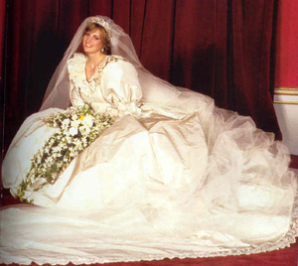
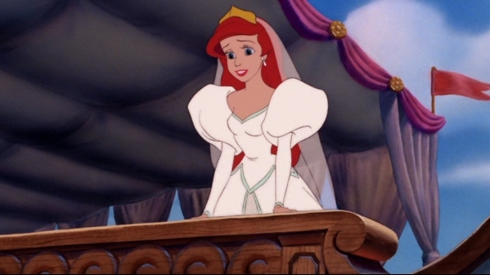
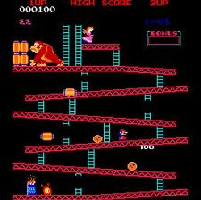
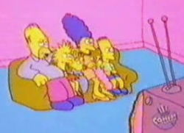
“Modern Families”
Return to Traditional Values
Weddings
TV shows: Bill Cosby, Family Ties
Backlash: Simpsons, Roseanne
Individuality & Isolation
Fast Food
Video Games: PacMan, Donkey Kong, Legend of Zelda
Personal Computers
Cable Television: MTV, CNN, HBO

Slide 5
Crisis of the 1980s
AIDS (Acquired Immune Deficiency Syndrome)
First victims: Gay men, Bisexuals, Drug Users, & Blood Transfusion Recipients
Fear among gay & straight Americans
Mainstream actors & athletes come out with HIV & AIDS
“Make Love Not War” → “Safe Sex”
Dovetails nicely with Conservative ideals
DRUGS
Nancy Reagan “Just Say No”
George H.W. Bush = tough on crime
Cocaine
Powder Cocaine = high 15-30 minutes; dangerous, more expensive used mostly by whites
Crack Cocaine = high 5-10 minutes; more dangerous, cheaper, used mostly by blacks
Drug Use Declines by the end of the Decade

Slide 6
Foreign Policy
1982: Israel invades Lebanon
Lebanon more susceptible to attacks between rival groups (PLO, Muslims, & Christians)
US, France & Italy send in troops to maintain order
1983: Suicide bombers blow up Marine barracks
1984: US withdraws
Iran-Contra Scandal
CIA used to arm & train Nicaraguan anti-Communist, Anti-Cuban Contras
1986: We learn that Military sold arms to Iran (to help release the Americans in Lebanon)
1987: 2 National Security advisors, CIA director, Secretary of Defense, Secretary of State all implicated

Slide 7
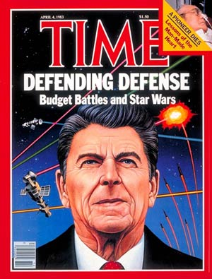
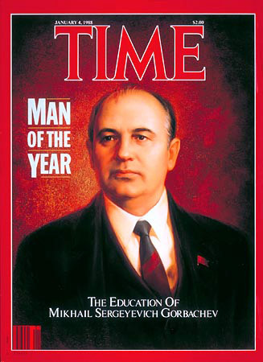
Foreign Policy
USSR = “Evil Empire”
“Star Wars” (Strategic Defense System)
“ships” in orbit with lasers
1985: Mikhail Gorbechev comes to power
Glasnost & Perestroika
1987: Reagan & Gorbechev sign against intermediate-range missiles

Slide 8
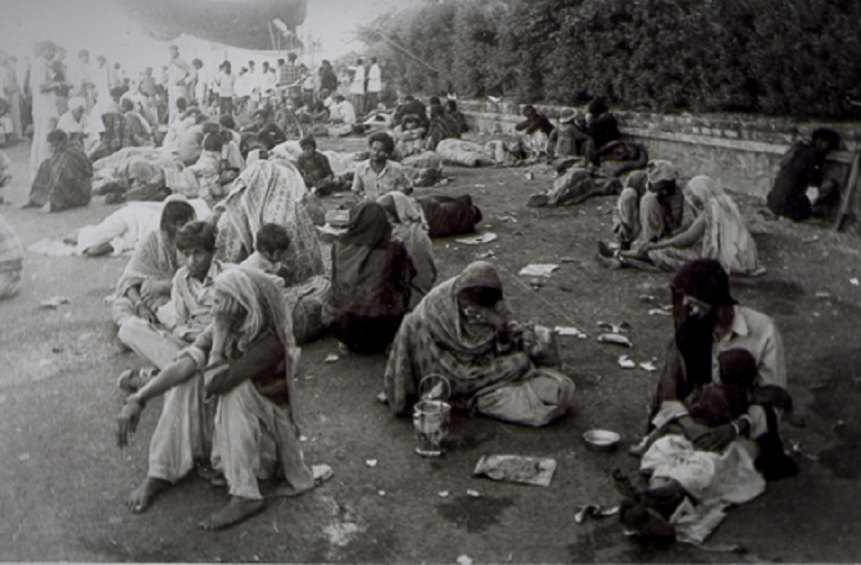
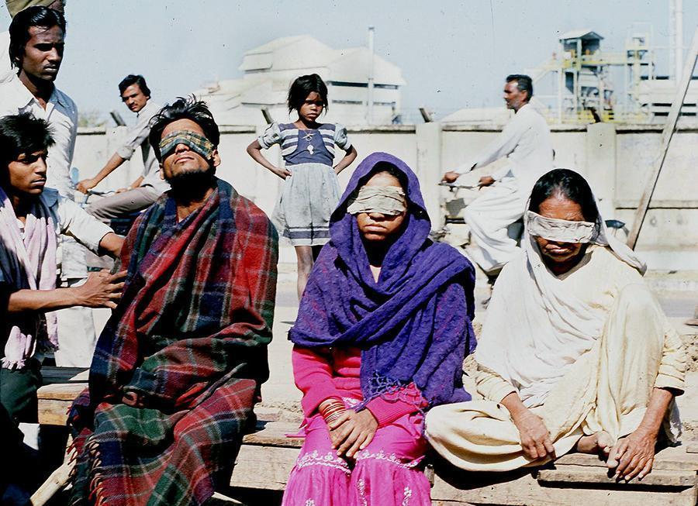
Meanwhile in India…
1984: Sikh Protest in Punjab, India
Sikhs in the Punjab province fought for self-rule
Squashed by Indira Gandhi.
1984: Bhopal Disaster
Pesticide Plant leaked
500,000 people exposed to toxic gas
16,000 died

Slide 9
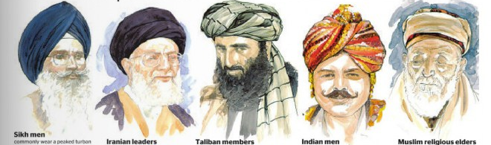

Slide 10
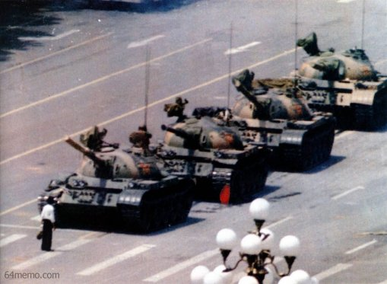
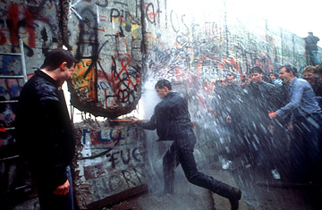
The End of the Cold War
HW Bush (Reagan’s VP) runs for president
Tough On Crime & No New Taxes
1989: Tiananmen Square Riots
Students rise up
Chinese gov’t gets involved
We aid the students, but then afraid of backlash
1989: Europe:
Hungary, Poland, and Czechoslovakia no longer get help
Romanian government collapse
OCT: Berlin Wall flub
1990: Estonia, Latvia, and Lithuania independent; Gorbechev out
1991: USSR collapses. Yeltsin president.

