Slide 1
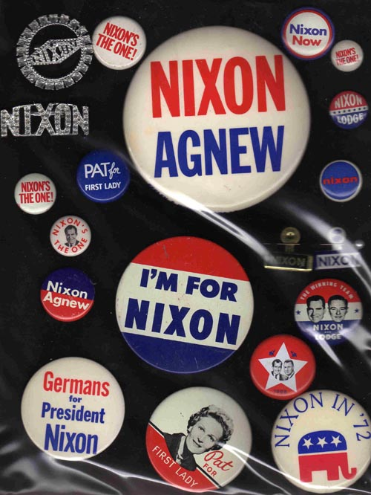
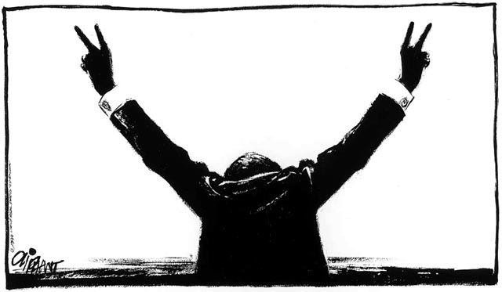
The NIXON Administration

Slide 2
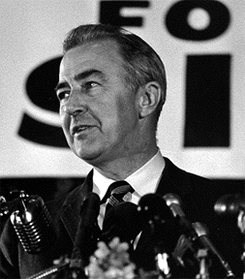
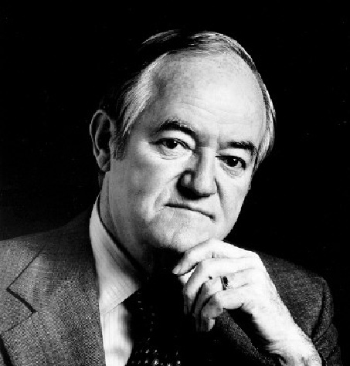
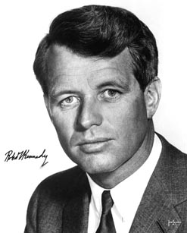
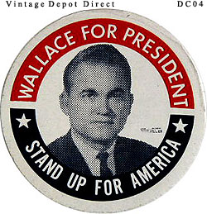
1968 Election
Lyndon B Johnson does not seek a 2nd term
MLK assassinated
Killer: James Earl Ray
Robert Kennedy (D) | Hubert Humphrey (D) | Richard Nixon (R) | George Wallace (3rd party)
Appealed to both poor and affluent | LBJ’s Vice President | Supported by the “forgotten” Americans | White supremacist
Pro Israel; Anti-Vietnam | Supported by party bosses and labor chieftains |  | Anti: welfare, school integration, hippies, protesters
(murdered) | 42.7% | 43.4% | 14%

Slide 3
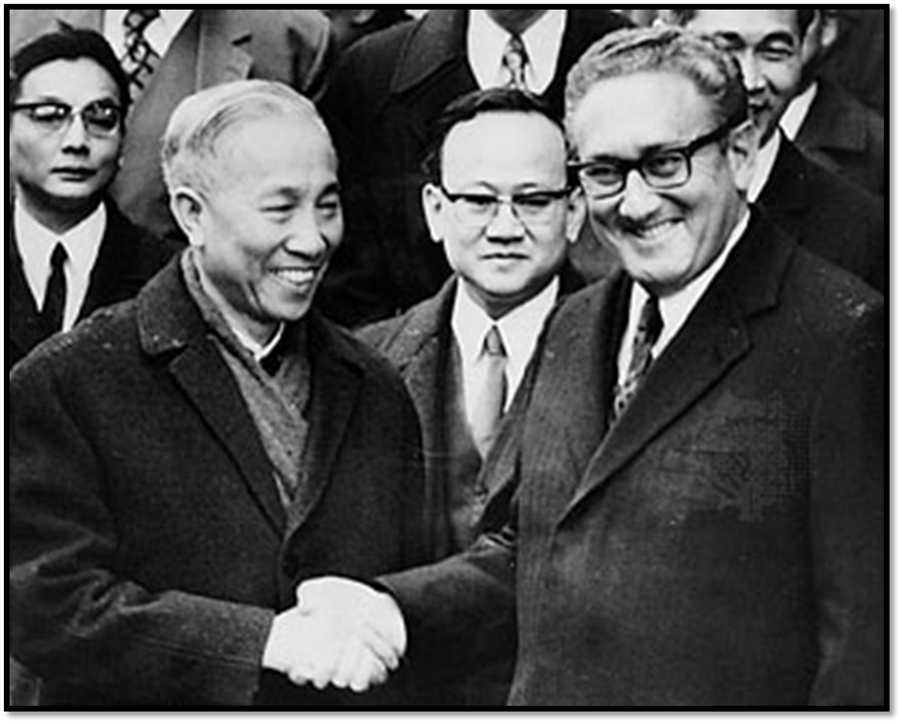
End of Vietnam
1969: Nixon doctrine
Vietnamization
Talk with North Vietnam
Threaten to nuke them
Cambodia and Laos get sucked into the war
April 1972: Easter Offensive
October 1972: Final Talks
US troops leave
We get our POWs back
North Vietnam troops stay in South Vietnam
1973: Paris Peace Accords

Slide 4
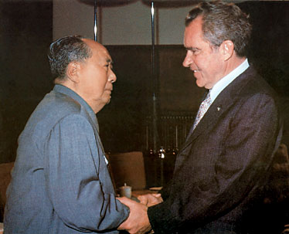
Nixon’s Other Foreign Affairs
China
China doesn’t want to be isolated; we want to play China & USSR off one another
Feb. 1972: Nixon visits
USSR
May 1972: Nixon visits Moscow
SALT I (Strategic Arms Limitation Talks)
Middle East
Yom Kippur War (Oct. 1973)
Oil Embargo

Slide 5
Domestic Affairs
Passed
Price and wage controls
Affirmative action
18 year olds can vote
Proposed “Family Assistance Plan” in 1969
1972 Election
Nixon STILL worried
wiretap the Democratic National Committee @ Watergate
Carl Bernstein & Bob Woodward connect Watergate to the White House
Nixon fires people & finds “enemy” list
1974: 3 almost-impeachments
Obstruction of Justice
Abuse of Power
Contempt of Congress
August 9: Nixon resigns

Slide 6
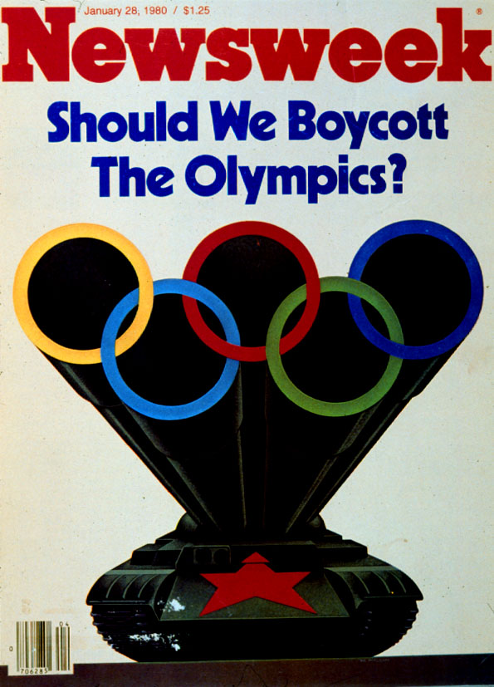
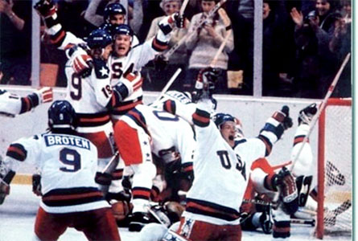
Carter Foreign Relations: Communism
1979: Carter recognizes People’s Republic of China
1972-9: SALT II Negotiations
With Leonid Brezhnev
No more than 2400 weapons systems
We give the USSR wheat
January 1980: USSR invades Afghanistan
SALT II falls apart
Carter boycotts the 1980 Olympics

Slide 7
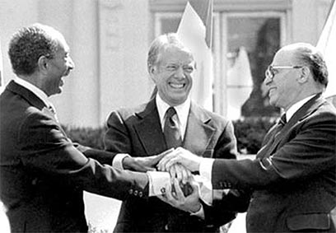
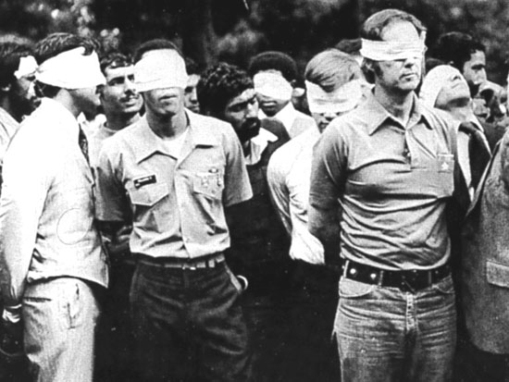
Carter Foreign Relations: Middle East
1978: Carter invites Egypt & Israel to Camp David
Signed by leaders in 1979
Sadat assassinated in 1981
1979: Iranian Hostage Crisis
Iranian Shah flees his country
Ayatollah Khomeini takes over
Iranian student revolutionaries storm the US embassy
Take 64 hostages; 51 kept for 444 days
2 rescue missions

Slide 8
Crisis in the Family
Men
POWs emasculated overseas, emasculated at home
Anti-war children?
Women
1973: Roe V. Wade (14th Am. doesn’t cover the unborn)
Women’s movement splits
Many women = breadwinners
Wasteful families
Home gas consumption & the Oil Crisis of 1973
Women workers = “breadwinners”
Work = personal fulfillment
Unhappy in a job → quit
Happy in a job → obsessed

Slide 9
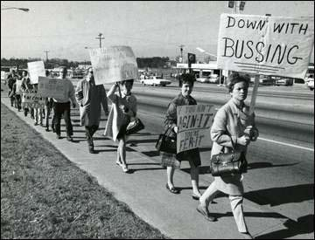
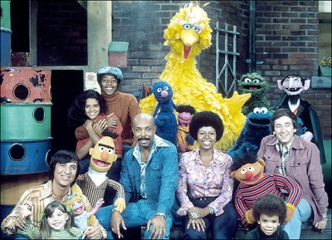
Race
Busing & Affirmative Action
Multiculturalism
Whites feel less racist
Debut of Sesame Street
Native American nations are sovereign
Rise in “ethnic” names & hair

Slide 10
Environment
1960s
1970s
Silent Spring (1962)
Johnson’s Great Society
Suburbs, technology, oil spills, crop poisons
Cuyahoga River Fire (1969)
Death of Lake Eerie (1969)
Earth Day (1970)
Greenpeace
Magazines
Whole Earth Catalogue
The Lorax
Solar Panels on White House (1979)
Three Mile Island Meltdown (1979)
No injuries
Few nuclear power plants built

Slide 11
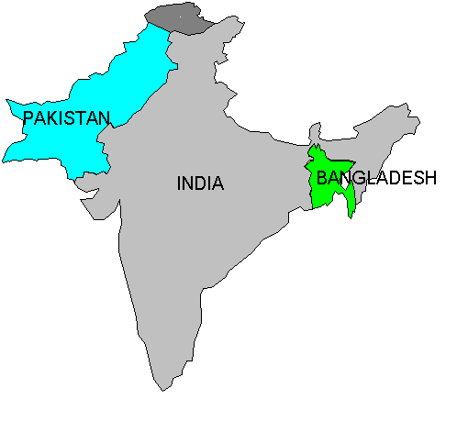
Meanwhile in India
Indira Gandhi
Leader of India
E& W Pakistan go to war
Bangladesh is created
USA joins
Sterilization Policy

