Slide 1
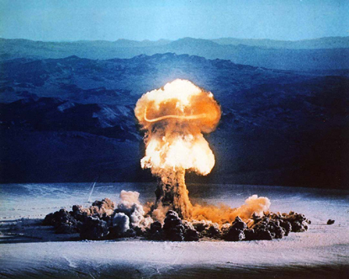
The 1940s

Slide 2
Yalta Conference: FEB 1945
Unconditional surrender of Germany
Reparation council in Russia
Communist Provisional Government of Poland
The United Nations
Stalin wanted all Soviet Socialist Republics to be in the UN
Russia agreed to fight Japan within 90 days after the defeat of Germany.

Slide 3
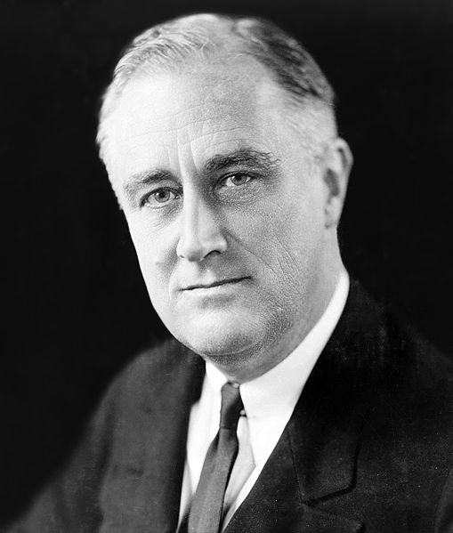
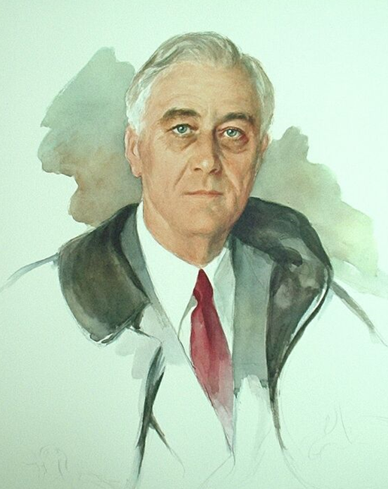
FDR: 1930s versus 1945

Slide 4
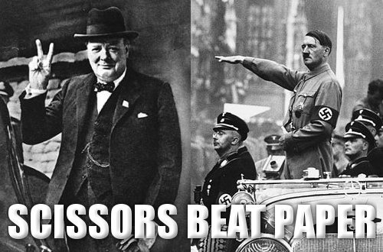
Ending the European Front
British & US troops attack Germany from one side, Russia from the other.
Hitler commits suicide April 30, 1945
Germany surrenders May 2

Slide 5
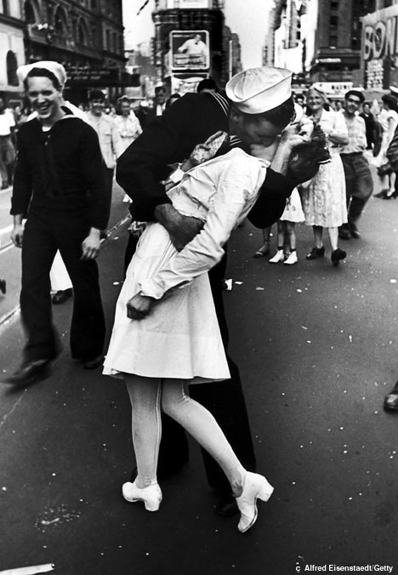
Ending the Pacific Front
FDR dies April 12
We want unconditional surrender
Hiroshima (August 6) & Nagasaki (August 9)
Russia enters the war August 9
Japan surrenders September 2

Slide 6
Japan Occupation: 1945-1952
GOAL #1 : punish & reform
Emperor is
not holy
US picks
new leaders
No weapons
or colonies
GOAL #2: revive economy
Inflation
Lack of food
GOAL #3:
treaty & alliance
can have weapons back
US base stays in Okinawa

Slide 7
The Build-Up
Stalin needs buffer states (satellites)
Implied by Yalta
To ward off West invasion
However, they…
Are pro-Communism
Would hurt US business
Stalin’s 1946 Speech
Kennan’s “Long Telegram”
Churchill’s Iron Curtain Speech

Slide 8
…and they’re off!
Containment begins: Turkey & Greece
Europe can’t afford to help
Truman asks Congress for money (Mar 12, ‘47)
Truman Doctrine
National Security Council, the CIA, Department of Defense
The Marshall Plan
Eastern Europe likes it, USSR hates it; US loves the business

Slide 9
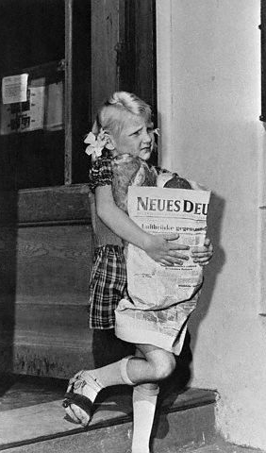
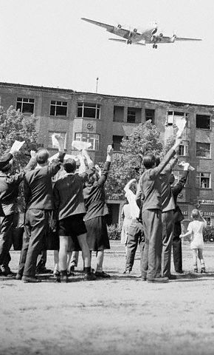
Berlin
USSR takes Hungary and Czechoslovakia
USSR wants Germany
Cuts off Berlin
Now what?
BERLIN AIRLIFT -- 1948
1949: NATO (North Atlantic Treaty Organization)
1955: Warsaw Pact

Slide 10
Postwar: The GI Bill
When veterans came home…
High divorce rates
Hard adjustment to “normal” life
Worried about jobs
1944: Servicemen’s Readjustment Act
Job priority
Low-interest loans for homes
Paid college / job training
Creation of state and community colleges

Slide 11
Meanwhile, in SOUTH AFRICA
South Africa was independent from Britain in 1931.
Their industry, plus fighting in WWII, attracted black African immigration. This led to loss of white African jobs.
In 1948, they elected the National Party into power, which legalized Apartheid.
Separate living areas
Separate jobs by race
No mixed marriages
Going against Apartheid = “Communism”

Slide 12
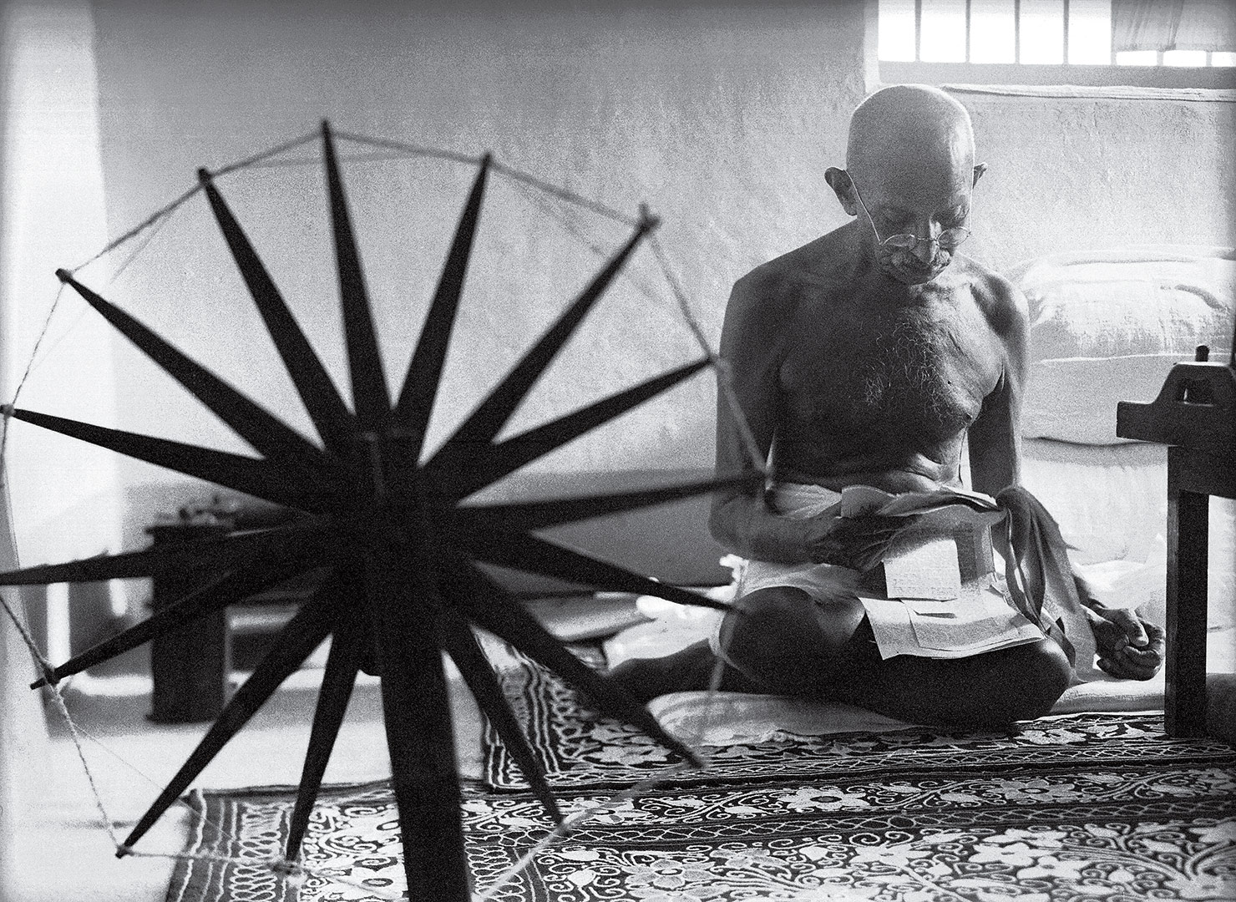
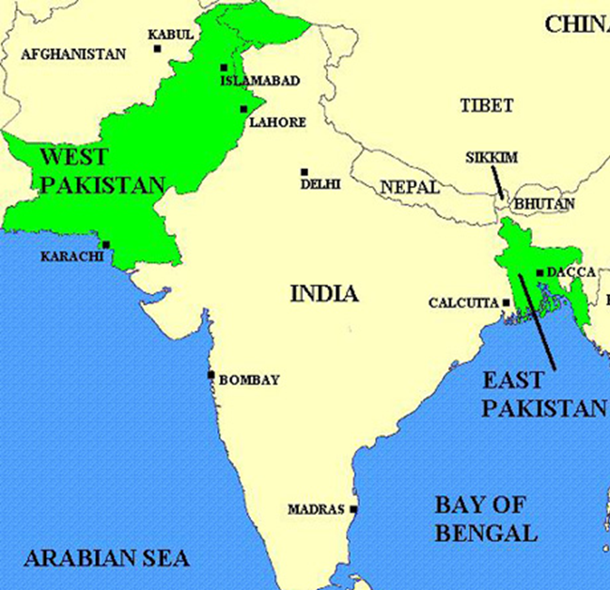
Meanwhile, in INDIA
Gandhi (& 60,000 others) jailed in the 1930s for Civil Disobedience. The World Watched as the British killed unarmed Indians.
1947: INDIANS UNITED and Britain ran
1948: Gandhi assassinated
After independence two countries were created:
India was reserved for the Hindus
West & East Pakistan was reserved for the Muslims
Hindu-Muslim violence killed one million people
10 million crossed borders: Hindus to India, Muslims to Pakistan

Slide 13
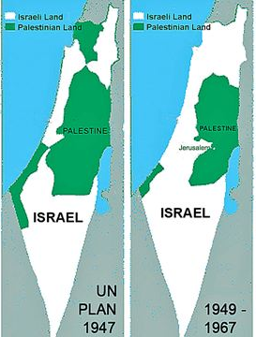
Meanwhile, in the MIDDLE EAST
2/3 of Jews in Europe die in the Holocaust
Many that live run to British-owned “Palestine”
The British turn it to the United Nations. The Jews accept the map, but the Arabs do not.
The Jews go ahead and declare Israel a nation – and the Arabs go to war.
700,000 Arab refugees

Slide 14
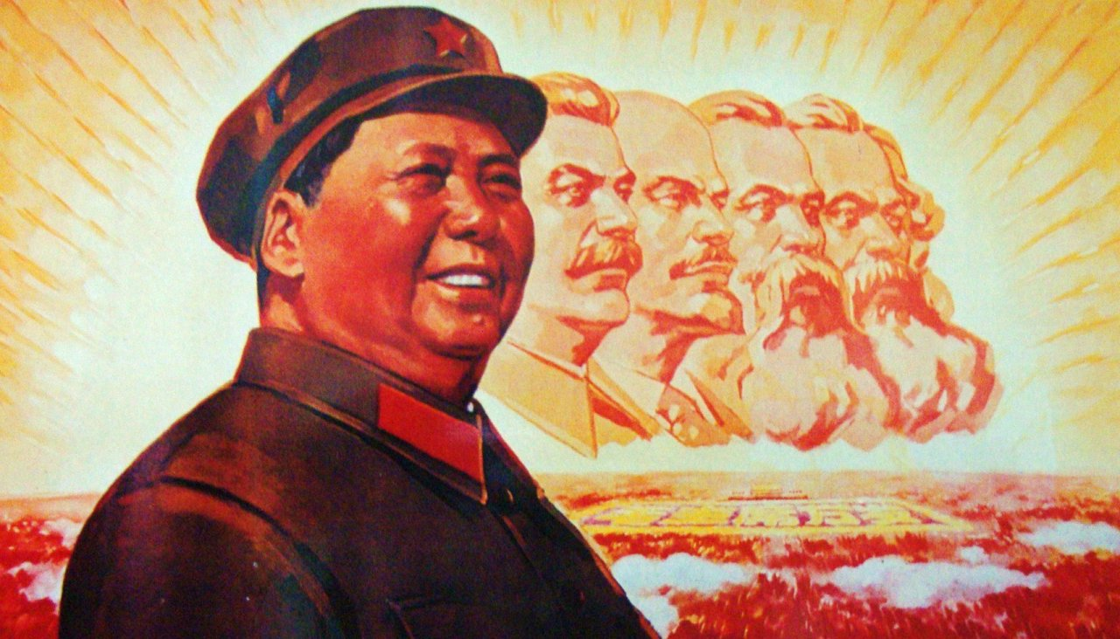
Meanwhile, in CHINA
In the 1930s, Mao Zedong (Communist) fought the Nationalist government.
All fighting stopped as both sides grouped together to fight the Japanese in WWII
After WWII, Mao quickly won the civil war.

