Slide 1
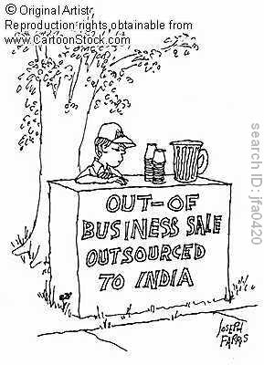
Opener: 3/10 - #10
Analyze the political cartoon and explain what you think it means in 3-5 complete sentences.

Slide 2
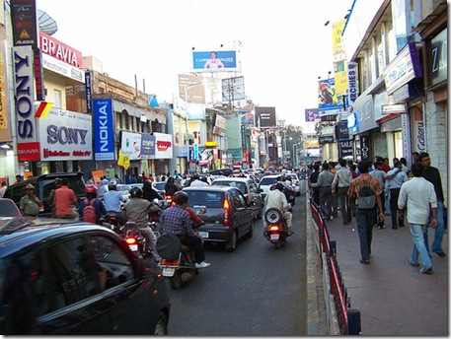
South Asia’s Economy
South Asia is the poorest region in the world after Sub-Saharan Africa.
Many South Asians are
migrating to urban areas,
primarily in search of
better jobs and higher
wages.

Slide 3
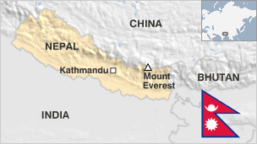
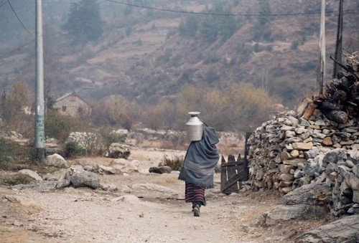
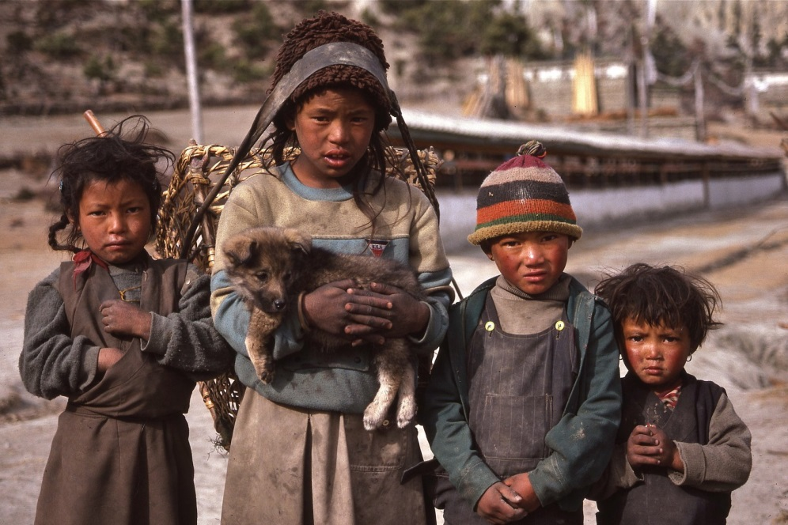
Nepal
Nepal is among the poorest and least developed countries in the world, with about one-quarter of its population living below the poverty line.

Slide 4
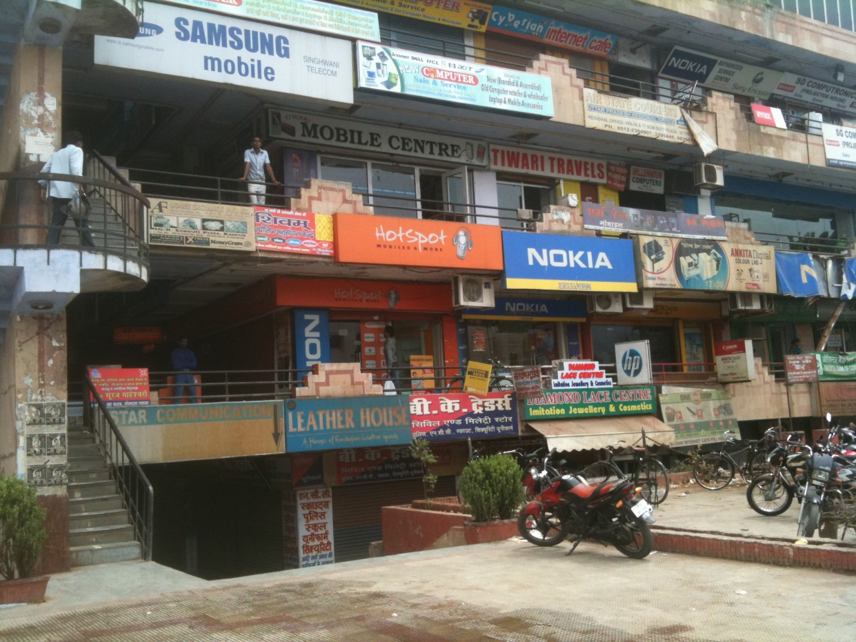
Outsourcing
Outsourcing: The term used when a company moves part or all of it’s business/operations to another country; usually done to reduce cost.
Many American
companies are
sending jobs to
India.
Results??

Slide 6
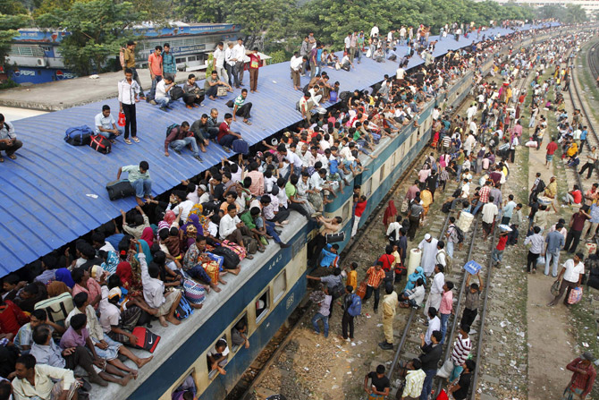
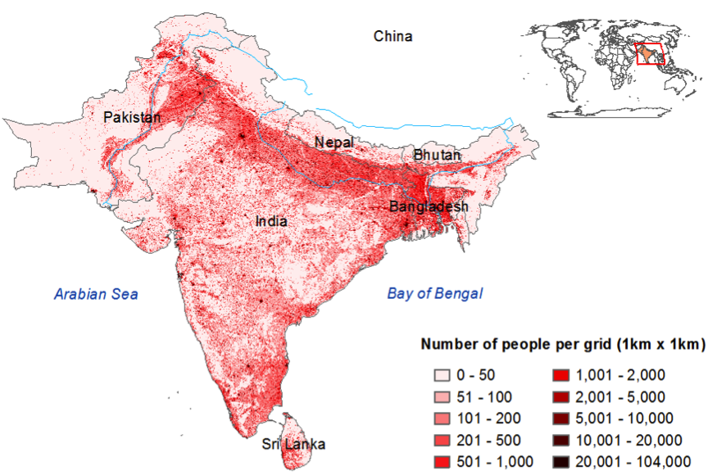
Overpopulation
Of the 10 most populated countries in the world, 3 are located in South Asia:
India (2)
Pakistan (6)
Bangladesh (8)

Slide 7
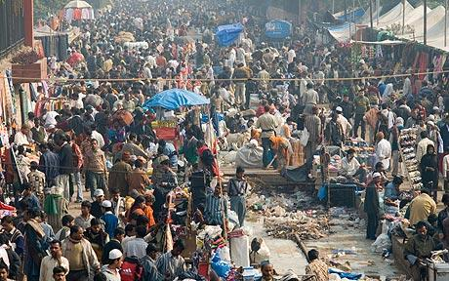
India
India’s population is growing so rapidly it will soon surpass China as the most populous country in the world.
India’s population
today –
1.2 billion
people

Slide 8
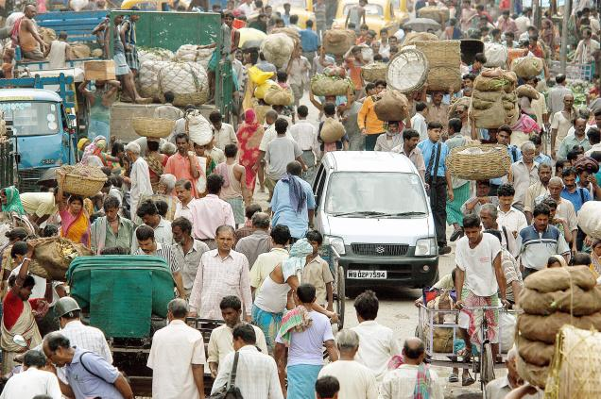
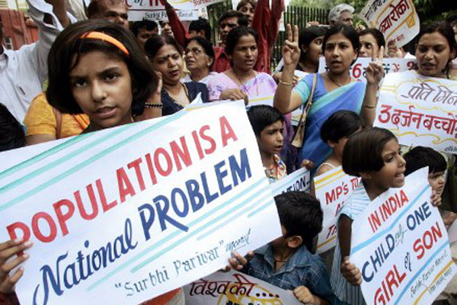
India’s Population
Southern India is more urbanized and educated with lower birth rates
Northern India is still rural with women still having an average of 5 children in their lifetime
Male preference; 35 million fewer women than men

Slide 9
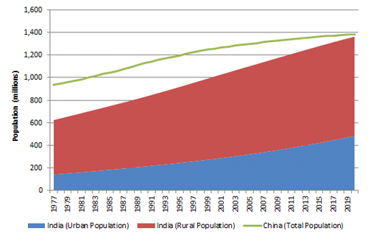
Population Growth
If birth rates in the north do not change India’s population will double by 2050!

Slide 10
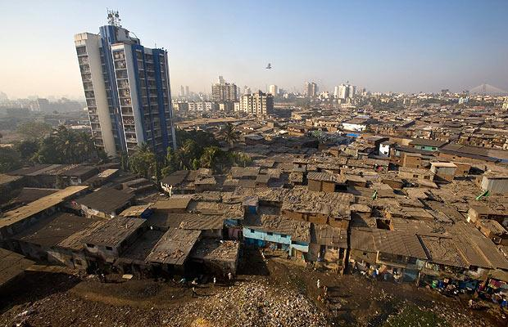
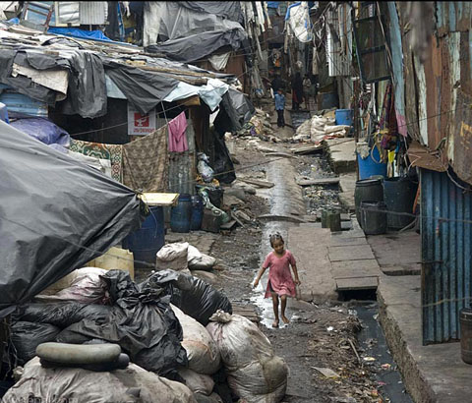
Slums
65 million Indians live in slums
A slum,, has been defined as residential areas where dwellings are unfit for human habitation by reasons of disrepair, overcrowding, and lack of ventilation, light or sanitation facilities.

Slide 11
Socrative – Space Race
Go to b.socrative.com
Teacher’s Room: 0b2f0875
Enter BOTH of your names
Example: AshleyAndrew
DO NOT START UNTIL I SAY GO!!!

Slide 12
Current Issues
Vice
Mumbai Slumscrapper (min 17)
https://www.youtube.com/watch?v=8TMKyUdEEMo
Bonded Labor in Pakistan (min 16)
https://www.youtube.com/watch?v=7Yq-sfWSWLg

