Slide 1
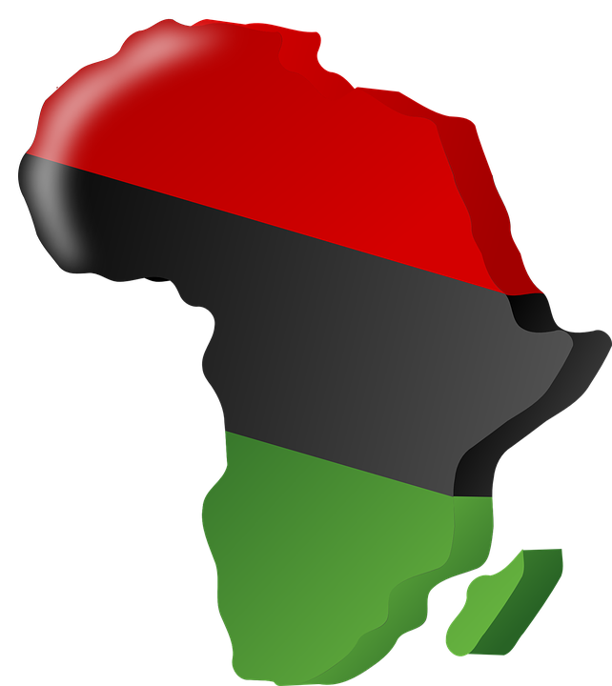
Songhai Empire
By;Tarique, Brantley, Darrian, and Tahj

Slide 2
Beginning
The Songhai had a fishing and trading center on the Niger river.
Songhai Influenced and converted to islam.
Songhai people ruled by Mali.
Forced to pay taxes.
Mansa Musa kidnapped the king's sons.
Prince Ali Kolon escapes and establishes The SUnni Dynasty.

Slide 3
Decline
After Sunni Ali’s Disappearance, His son became king.
The new king had advances in military ,created new laws, encouraged new math ideas.
Decline happened after the end Askia Muhammad’s reign
After the disastrous defeat at the Battle of Tondibi (1591), the Songhai Empire collapsed.

Slide 4
Religion
The people of Songhai followed the african religion of witch doctor, spirits, and magic.
They were polytheistic at first.
But leaders of Songhai were Muslim, religion was Islam.
The Songhai people became Muslim after the muslims from the north came in contact with the Songhai in the early 1010.
They followed the islamic practises.
Prayed 5 times a day.
Avoid alcohol and pork.
Observe the one month fast of Ramadan.

Slide 5
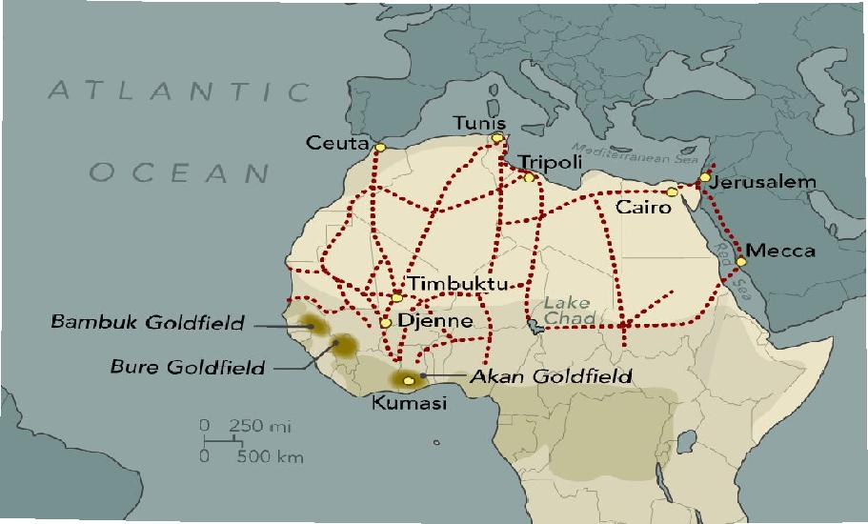
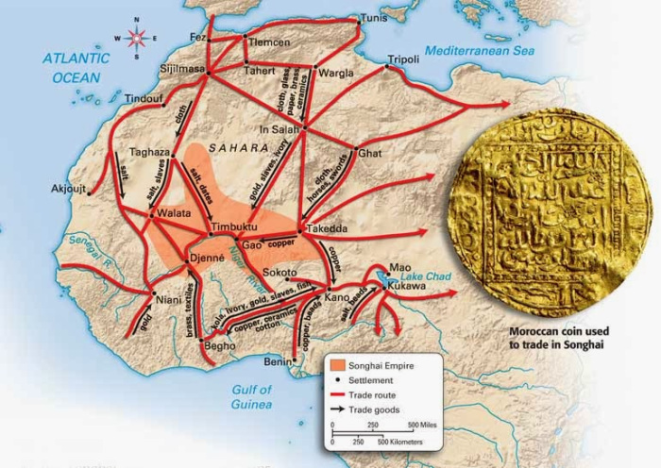

Slide 6
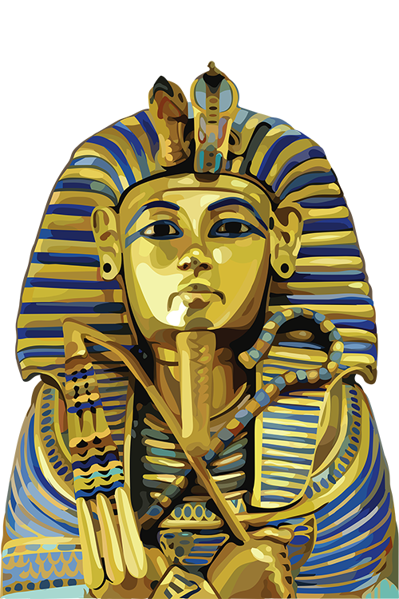
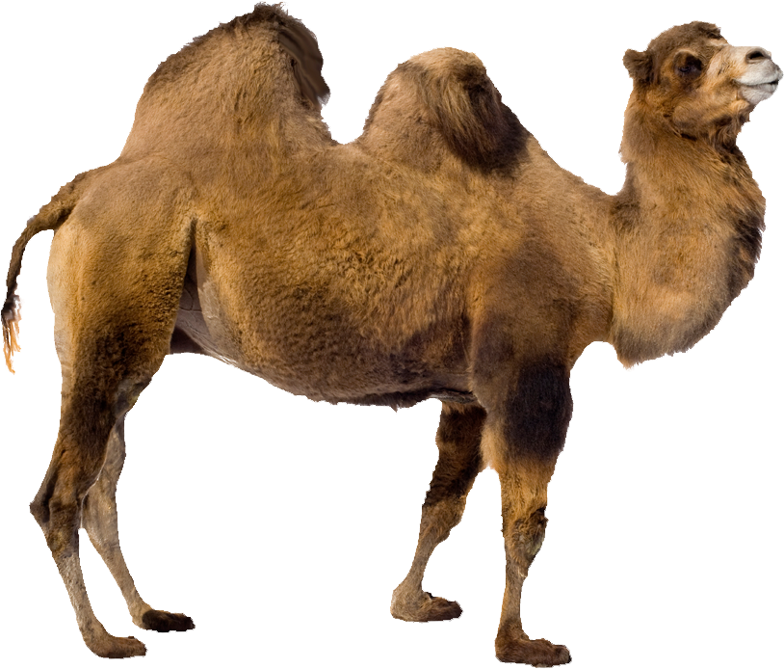
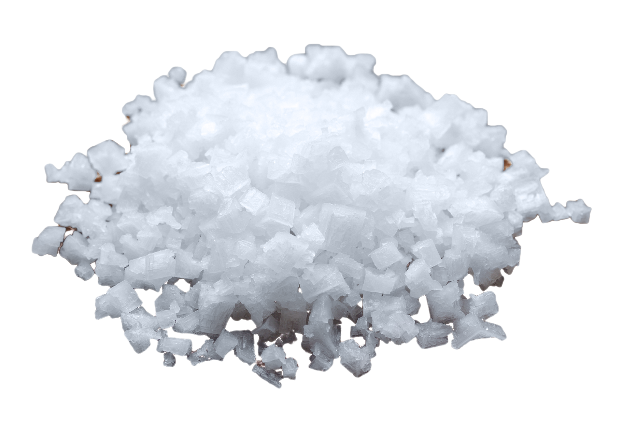
Trans-Saharan African Trade
Trans-Saharan Africans wanted gold.
To travel across the Saharan Desert, they needed Camels. This spread Islam across
In exchange for gold, they wanted salt.
Notes:
In the above slide is a map of trans-Saharan Africa’s trade route.
When the Berber-speaking peoples first started to use Camels, they were able to travel across a large expanse of the Sahara Desert, which allowed for better trades.

Slide 7
Extra Facts About The Songhai Empire
West Africa’s Niger River provided bigger and better harvests than the Nile. According to Major Felix Dubois, a pioneering French scholar on the Songhai Empire: ‘What the Nile has done for Egypt, the Niger has accomplished for the Sudan (i.e. West Africa). In the course of a year we witness the same striking and opposed pictures. The cultivation is as facile as that of Egypt, and is due to the same regular rise and fall of the river. But the Niger shows an even greater munificence in its gifts than does its brother of Eastern Africa.
Even before the era of kings, the horse was an important animal among the Songhai. According to French historian, Jean Beraud-Villars: ‘They learned to use the horse, which will play a very important role in their history.
Salt was the Songhai currency. They mined it in the Berber territories and carried it south by caravan. There were royal storehouses for salt.
The Mali and Songhai Empire had banks. In the words of Lady Lugard: ‘Systems of banking and credit, which seem to have existed under the earlier kings of [Mali], were improved. Banking remained chiefly in the hands of the Arabs, from whom letters of credit could be procured, which were operative throughout the Soudan [i.e. West Africa], and were used by the black travelling merchants as well as by Arab traders.
Gao had a population of 100,000 people. A 1585 AD census suggests that Gao had 7,626 blocks of walled houses, ignoring straw huts. According to Sergio Domian, this suggests a population of 100,000 people.

