Slide 1
RUSSIAn EMPIRE
BY:BANESA MOJICA,RAQUEL HERNANDEZ,LAURA SALGADO,MYKAYLAH TINKER

Slide 2
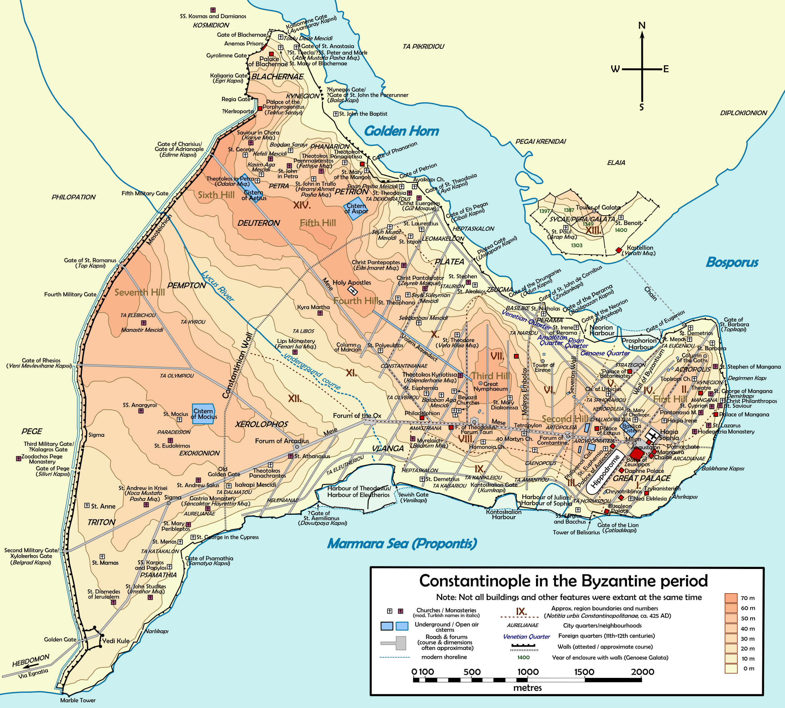
Effect of byzantine culture on Kiev
Kiev was the first major city in russia
Located on a river with access to the Black Sea made trade possible with the Byzantine Empire
Kiev became the center of Russian Byzantine Christianity
The Mongols invade and sack Kiev in 1240

Slide 3
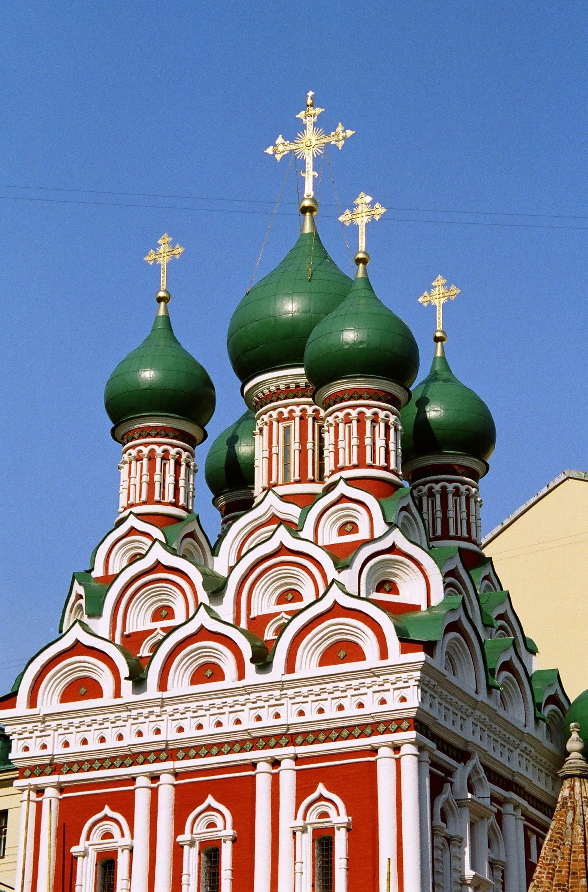
Impact byzantium had on moscow
The new settlement emerged to the north(Moscow)
The church moved its headquarters to Moscow, making it the center of Russian trade and religion
For years Moscow’s rulers paid homage to the mongols who allowed them to keep their religious practices

Slide 4
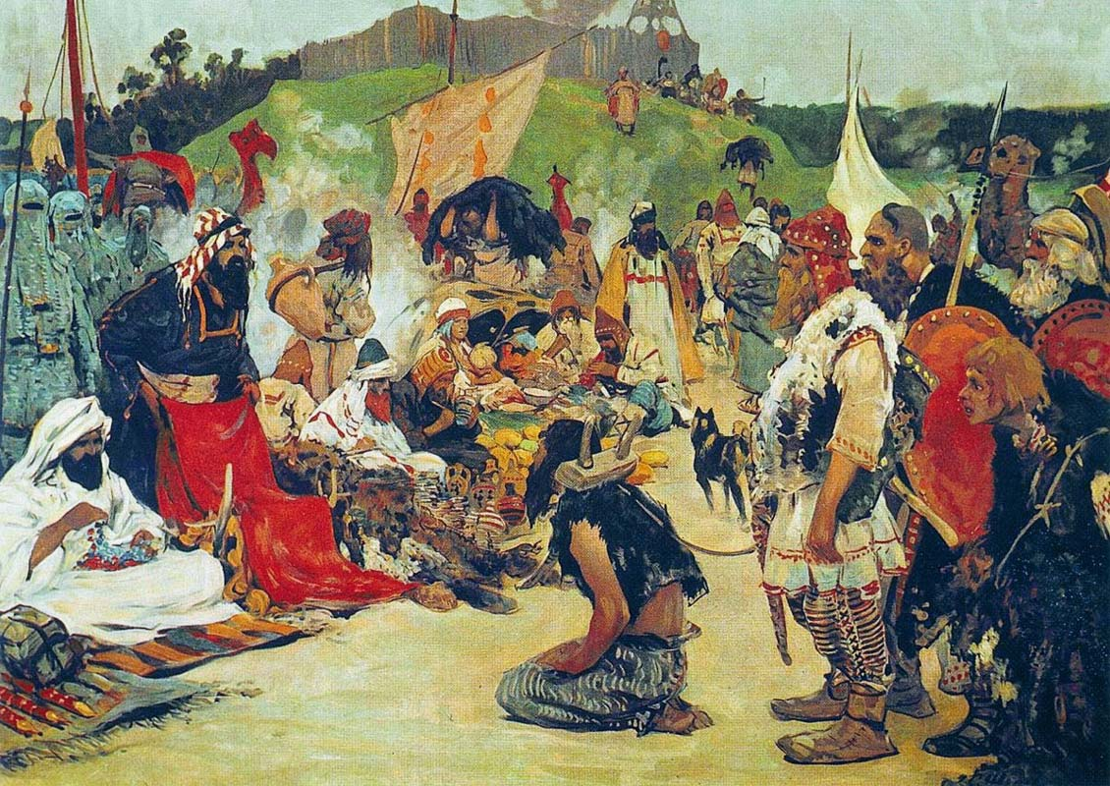
BYZANTIUM IMPACT ON RUSSIA
These early Russians relied on trade with Byzantium for a strong economy and culture.
The rapid decline of byzantium reduced russian trade and wealth.
Also, trade brought Kiev into the Byzantine sphere of influence missionaries converted the Slavs to Eastern Orthodox Christianity.

Slide 5
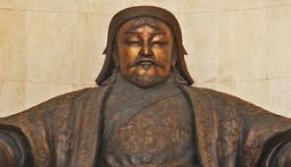
Genghis Khan (Chinggs khan)“Universal Leader”
While Genghis Khan was leader the Mongols conquered 11 to 12 million square miles an area about the size of Africa.
He ordered the adoption of a writing system, forbade the selling and kidnapping women and he banned enslaving any Mongol.
(The Mongols consisted of different tribes which placed all their trust in him)

Slide 6
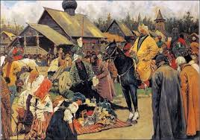
Mongol’s impact on russia
They easily captured the major russian cities(demolished Kiev in 1240)
Russians adopted mongol practice of subjugating women.
Trade routes opened up between China and Eastern Europe.
Absolute power of the mongols served as a model for later Russian rulers.
Subjugating: dominated or control.

Slide 7
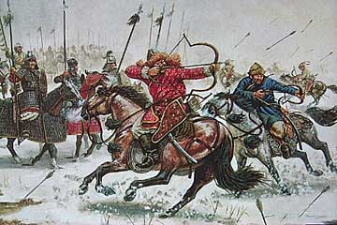
Under the Mongols Russians could…
Follow customs as long as they didn’t rebel
Choose whatever religion they wanted
BUT had to….
Give them absolute obedience
Massive amounts of tributes or payments
Russians agreed to these rules
During this time Russia was isolated to their neighbours meaning they had little access to new ideas and inventions.

Slide 8
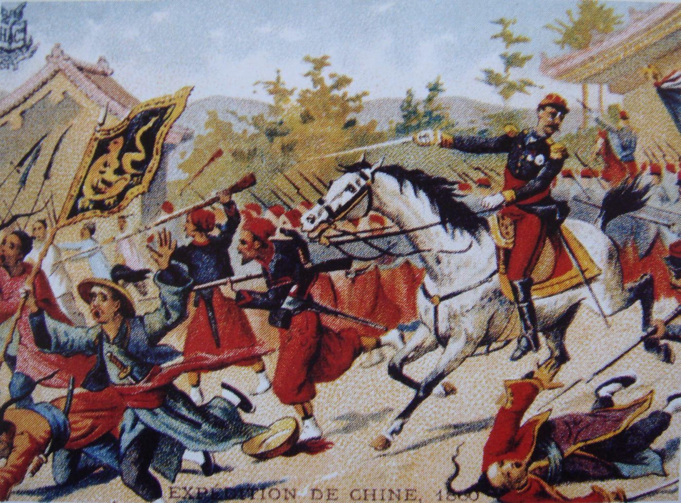
Mongols impact in the middle east
Background:Mongol incursion began in the early 13th century and was lead by Genghis Khan. Conquest was completed around 1250 by Genghis’s grandson Hulagu
Events: Mongols invaded Persia in the 13th century, by the time the conquest was completed the persian population was decreased to barely ¼ of what is was.The Mongols kept the persians in poverty and destroyed the economy.

Slide 9
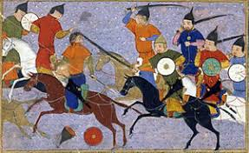
Mongols impact on china
Two Impacts the Mongols had on China were:
The complete reunification of China; having conquered Xixia, the Jin, Kara- Kitai and Song Dynasty.
The Mongols also brought cultural influences from the Middle East into China such as surgery and astronomy.

Slide 10
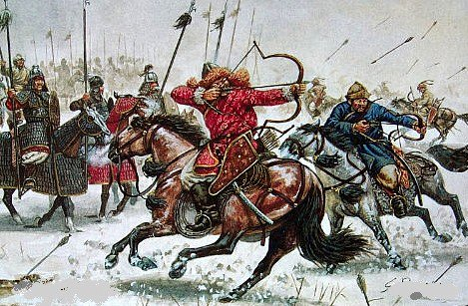
Fun facts about mongol
The women were the ones who called the shots
They ran businesses and religion
Mightiest queen was Mandhuhai
Men did..
-Surprise attacks
-Fake withdrawals

Slide 11
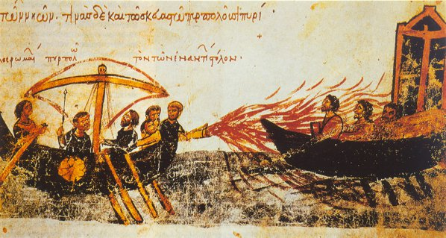
Byzantium fun facts
The art is ENTIRELY focused on religion.
Official language was latin until it changed to greek.
The emperor often paid gold or tribute to enemies.
Dniper and Volga allowed irrigation, food, water, and trade and linked Russian people with Byzantine empire.

