Slide 2
Famine
How Can Hunger kill more people worldwide than Aids/Malaria, but only 1 out of 345 Africans suffer from Famine?
How is famine connected to AIDS & Drought?

Slide 3
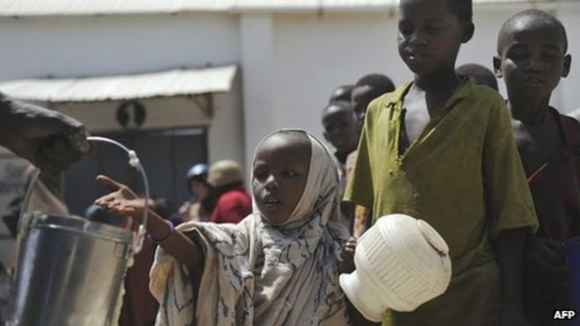

Slide 4
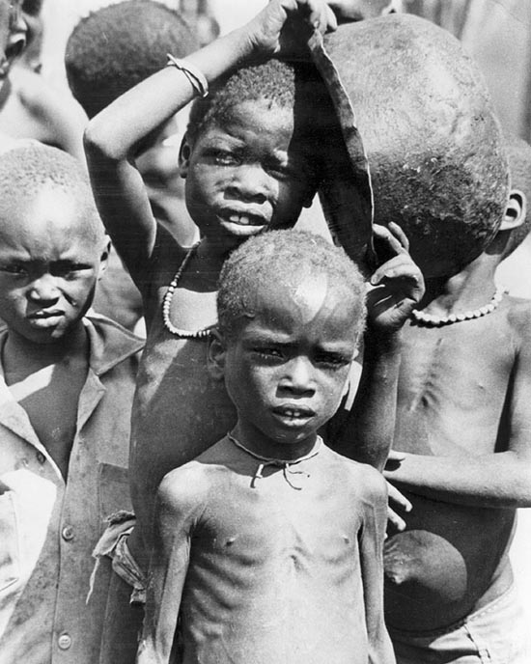
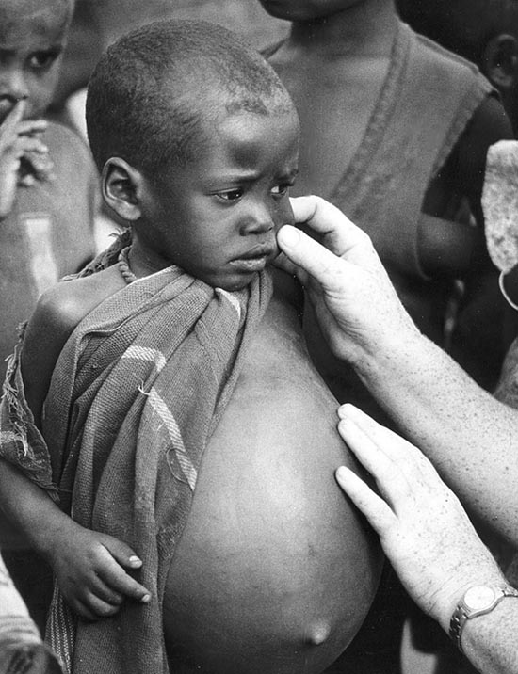

Slide 5
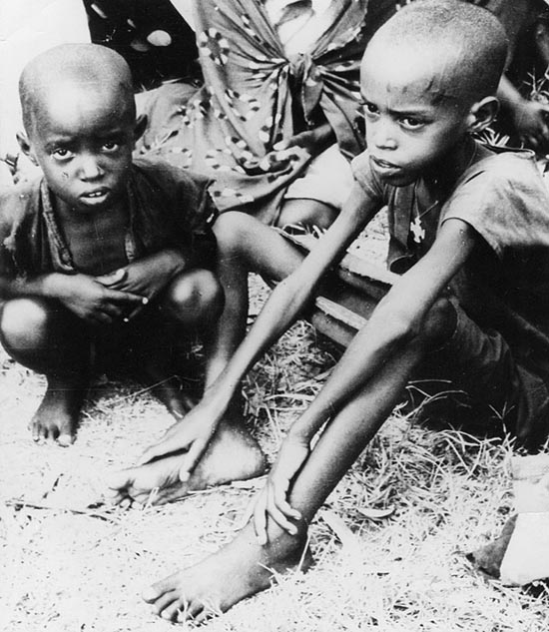

Slide 9
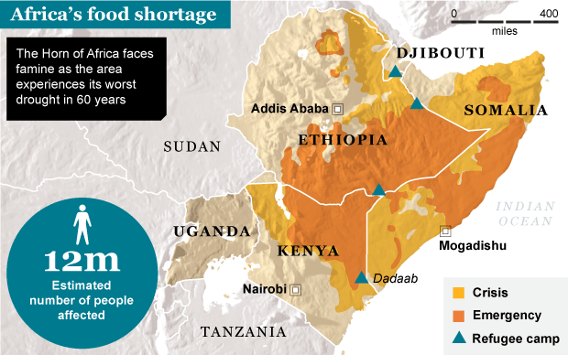

Slide 12
HOWEVER
ONLY
1 in 345 Africans are affected by famine in any given year.

Slide 13
Causes of Famine
Many farmers say that rains have become less reliable in recent years, which could be the result of global warming.
The Sahara desert is certainly expanding to the south, making life increasingly difficult for farmers and pastoralists in places like Niger.
Also, rising populations have led people to farm on increasingly marginal land, even more at risk from even a slight decline in rainfall.
Southern Africa has the world's highest rates of HIV/Aids and this is a major factor in that region's food crisis.
Some of those who should be the most productive farmers - young men and women - are either sick or have died, so their fields are being left untended, while their children go hungry.

Slide 14
Lord’s Resistance Army
Why would the LRA kidnap children instead of adults?
How does the history of colonization relate to the LRA?

