Slide 1
AIDS & Malaria
How does climate affect the spread of Malaria?
Why are children most often victims?
How are the 2 diseases alike?
Why do people put awareness posters at places like parks & Churches?

Slide 2
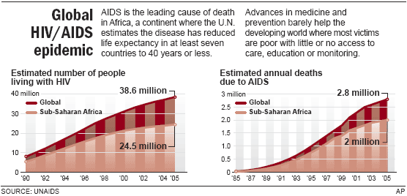

Slide 3
Symptoms
Malaria
AIDS
Pain: in the abdomen or muscles
Whole body: chills, dizziness, fatigue, fever, malaise, nausea, night sweats, shivering, or sweating
Gastrointestinal: diarrhea or vomiting
Also common: fast heart rate, headache, mental confusion, pallor, shortness of breath, or yellow skin and eyes
Pain: can occur while swallowing or in the abdomen
Cough: can be dry
Whole body: fatigue, fever, loss of appetite, nausea, or sweating
Gastrointestinal: persistent diarrhea, or vomiting
Throat: difficulty swallowing or soreness
Mouth: ulcers or white tongue
Groin: sores or swelling
Also common: headache, opportunistic infection, oral thrush, pneumonia, red blotches, skin rash, swollen lymph nodes, or unintentional weight loss

Slide 5
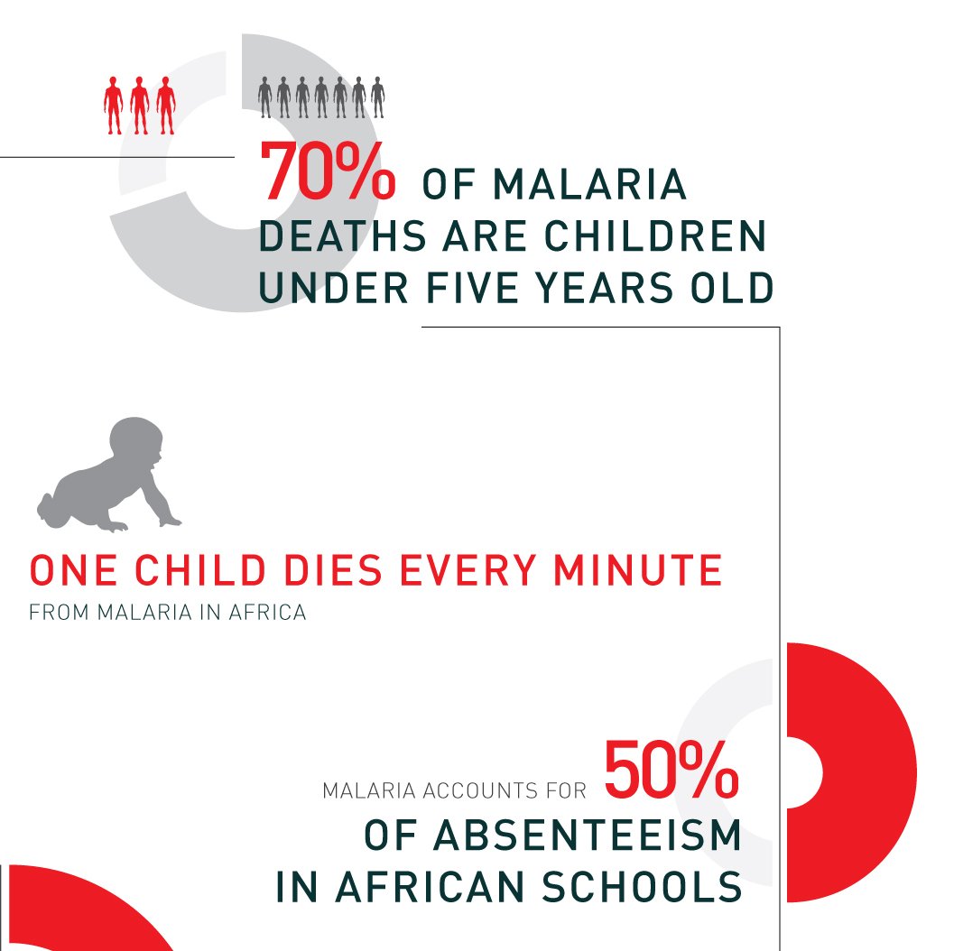
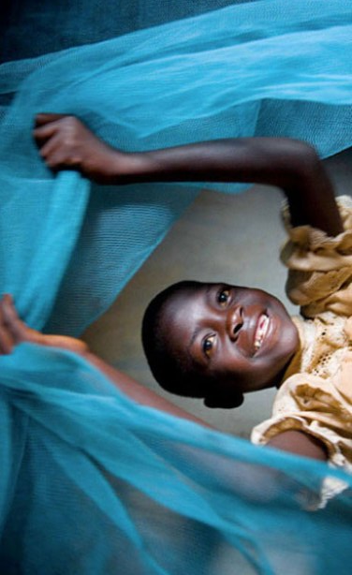

Slide 7
One Story of AIDS in Rwanda
"After finding out about my situation, it was not easy at all. When I was told that I was HIV-positive, I thought it was a joke, I didn't believe it. I spent several weeks feeling sorry for myself, asking myself what happened to me. I cried a lot, I didn't want to accept that I was infected. I could not imagine that I would stay alive for more than a week. When the news of my illness reached my office, I was dismissed outright. My boss thought I would either die very soon or contaminate the other colleagues. I found myself alone without friends or a job, and I realized that there was a problem. I began to accept the hard reality that it was necessary to fight to survive. I had no money, no savings and could not imagine that I would overcome this situation.“
John's girlfriend left him, and he found himself alone with a six-month-old baby. He remembers,
"It was even more difficult as I did not know how to take care of a baby. I did not know how to calm her cries during the night. I used to walk with my baby all day long to find something to eat…but this was not easy because I couldn't walk every day due to my illness."
(John is now receiving treatment due to the SOS Children Rwanda. His daughter also gets checkups to make sure she doesn’t get the disease, too.)

Slide 8
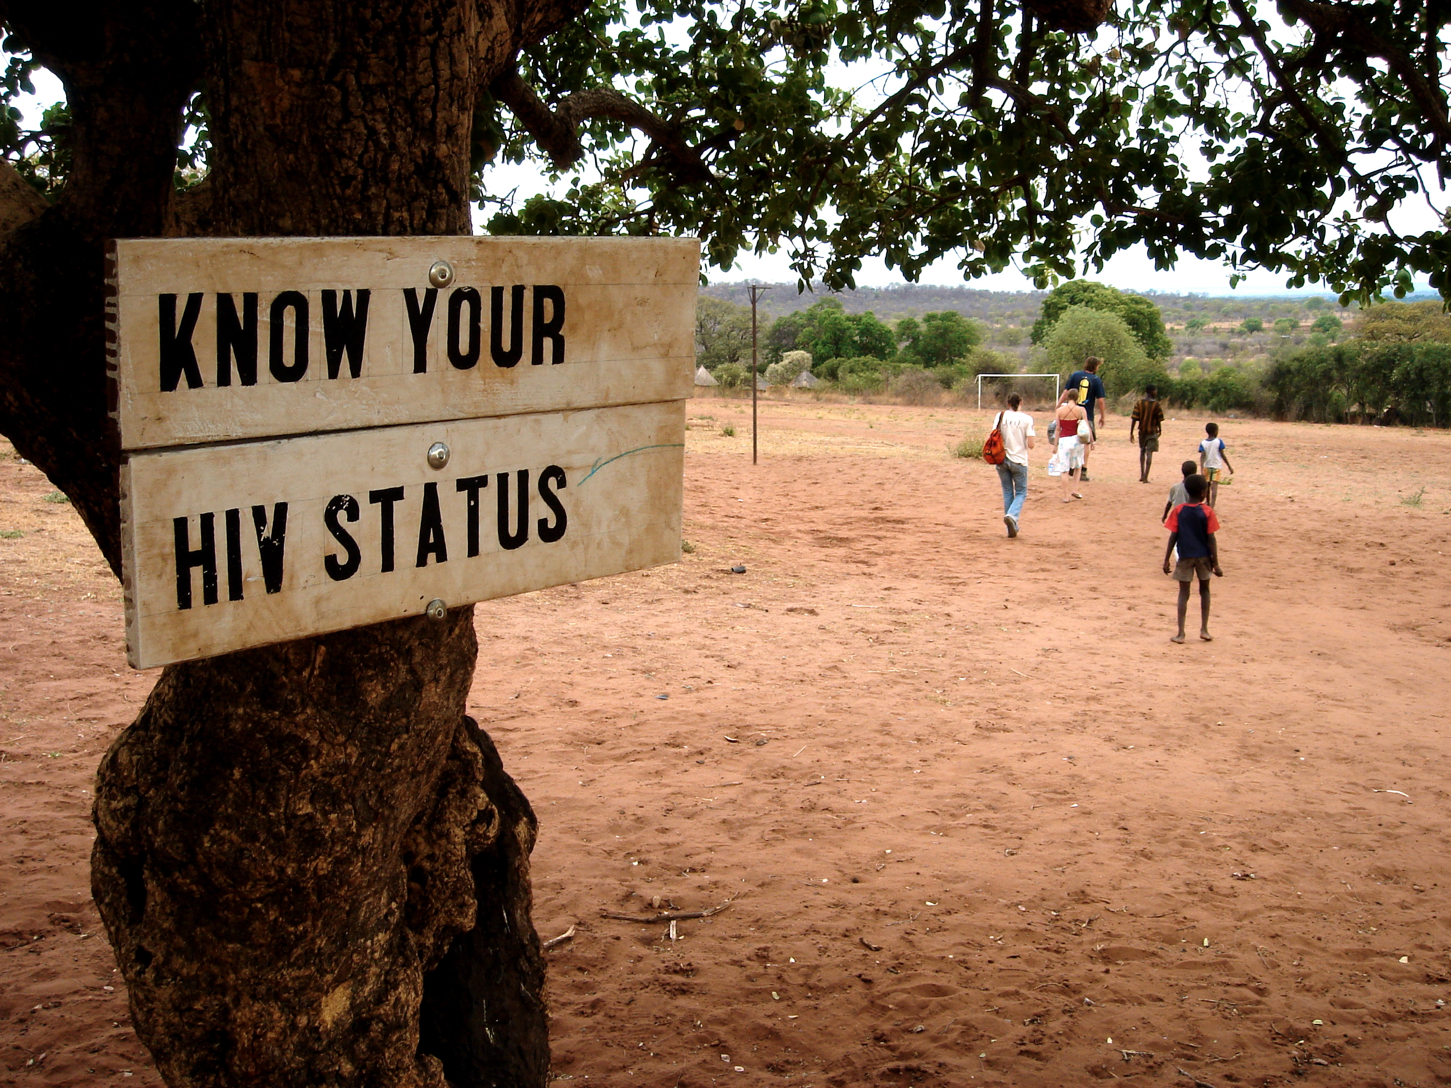

Slide 9
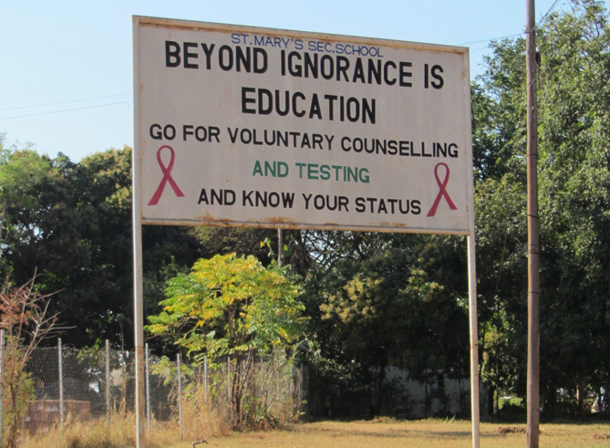

Slide 10
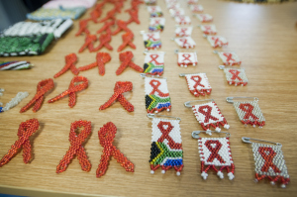
Awareness Pins
AIDS patients in South Africa (at Soweto Hospice) have made these pins to helps spread awareness of the disease to others. They receive food while at the Hospice, but also emotional support from other people living with AIDS.

Slide 11
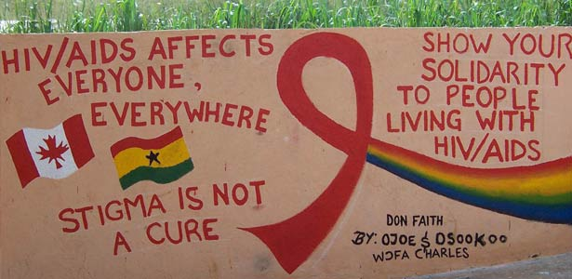

Slide 12
How Stigma about HIV/AIDS spreads the disease even more
People in Africa who have HIV/AIDS have reported the following prejudices against them:
*Loss of Job
*Loss of Family
*Poor care from doctors
*Feeling worthless
*Loss of reputation
This makes LOTS of people afraid to get tested, go to the doctor to get treatment, or tell others if they have HIV. In the end, this secrecy only spreads the disease more and makes the lives of those who do have the disease much worse than they need to be.

Slide 13
Drought
How is climate related to Drought?
Why would drought be worse in the Great Rift ValleY?

Slide 14
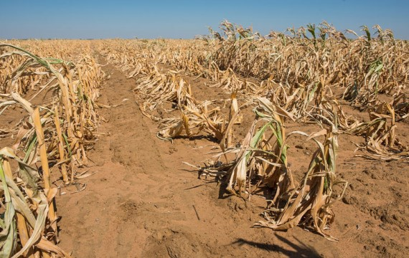

Slide 15
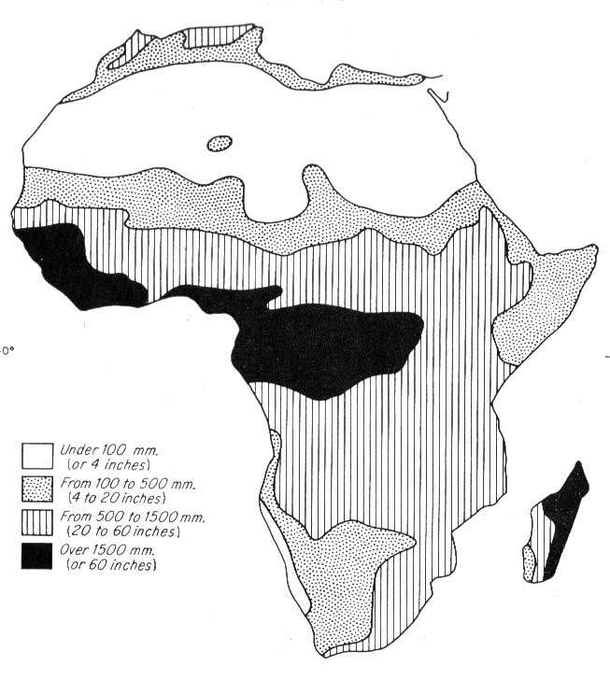
Total Annual Rainfall
in Africa

Slide 16
People walk past a dry riverbed in the Matam region of northeastern Senegal in the Sahel region of Africa

Slide 17
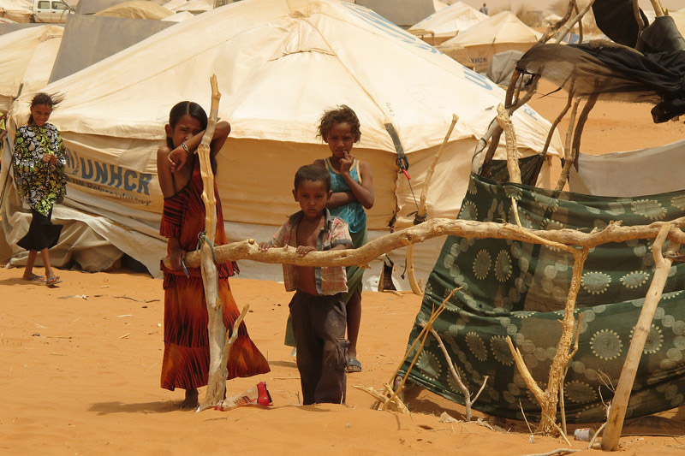
Drought has affected residents of the Mbera refugee camp, Mauritania, in the Sahel region of Africa.

Slide 18
Effects of Drought
Periodic drought occurs naturally in most parts of the world, and has been linked to the migration of early humans from Africa more than 100,000 years ago.
The impact of drought can be reduced through careful land management, and drought alone rarely causes famine: poverty, poor distribution systems and other socio-political factors are also to blame.

Slide 19
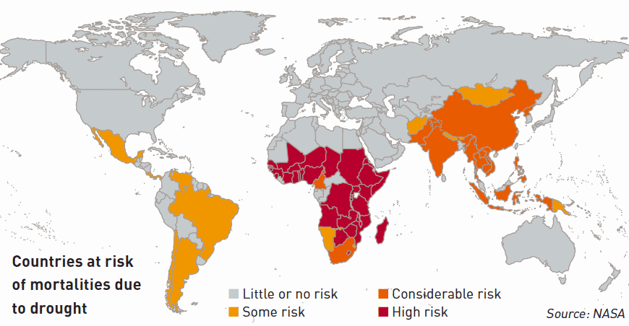

Slide 20
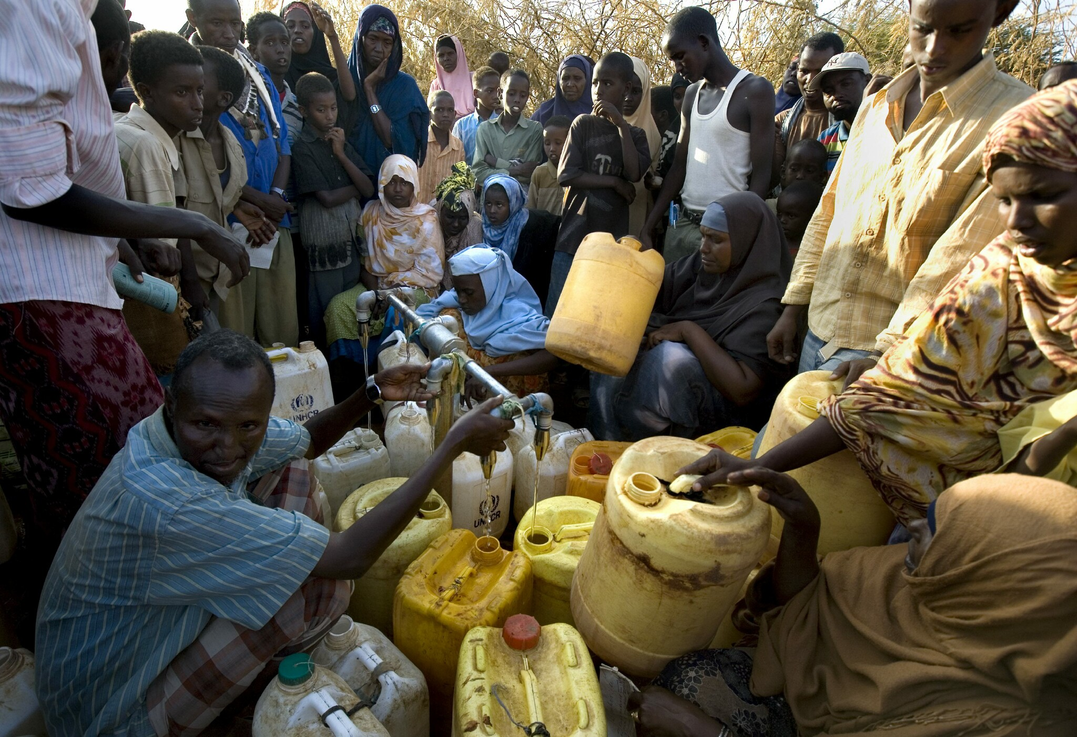

Slide 21
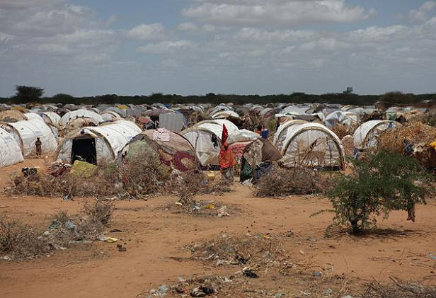

Slide 22
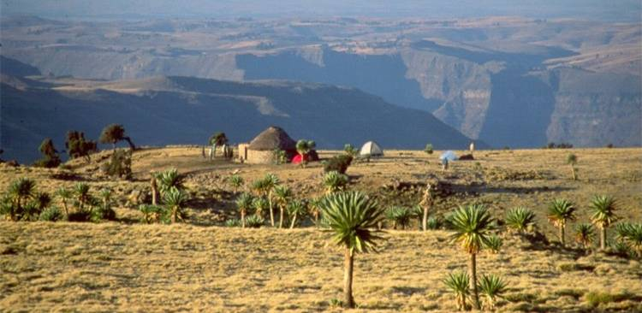
Ethiopia
Difficult Environment:
Deep Canyons → Isolated Villages
Crops Depend on Erratic Rainfall
Prolonged Drought → Famine

Slide 23
Genocide
How did governments cause/impact the Genocides?
How did the colonial practice of putting 2+ ethnic groups in 1 country cause the Genocides?

Slide 24
Comparison
Hutus
Tutsis
Majority of population
Mostly grew crops
Belgians classified them as “Broad Nose”
Minority of population
Mostly herded animals
Belgians classified them as “Long Nose”

Slide 25
What Led to the Genocide in Rwanda?
1. Tutsis were the “upper class” when Belgium ruled Rwanda. They also were seen as the upper class before the Belgians got there.
2. In the 1959, Hutus led a resistance group. They killed 20,000 Tutsis and Rwanda was independent by 1961.
the Hutus led Rwanda for the next 30 years. The Tutsis weren’t allowed to rule. The Tutsis formed their own resistance group (“Rwandan Patriotic Front”)
4. On April 6, 1994,the airplane carrying Rwandan President Habyarimana and the Hutu president of Burundi was shot down as it prepared to land in Kigali. Both presidents died when the plane crashed.
5. The Hutus blamed the Tutsis. The Tutsis blamed some Hutu extremists. So both ethnic groups started to kill each other.

Slide 26
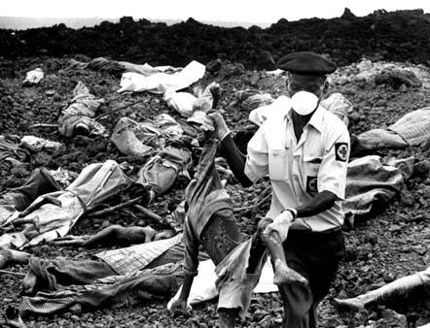
How did the killings happen?
Killed in their villages or in towns, often by their neighbors and fellow villagers
Militia members typically murdered their victims by hacking them with machetes, although some army units used rifles
The victims were often hiding in churches and school buildings, where Hutu gangs massacred them
Ordinary citizens were called on by local officials and government-sponsored radio to kill their neighbors and those who refused to kill were often killed themselves
Everyone killed so they weren’t killed themselves:

Slide 27
How many people were killed?
The RPF government has stated that 1,071,000 were killed, 10% of which were Hutu (determined in February 2008)
United Nations lists the toll as 800,000
African Rights estimates the number as "around 750,000,"
Human Rights Watch states that it was "at least 500,000”
*2,000,000 Hutu refugees fled to Burundi, Democratic Republic of Congo, Tanzania, and Uganda. This led to thousands of deaths from diseases in camps, and wars in those 4 countries.

Slide 28
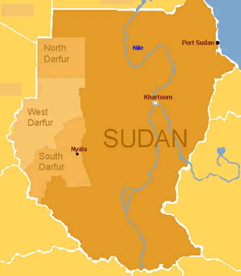
Darfur Facts
6,000,000 people live there
100 different ethnic groups
Some are nomads
Some are farmers
All are Muslim.

Slide 29
How did the attacks happen?
Attacks on Darfuri villages commonly begin with Sudanese Air Force bombings. Air campaigns are often followed by Janjaweed militia raids. All remaining village men, women, and children are either murdered or forced to flee. Looting, burning food stocks, enslaving and raping women and children, and stealing livestock are common. Dead bodies are tossed in wells to contaminate water supplies and entire villages are burned to the ground.

Slide 30
Why did the Genocide happen?
The “Darfur Genocide” refers to the current mass slaughter and rape of Darfuri men, women and children in Western Sudan. The killings began in 2003 and continue still today.
The genocide is being carried out by a group of government-armed and funded Arab militias known as the Janjaweed (which loosely translates to ‘devils on horseback’). The Arabs are mostly nomadic. These militias are historic rivals of the main rebel groups, the Sudanese Liberation Movement (SLM), and the Justice and Equality Movement (JEM) (non-Arab, not-nomadic groups). As of today, over 480,000 people have been killed, and over 2.8 million people are displaced.

