Slide 1
Opener: 3/9 - #7
COPY and analyze ONE of the quotes below in 3 complete sentences:
“Live as if you were to die tomorrow. Learn as if you were to live forever.” -Mohandas Gandhi
“An eye for an eye only ends up making the whole world blind.”
-Mohandas Gandhi

Slide 2
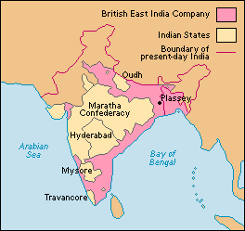
Europeans Arrive
In 1500s, French, Dutch and Portuguese build cloth and spice trades
British East India Company controls Indian trade by the early 1600s
Establish direct rule in 1857
“The sun never sets on the British Empire.”

Slide 3
Independence
Many people of South Asia wanted freedom from Great Britain
Mohandas Gandhi believed that Indians should rely on nonviolent methods to persuade the British to leave India.

Slide 4
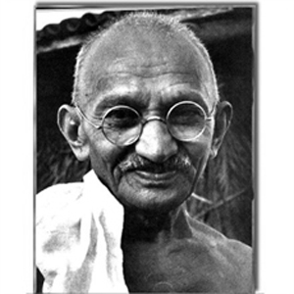
Mohandas “Mahatma” Gandhi
1888, studied law in London and got a job in South Africa
While in South Africa Gandhi witnessed and experienced a lot of Indian prejudice.
Gandhi first began using “non violent” protests against the South African government.

Slide 5
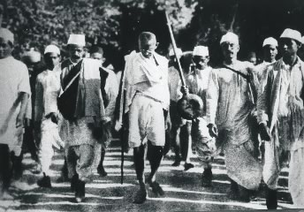
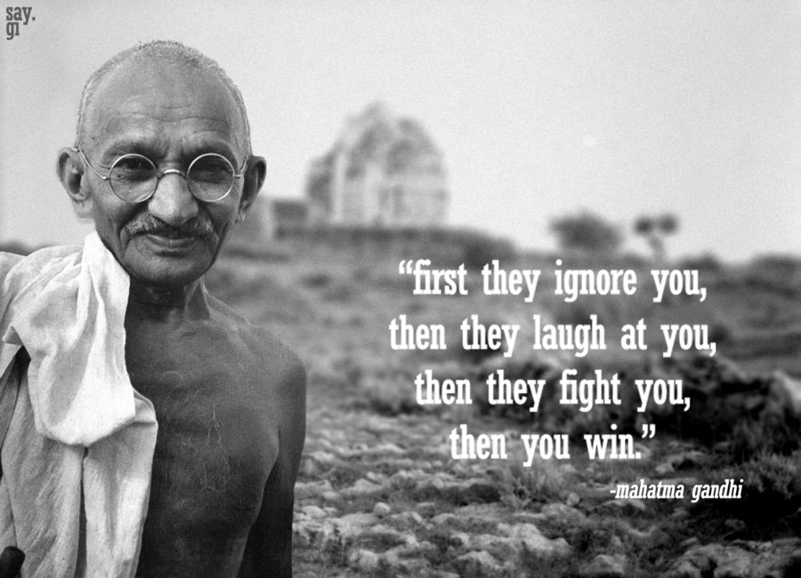
Independence Movement
1915 - Gandhi moved back to India where many Indians had turned against British rule.
Gandhi employed non-cooperation, non-violence and peaceful resistance as his “weapons” in the struggle against the British
Began a boycott of British goods

Slide 6
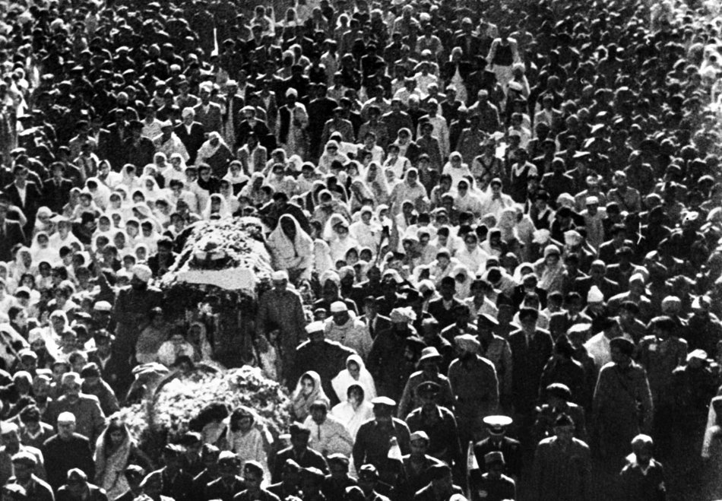
Independence
1947 – India wins independence
1948 – Gandhi is assassinated by a radical Muslim

Slide 7
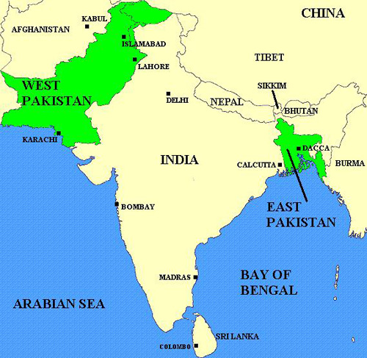
Partition & War
After independence two countries were created:
India was reserved for the Hindus
West & East Pakistan was reserved for the Muslims
Hindu-Muslim violence killed one million people
10 million crossed borders: Hindus to India, Muslims to Pakistan

Slide 8
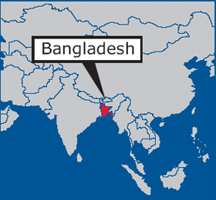
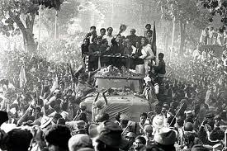
Struggles after Independence
Civil war between East & West Pakistan
Ethnically different and geographically far apart
In 1971, East Pakistan revolted and became the independent country of Bangladesh.

