Slide 1
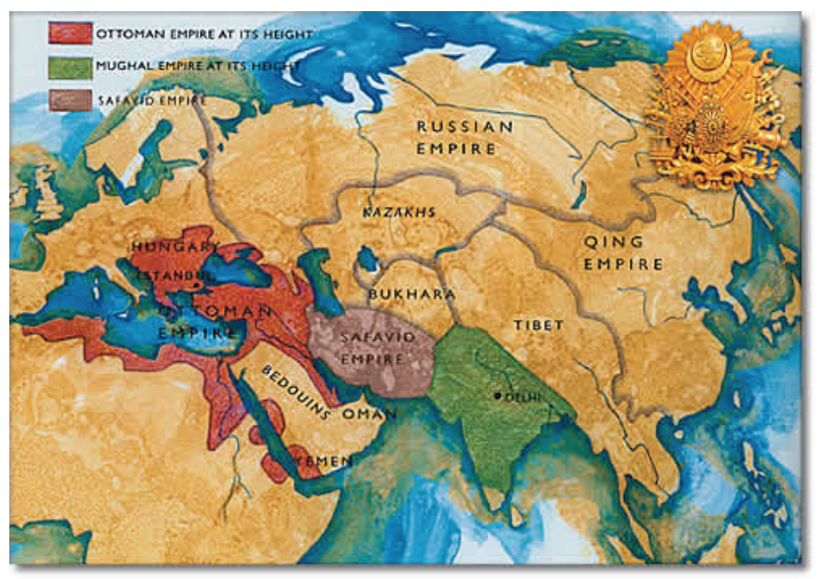
Muslim Empires in 1683 Ottoman, Safavid, & Mughal

Slide 2
Muslim Empires were characterized by…
New military technology
(gunpowder & cannons)
Strong armies
Cultural diffusion
Improvements to bureaucratic government

Slide 3
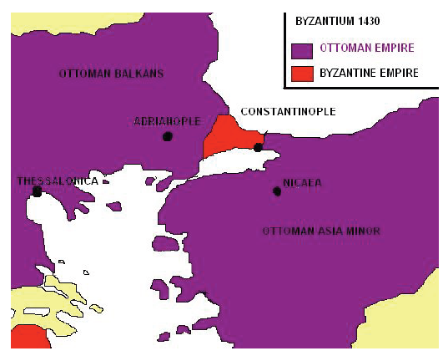
Mehmed the Conqueror Ottomans
1300 - Byzantine Empire in decline
Islamic warriors raided Byzantine Territory
Most famous – Othman; his followers known as Ottomans.
In 1453, Mehmed II (Mehmed the Conqueror) captured Constantinople after a seven-week long battle.

Slide 4
Ottoman Empire

Slide 5
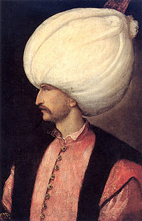
Ottoman Empire: Suleyman the Magnificent
Ruled for 46 years
Great military leader
Created new law code (known as “the Lawgiver”) & reduced taxes (improved citizens’ lives)
20,000 personal slaves staffed his bureaucracy
Religious freedom
Flourishing of art, literature, & architecture

Slide 6
Suleyman the Magnificent
Devshirme System (Army)
Male children of conquered Christian territories were educated, trained, & converted to Islam so they could later fight in Suleyman’s army
Great opportunity for many young boys
Many Christians bribed Muslim officials to accept their children into the Devshirme system

Slide 7
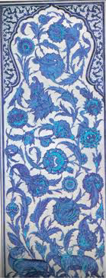
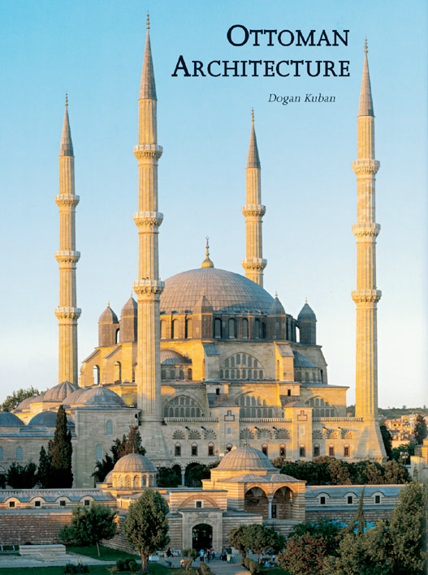
Mosque of Suleyman

Slide 8
Safavid Empire

Slide 9
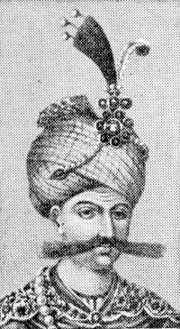
Safavid Empire: Abbas the Great
Also known as Shah Abbas (king)
Limited power of the military
Reformed government by punishing corruption & only promoting officials who were worthy
Expanded trade w/ Europe
Built capital city of Esfahan, considered to be one of the most beautiful
Expansion of art (sent artists to Europe to study under artist Raphael; carpet weaving became a national industry)

Slide 10
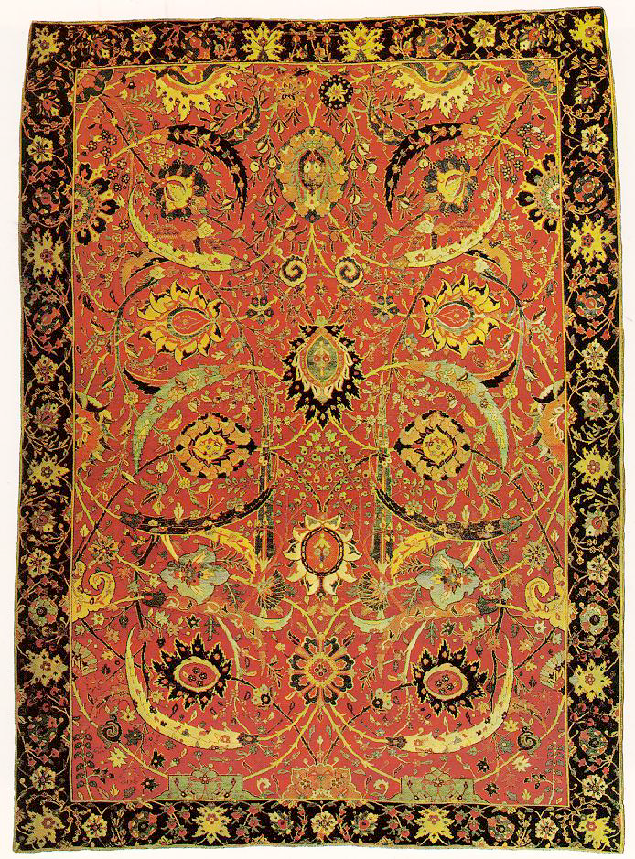
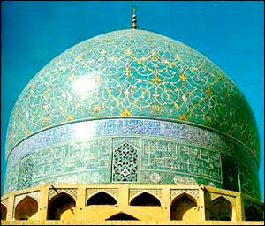
Safavid Art & Architecture

Slide 11
Mughal Empire

Slide 12
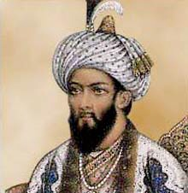
Mughal Empire: Babur
Inherited the kingdom at the age 11
It was taken away from him by his more powerful elders
He raised a powerful army & regained control of the Empire

Slide 13
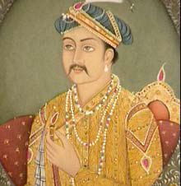
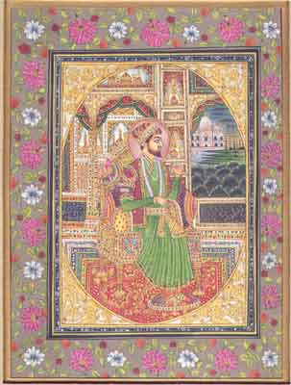
Mughal Empire: Akbar
Grandson of Babur
Akbar means “Great”
Took the throne at age 13
Supported aggressive military power
Flourishing of art, literature, & architecture
Supported cultural diffusion

Slide 14
Mughal Empire: Akbar
Cultural diffusion:
Islamic tradition of religious freedom
Married Hindu princesses & allowed them to practice Hindu rituals in his palace
Appointed a Christian monk to tutor his son
Foreigners could rise to a high office in gov’t
Soldiers of different languages developed a new language, Urdu, meaning “from the soldier camp”

Slide 15
Islamic Empires Decline
Incompetent leadership leads to the decline of both the Ottoman and Safavid Empires

