Slide 1
Openers 8/24-8/28

Slide 2
Opener 8/26 #5 in notebook
Read the following quotes with missing words. Write down the entire quote, and make a guess at what each of the missing words are.
“Several experts on the Middle East concur that the Middle East cannot be ______________.”--Recep Tayyip Erdogan
“Above all, it is not decency or goodness of gentleness that impresses the Middle East, but ________________.”--Meir Kahane
“In the Middle East, the conflict today is a matter of ______________ and not of _________________.” -- Shimon Peres
Once you learn the correct word -- Do you agree? Why or why not?

Slide 3
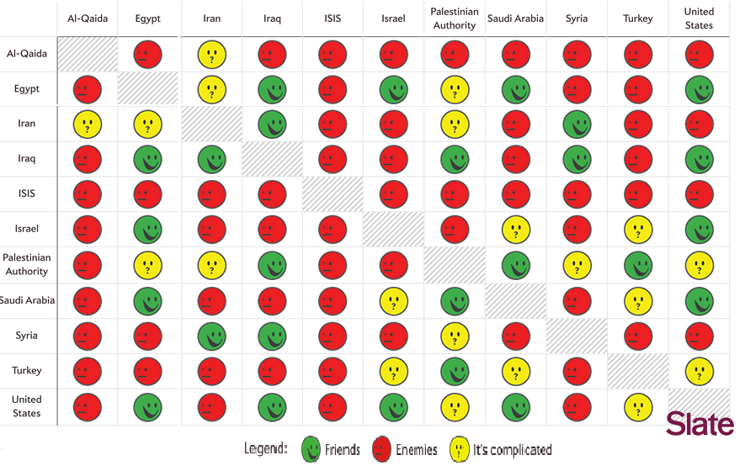
Opener 8/27 #6 in your Notebook
WRITE THIS DOWN: Imagine that countries are students in a classroom. Some get along, others are ready to fight. Your job is to create a seating chart that makes sure that no one is sitting next to someone they don’t like, or else they’ll fight!

Slide 4
Opener 8/28 #8 in your notebook
Answer the following in complete sentences (but you don’t have to write them):
Which words or phrases in the cartoon appear to be the most significant? Why do you think so?
Describe the action taking place in the cartoon.
Explain the message of the cartoon.
Do you agree with the cartoonist? Why or why not?

