Slide 1
Mali
By: Michael Kearse, Jayden DeVine , Dominic Rutigliano

Slide 2
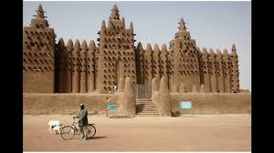
What is Mali empire
The Mali empire was one of the largest empires in West African History. It was founded in 1235 CE by the legendary king Sundiata.
The mali empire was the richest empire out of all the empires.
It compared to all of the other empires by the Mali was the the richest one we had had all the fancy equipments our empire was like a castle.
The Manding language were spoken in the empire.

Slide 3
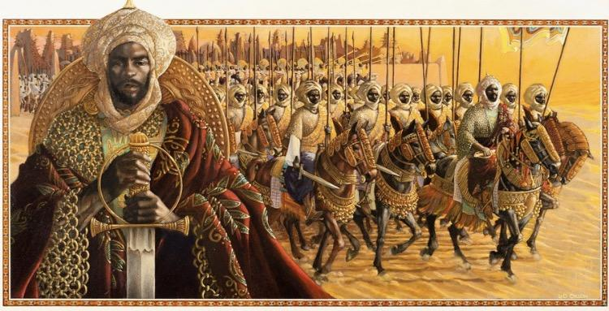
History Of The Mali Empire
The Mali Empire arose from several small Malinke Kingdom in Ghana.
The founder is named Sundiata Keita and became renowned for the wealth of its rulers. The Mali empire arose with the consolidation of several small Malinke kingdom in Ghana around the areas of the upper Nigeria river.

Slide 4
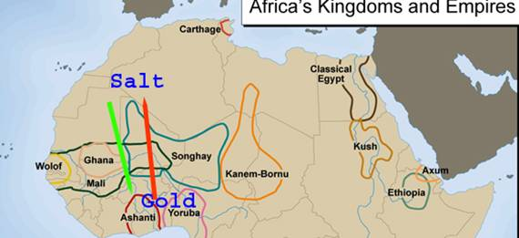
Economic of Mali empire
The Mali was the cradle of one of the greatest empires in precolonial Africa.
It was built on gold and flourished during the Middle Ages of Europe. The government ,l mansa had absolute power which was incontestable.
He ruled the empire with total authority, passed down by heredity. In fact, nearly every part of Mali society was based on ancestry. Mali economy had 500 slaves carrying staffs of gold, followed by 100 camels laden with over 30,000 pounds of gold and jewels.
Mansa Musa spread this wealth through Cairo as he passed across Egypt on his way to Mecca.

Slide 5
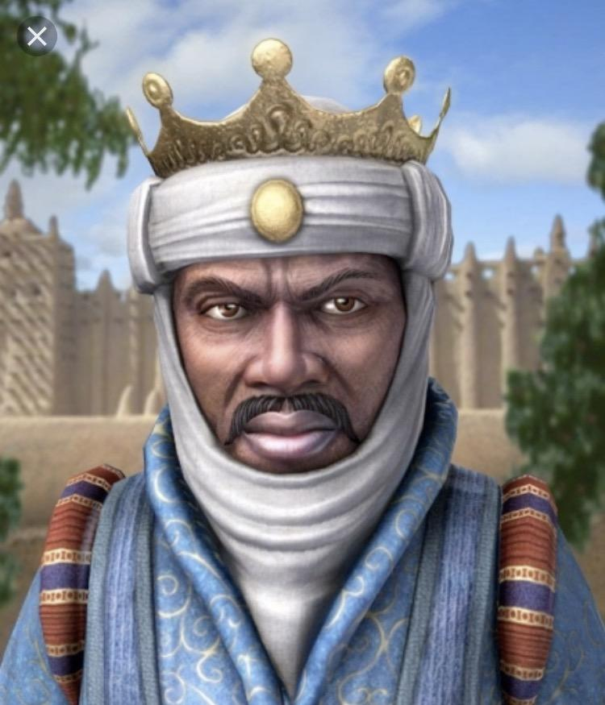
Leader: Mansa Musa
Mansa Musa was the world's richest man and was a leader of the Mali Empire. A big thing that Mansa di was a 4,000 mile expedition to Mecca.
He dressed thousands of servants dressed very wealthy. Mansa gave out so much gold he generated a brief decline in its value.

Slide 6
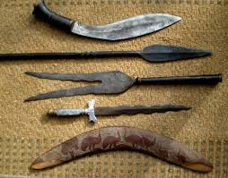
Mali empire Battles and weapons
The military history of the Mali Empire is that of the armed forces of the Mali Empire, which dominated Western Africa from the mid 13th to the late 15th century.
The military culture of the empire’s driving force, the Mandinka people, influenced many later states in West Africa including break-away powers such as the Songhay and Jolof empire.
They won most of the battles because they had a huge pact of army the weaponry was swords and other things . our war system was very strong, and powerful that not out other empires and battles.

Slide 7
Our Quick Goanimate video on Mansa Musa

Slide 8
Closing
By: Michael Kearse, Dominic, Jayden

