Slide 1
The Muslims
Aaron Roberts, Jasmine Guillen, Michelle De Los Santos, Yesika Arias

Slide 2
Origins of Islam
Islam first came about in Mecca when Muhammad, a prophet, heard a voice at around age 40. The voice he heard was believed to be Gabriel, a messenger for Allah.
After gathering a following, Muhammed and other believers of Islam were attacked by the people of Mecca. They thought that Muhammad and his ideas would corrupt the city.
As a result of this violent development, Muhammad and his group of followers fled Mecca in 622 and arrived in Yathrib
Muhammad eventually returned in 630, along with 10,000 followers who became believers after he became known as a leader and made deals with the Jews and the Arabs

Slide 3
Origins of Islam (Continued)
After Muhammed returned the leaders fled Mecca out of fear of defeat
Most people of Mecca accepted the Islam belief and many converted
Muhammad died two years after his return

Slide 4
Spread of Islam
After the death of Muhammad the community chose Abu-Bakr (a close freind to Muhammad) as the leader
Jihad, the struggle against nonbelievers, was used as encouragement and justification for the spread of Islam after some people stopped beleiving in Islam
The Muslims controlled Arabia, Syria, and lower Egypt under Umar (Syria and lower Egypt were parts of the Byzantine Empire at the time)
The conquering was largely made possible because the Byzantines and Sassanids had already fought each other to the point of exhausting their military and resources
Eventually (that is, around 750) the empire grew across Asia, Africa, and even Europe

Slide 5
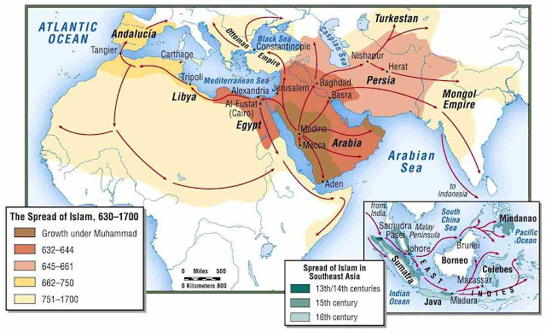

Slide 6
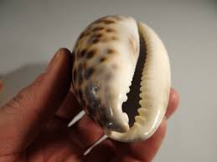
Trade Routes
Goods are traded such as Luxury Silks, Spices
The Cowrie Shell became the first currency (they did not want paper or coin currency)
They called their currency ‘Universal Currency’
Many slaves were sold by the muslims
Metal Goods & Textiles were the most valuable objects they traded
There was an Abundance of artistic and religious trade which caused New forms of Agriculture & Art

Slide 7
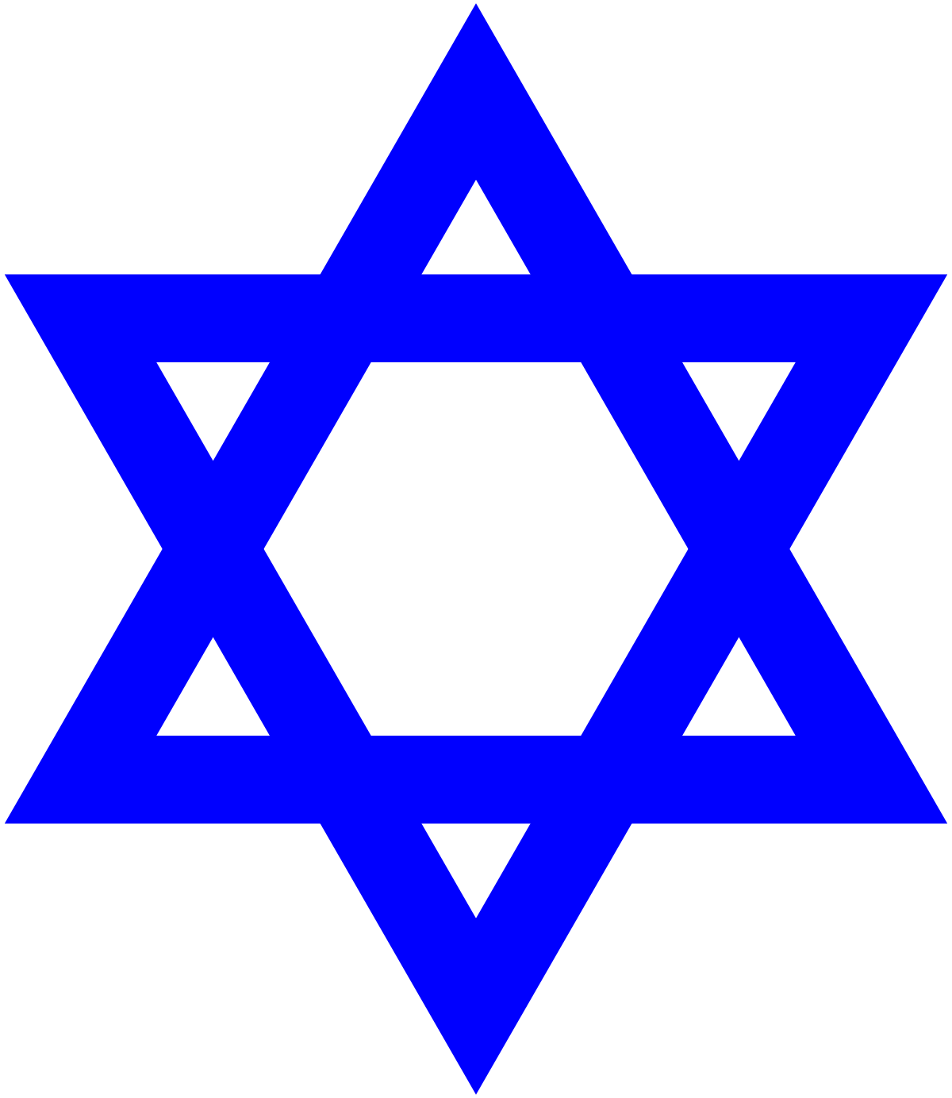
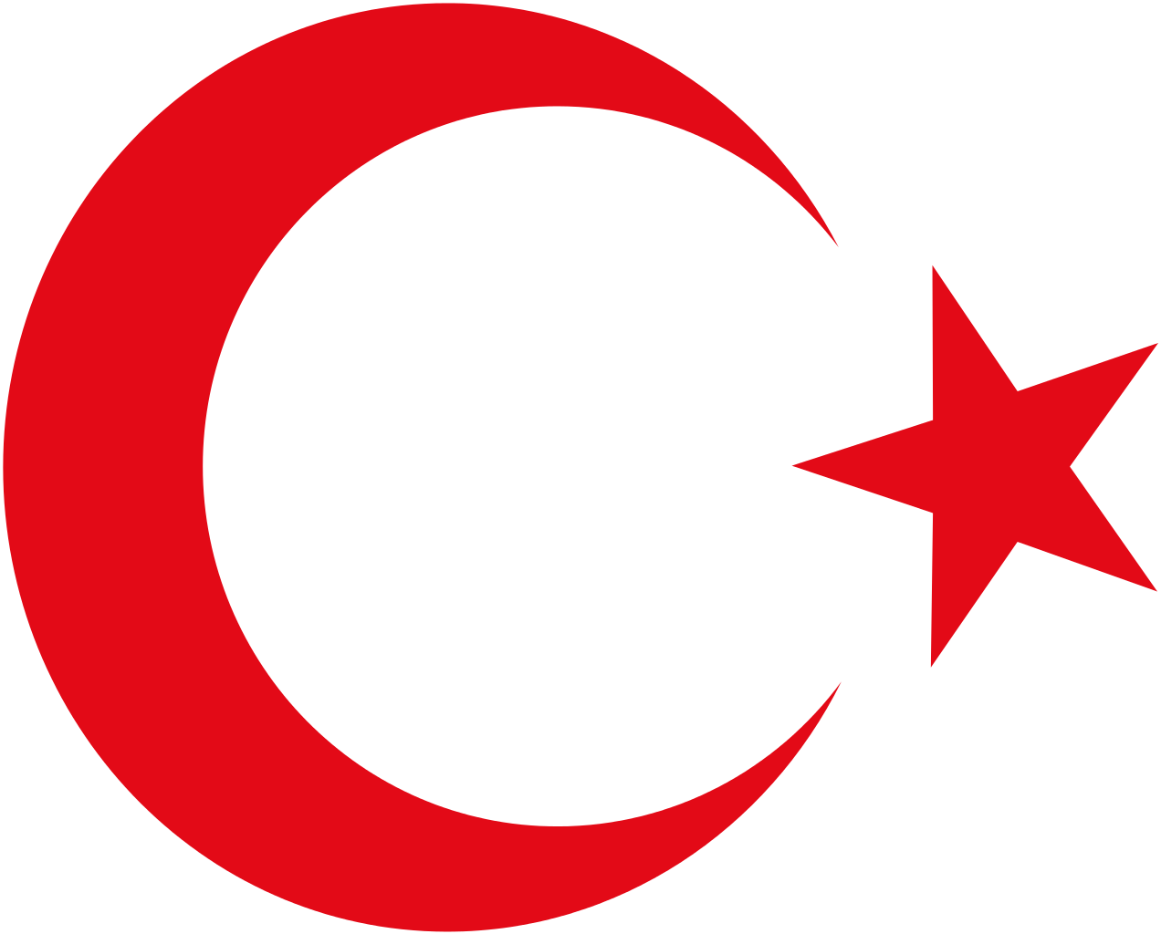
Judaism,Christianity,and the Islam
To the muslims Allah is the same god that Christians and Jews worship
All three believe that there is heaven,hell,and a day of judgement
They all trace their ancestry to Abraham just as the Jews and Christians
They all have a Holy book

Slide 8
Sunni vs Shia muslims
Sunni
They believed that Muslim leaders should be elected
Shia
They believed Muslim rulers should be descendants of Muhammad
They both claim that they both have assorted the meaning of various passages in the Quran
To muslims, Allah is the same god that is worshipped in Christianity and Judaism

Slide 9
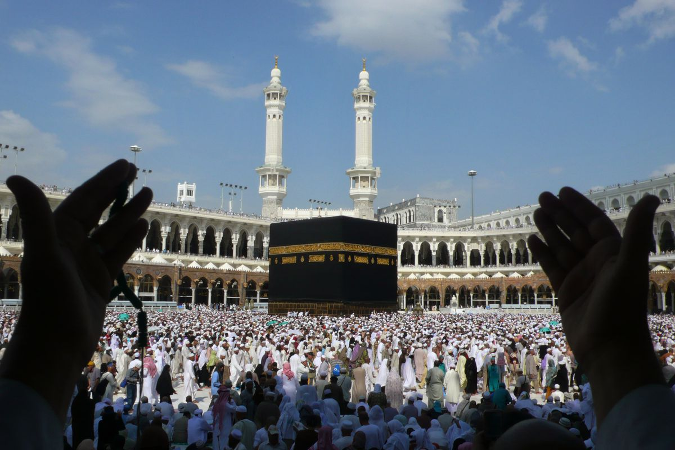
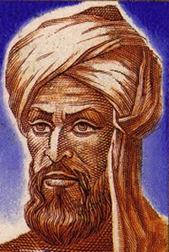
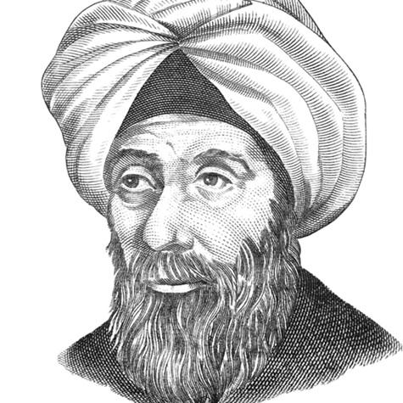
Science, math and geography
Muslims studied skies to help fix location of cities so that when the worshippers prayed they could be facing Mecca correctly
The study of stars(astronomy) helped guide muslim traders go to where they needed to go.
Mathematicians and scientist relied heavily on scientific observation and experimentation
A mathematician named Al-Khwarizmi created a technique which was bringing unknowns to match a known quantity. He called this technique al-jabr which we know today as algebra
Muslim scholar Ibn al-Haytham formulated the scientific method and has been referred to as “the world’s first true scientist.”

Slide 10
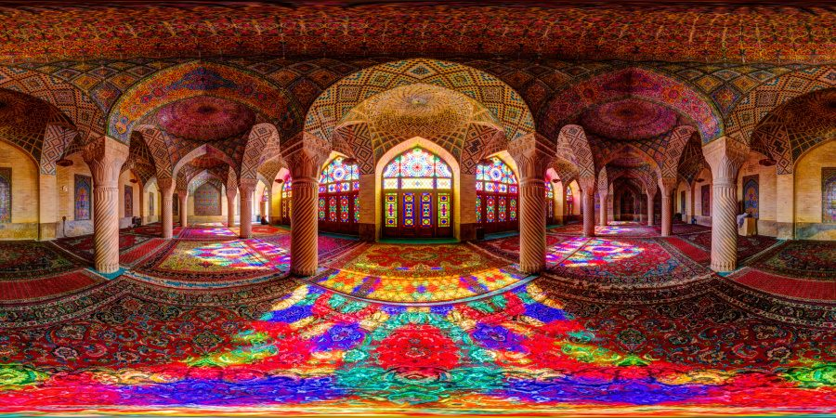
Math in the
Mosque
The Nasir al-Mulk also know as the
rainbow mosque is
nne of greatest mosque standing
today. The Muslims who built this must
have had excellent mathematical skills
to be able to precisely place each shape where they did and create these geometrical patterns as you can see in the picture.
As you can see there's no sight of Allah or any religious figures in the Mosque like how churches are and that's because Muslim leaders feared that people would worship the imagine rather than Allah

Slide 11
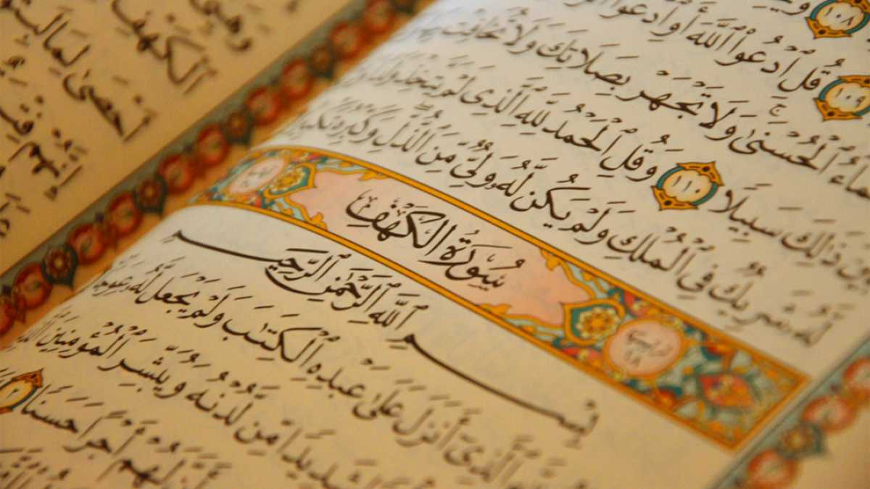
Fun Facts !
The Quran is the most memorized book in the world
Every Muslim tries to visit Mecca at least once in his or her lifetime. This special visit is called a hajj.
Muslim scholars Ibn Rushd and Ibn Sina were primarily responsible for saving the works of Aristotle, whose ideas would later dominate both the Christian and Muslim worlds.

Slide 12
Question time !
1.Which Islamic mathematician is known for founding Algebra ?
A. Isaac newton
B. al-Khwarizmi
C. Muhammed
D. Euclid

Slide 13
2.What do all Jews Christians and muslims have in common?
A.they all believe in Jesus
B.they all are polytheistic
C.all of their original language is hebrew
D.they all have a holy book

Slide 14
3. After the death of Muhammed, who was put into power?
Umar
Abu-Bakr
Ali
Utman

