Slide 1
Exploration & Discovery

Slide 2
By 1500…
 | North America | Europe
Population | 10-15 million | 70 million
Life Expectancy | 50 years | 70 years
Infant Mortality Rate | 50-60% by 5 | 30-50% by 5
Health Problems | Arthritis, Anemia, Blood Poisoning, Dysentery, Hepatitis, Herpes, Rabies, Strep | Chicken Pox, Leprosy, Malaria, Measles, Plagues, Small Pox, Syphilis, Yellow Fever
Religion | Many, varying gods | 1 Christian God
Ownership | Tribal Uses | Individual Ownership

Slide 3
Historical “Truths”
People need water to live ⇒ Civilizations start near water.
(A) Internal Problems + (B) Outside Invaders = Fall of an Empire
Unemployed soldiers will turn on the king & queen.
Trade makes you richer & stronger in the long run. It will kill you in the short run.
KNOWLEDGE + MONEY + BOATS + NATIONAL UNITY = EXPLORATION

Slide 4
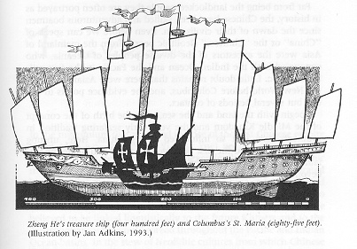
Why Europe?
Ottoman Empire = money, trade, technology, unity. What are they missing?
China: Zheng He explored, they had $$$, they had technology, they are united.
Europe
Renaissance
Faster ships, more accurate maps, printing press
Counter Reformation

Slide 5
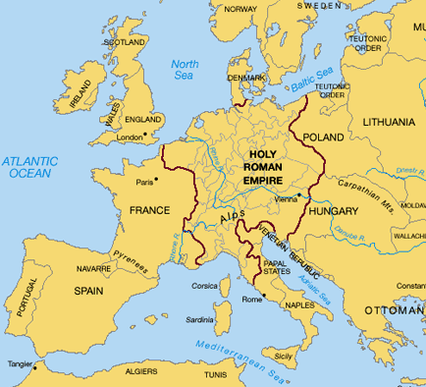
How we think Of Europe

Slide 6
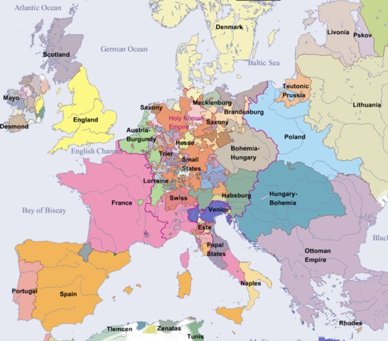
How Europeans Thought of Europe

Slide 7
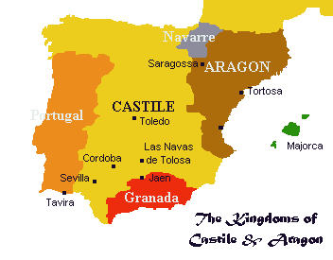
Spain
1492
Moors & Jews kicked out
Ferdinand & Isabella unify Spain
Lots of unemployed soldier
North America
South America found Inca & Maya Gold
De Leon & De Soto never come back
Columbian Exchange
Encomienda: Seasoning Process → Indians Work

Slide 8
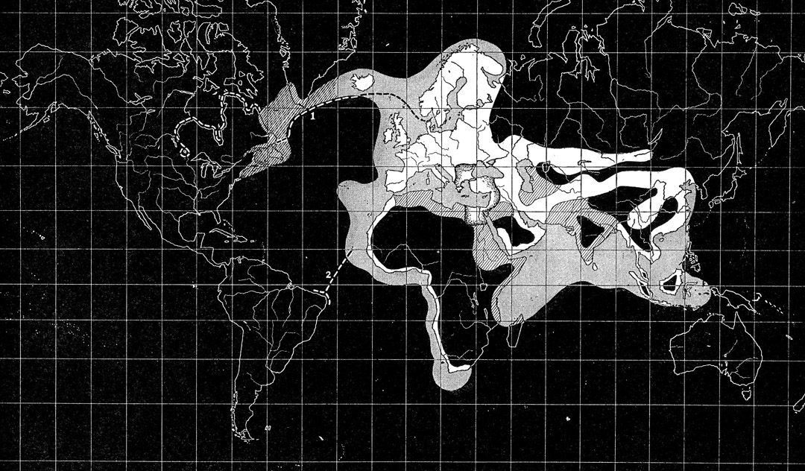
Exploration 1492

Slide 9
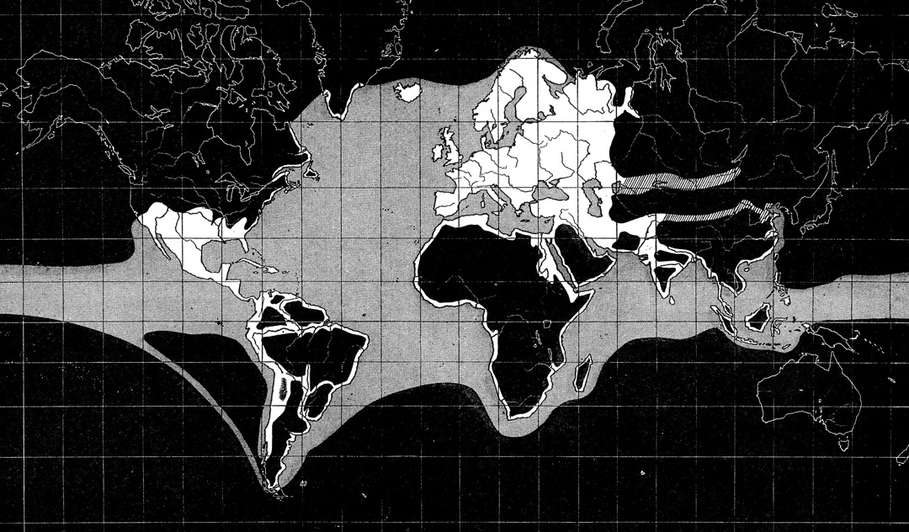
Exploration 1550

Slide 10
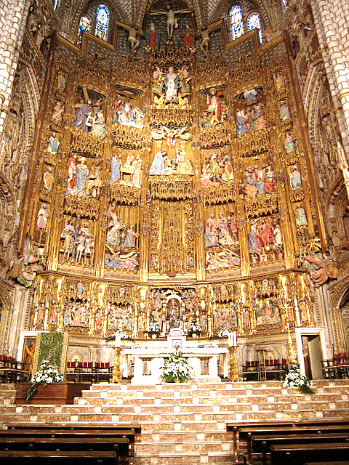
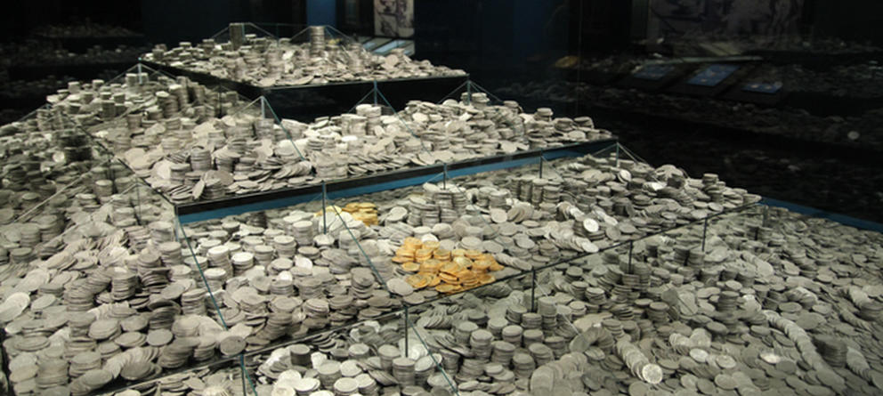

Slide 11
Origins of European Slavery
1492 & 1512: Pope confirms that Amerindians are human
Where did they come from?
They have souls
Sclavus = Latin for “Slavic person”
1200s – 1400s: Italian merchants sell Slavs around the Mediterranean
Slavery becomes color-specific
Color Symbolism
“White Man’s Burden”
Curse of Ham

Slide 12
Curse of Ham
The sons of Noah who came out of the ark were Shem, Ham and Japheth. (Ham was the father of Canaan.) These were the three sons of Noah, and from them came the people who were scattered over the whole earth. Noah, a man of the soil, proceeded to plant a vineyard. When he drank some of its wine, he became drunk and lay uncovered inside his tent. Ham, the father of Canaan, saw his father naked and told his two brothers outside. But Shem and Japheth took a garment and laid it across their shoulders; then they walked in backward and covered their father’s naked body. Their faces were turned the other way so that they would not see their father naked.
When Noah awoke from his wine and found out what his youngest son had done to him, he said,
“Cursed be Canaan! The lowest of slaves will he be to his brothers.”
Genesis 9:18-27 NIV

Slide 13
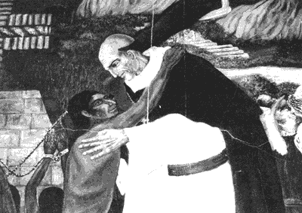
Spanish Slavery
1516-1518: Bartolomé de Las Casas
Empathy
Indians are humans and shouldn’t be treated poorly
Pragmatic:
Africans stronger than Indians
Africans have large-scale agriculture & familiarity with tools

Slide 14
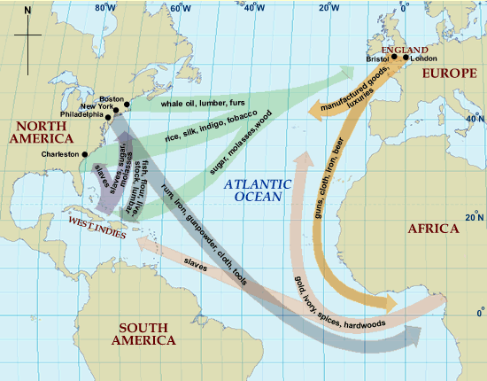
The “Triangular” Trade

Slide 15
Effects of Slave Trade
1441 – 1888: 20 – 50 Million Africans will be exported as slaves; 50% won’t make it to the coast; 30% die in the middle passage
West Africa
Fewer Countries
Changed trade
Some very rich West Africans
Hurt local economies
Broke up family units (encouraged polygamy)
European Strife
Portuguese → Netherlands→ British → Independent traders

Slide 16
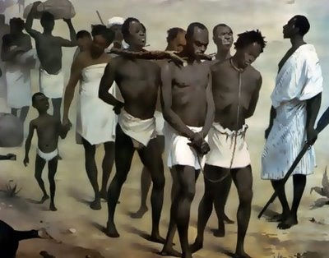
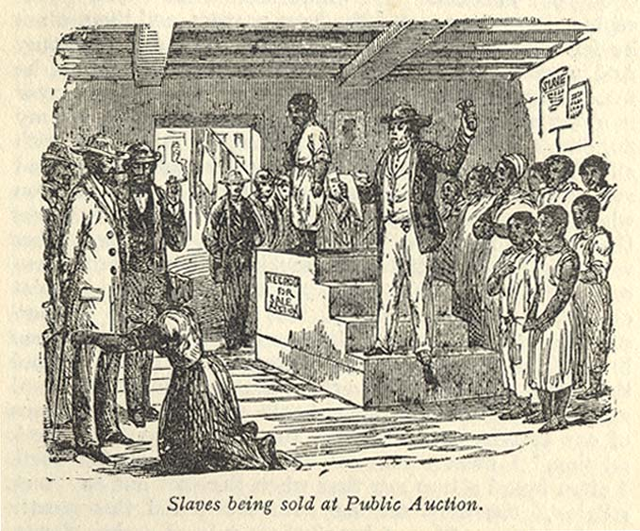
Personal Effects of the Slave Trade
4 ways someone became a slave
War, Kidnapping, Debt, Private Sale
If he/she make it to the coast…
Put in a castle, separated
“Makeup process”
To the doctor
Once on a ship…
Men in the hold
Women near the crew’s quarters
Children unbound
Once docked…
The Scramble
The Light of the Candle

Slide 17
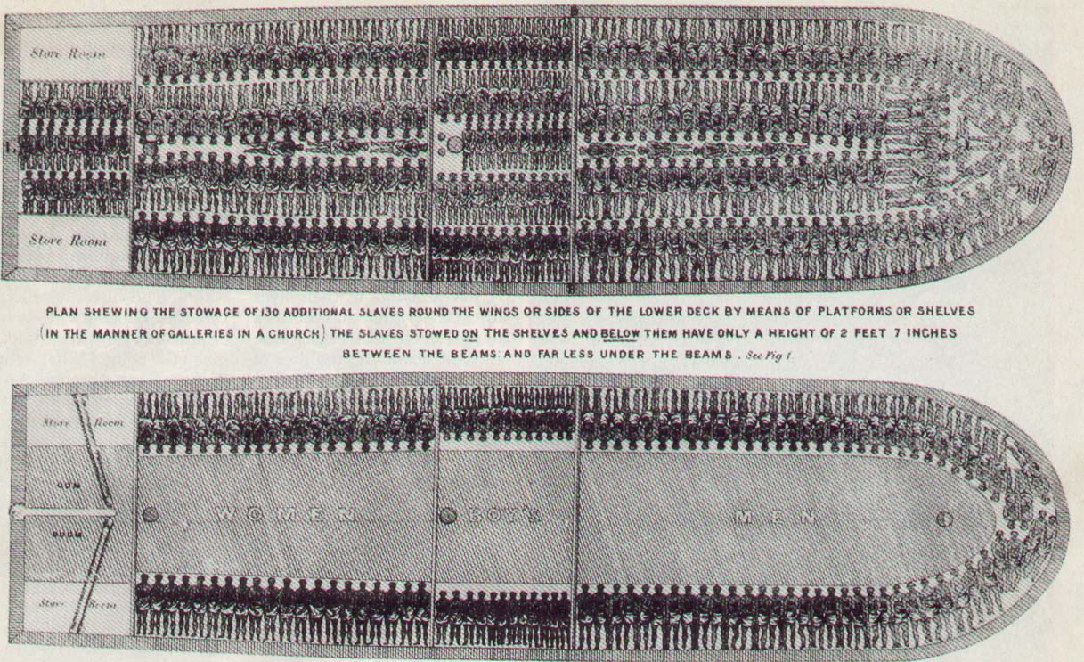
Middle Passage

