Slide 1
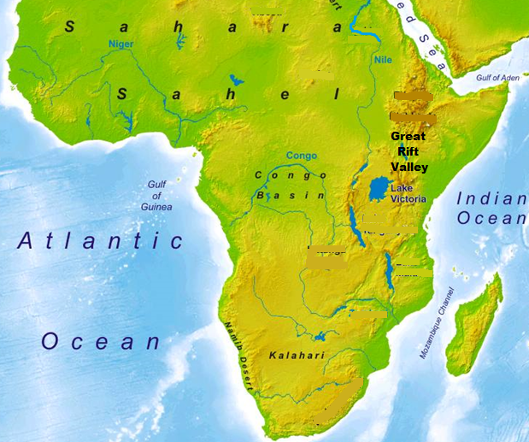
Africa’s Strengths & Weaknesses Map Notes
Physical Features:
Sahara Desert
Sahel
Niger River
Nile River
Great Rift Valley
Lake Victoria
Congo River
Congo Basin
Kalahari Desert
Namib Desert

Slide 2
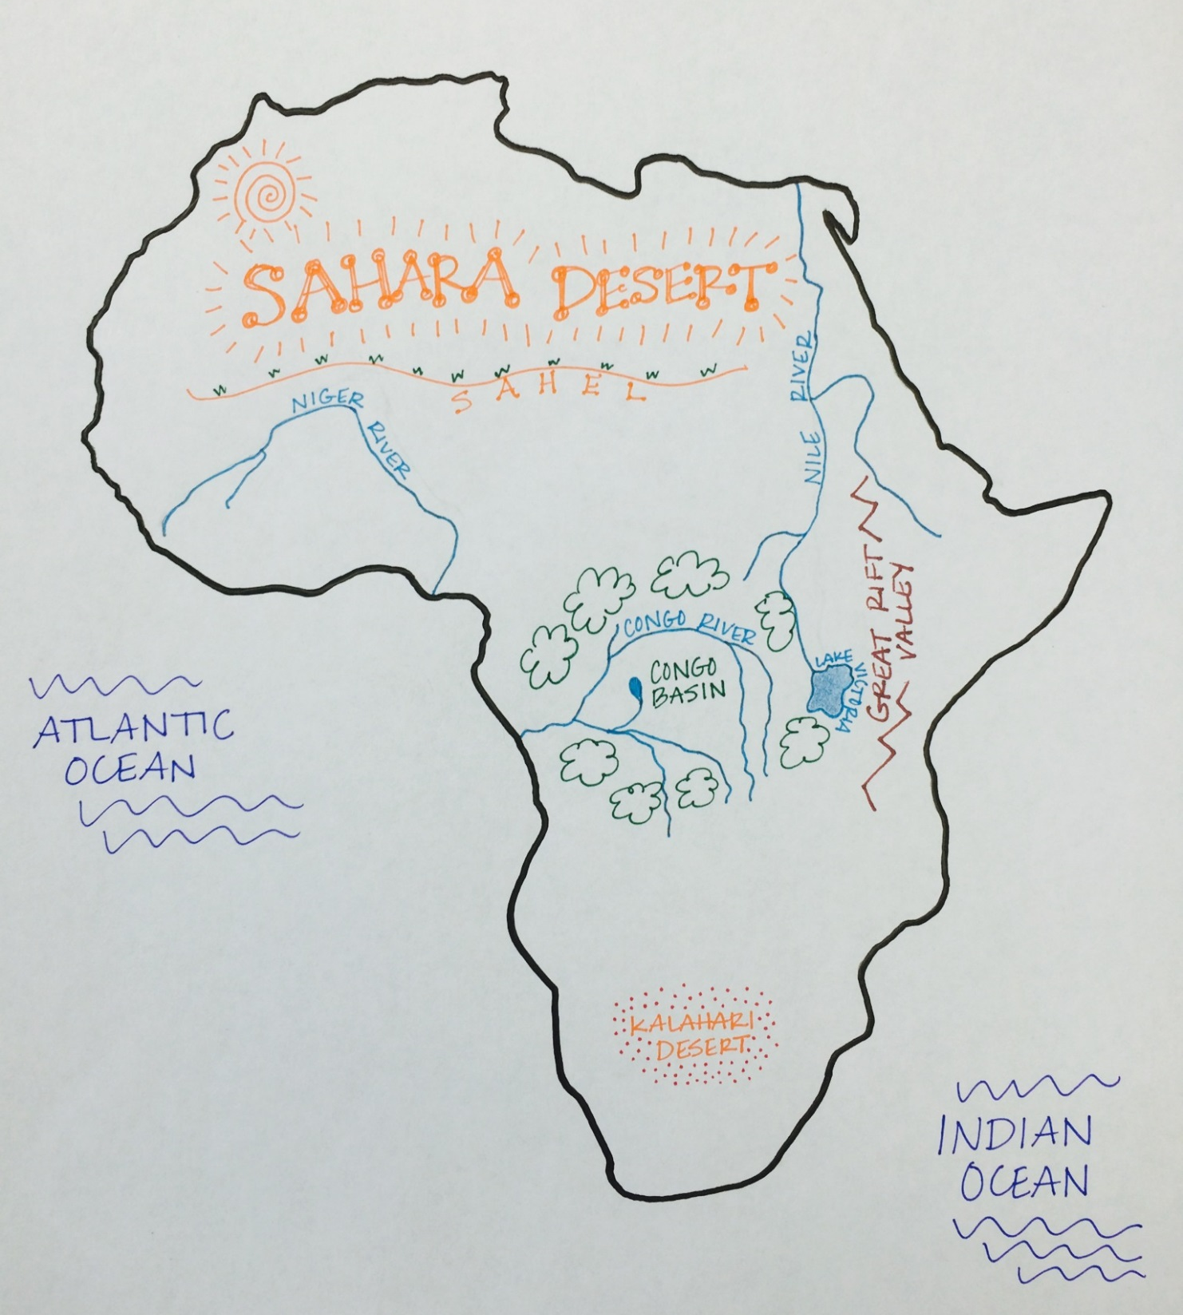

Slide 3
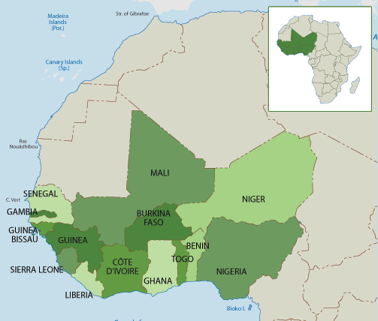
Western Africa
Strengths
Niger River
Resources
Gold
Diamonds
Lumber
Oil
Cocoa Beans
Weaknesses
Slave Trade
Ebola
Liberia & Nigeria

Slide 4
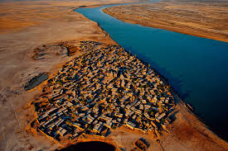
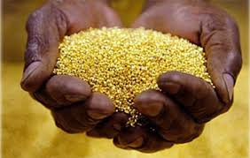
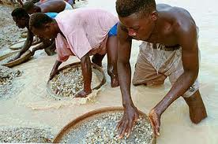
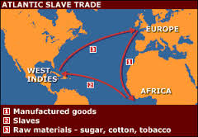
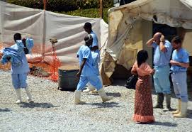
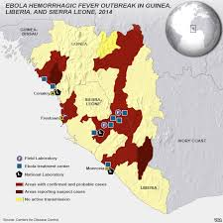
Western Africa

Slide 5
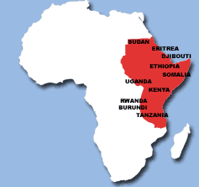
Eastern Africa
Strengths
Nile River
Great Rift Valley
Lake Victoria
Farming
Coffee
Tea
Sugar
Weaknesses
Famine
Genocide
Sudan & Rwanda

Slide 6
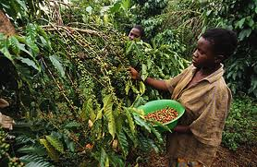
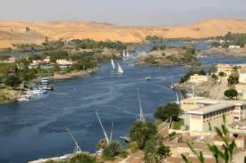
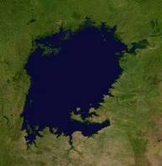
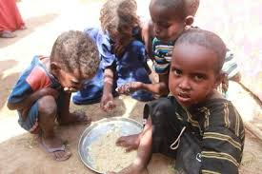
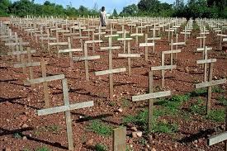
Eastern Africa

Slide 7
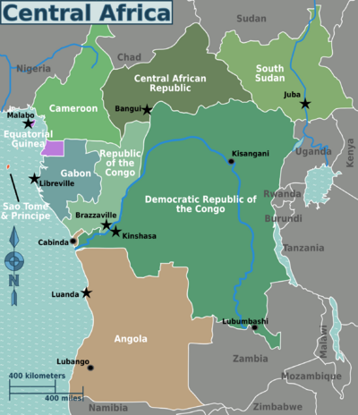
Central Africa
Strengths
Congo River Basin
Resources:
Oil (Angola)
Gold
Copper
Diamonds
Weaknesses
Malaria
HIV/AIDS

Slide 8
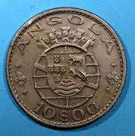
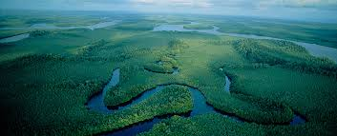
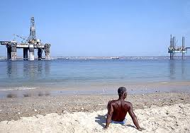
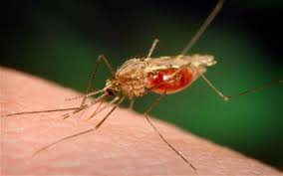
Central Africa

Slide 9
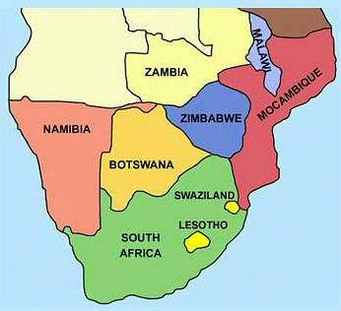
Southern Africa
Weaknesses
Kalahari & Namib Desert
Apartheid
HIV/AIDS
Strengths
Resources
Gold
Diamonds
Modernized Cities
Johannesburg, South Africa

Slide 10
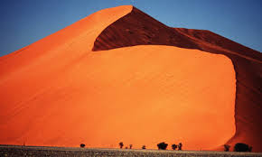
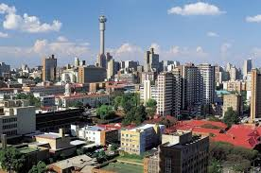
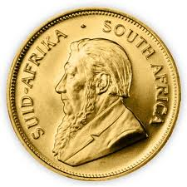
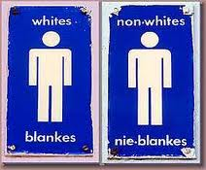
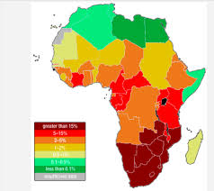
Southern Africa

Slide 11
