Slide 1
Africa Openers
9/4-9/18

Slide 2
Friday, 9/4
The name of this unit is “SUB-SAHARAN AFRICA”. Give me 5 words that you know that have “sub” in them.
What does the prefix SUB mean?
(video) https://www.youtube.com/watch?v=vVX-PrBRtTY
Reflection: What could be a negative connotation about calling this unit SUB-Saharan Africa? How does this clip change the way you think about the world?

Slide 3
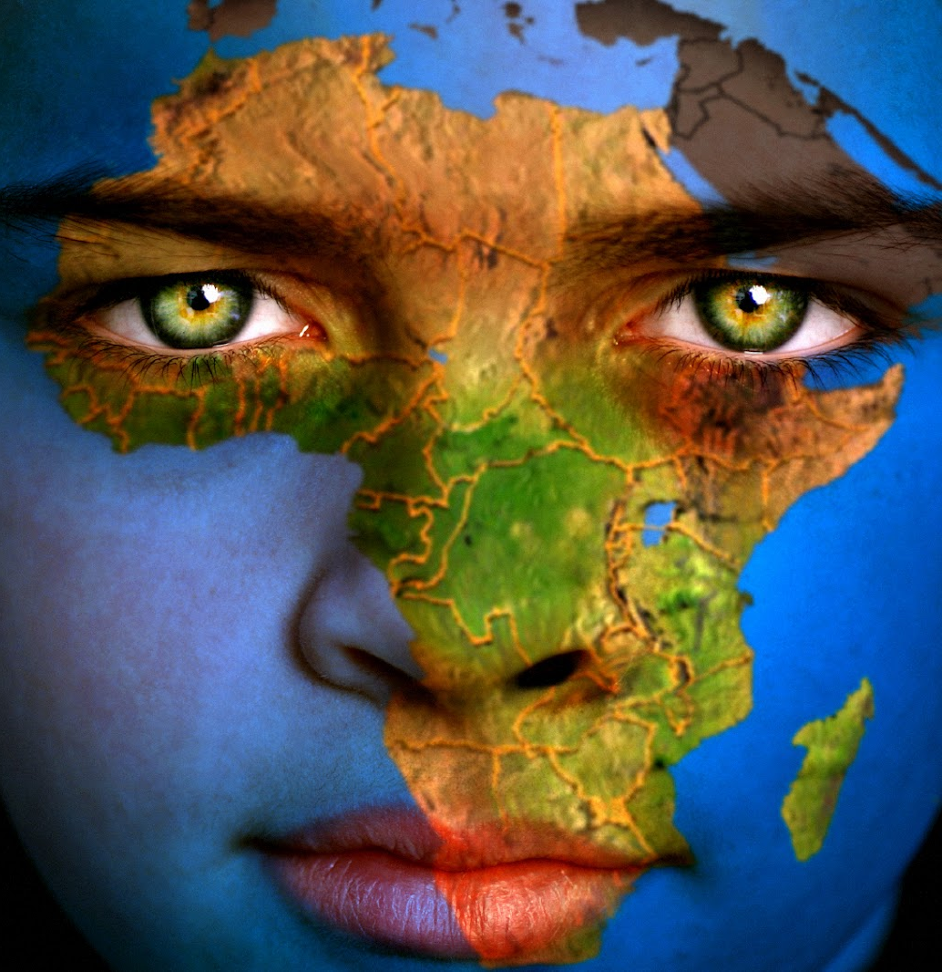
Tuesday, 9/8
How big is Africa? Get the 2 sheets on the table. Cut out some countries or continents you’ve heard of & glue them inside of the outline map of Africa. Then list the countries below your outline map.
Do you know how many countries are in Africa? Take a guess.

Slide 4
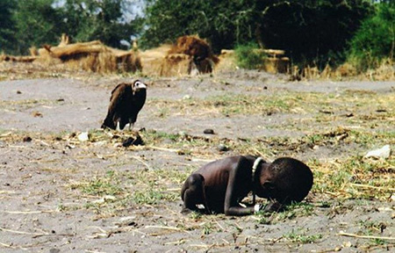
Wednesday, 9/9
Based on what you have observed above, list 3 things you might infer from this photograph.
What questions does this photograph raise in your mind?

Slide 5
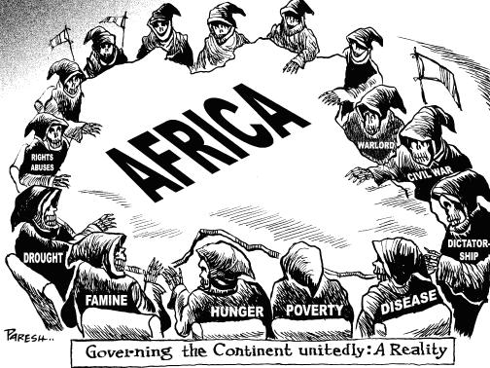
Thursday, 9/10
Answer the following in complete sentences (but you don’t have to write the questions):
Which words or phrases in the cartoon appear to be the most significant? Why do you think so?
Describe the action taking place in the cartoon.
Explain the message of the cartoon.
What do you think can be done to help the USA?

Slide 6
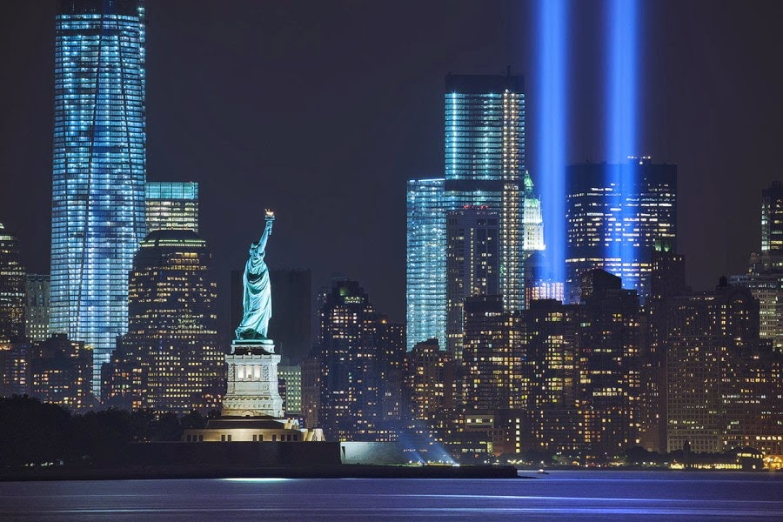
Friday, 9/11
In 2002, Members of the Masai tribe in Kenya helped the United States in the best way they could. Read about their story. You don’t have to write the questions.
What did you learn about the Masai tribe by reading the story? (at least 5 facts)
How is their understanding of what happened on 9/11/01 the same or different than what you know?

Slide 7
Monday, 9/14
Make a T chart with good things and bad things about foreign aid to Africa. How could it help? How could it hurt?
Watch this video: https://www.youtube.com/watch?v=aNqfFafXGLA
…Do you think he’s got a point?

Slide 8
Tuesday, 9/15
On April 27, 1994, a long line of people wait outside in Soweto, in the southwest suburbs of Johannesburg, South Africa.
What in YOUR life is so important that you would wait in a line this long, or longer, to have? Is there more than 1 thing? What makes it so important?

